Slide 1
The Joint Effort for Data assimilation Integration (JEDI)
System Configuration
Joint Center for Satellite Data Assimilation (JCSDA)
JEDI Academy – 16-20 November 2020

Slide 2
Overview
The JEDI system is controlled by an extensive and flexible configuration system
YAML based
Human friendly data serialization
Key-value pair specification
Nested sections
yaml.org
Goal is to reduce the need for writing custom code when setting up and running JEDI in an operational mode

Slide 3
YAML Basics
Friendly text format
Simple
Portable
Allows for comments
Indentation defines nested sections
Data types: integer, float, string, boolean, date
Tabs are forbidden
Common source of errors
Reference
http://yaml.org/spec/1.2/spec.html

Slide 4
YAML Examples
← List
← Series of key-value pairs
← Key-value pairs, where the values are lists
← List, where elements are a set of key-value pairs
‘-’ element within a list
‘:’ separates key and value
‘#’ comment

Slide 5
3DEnVar Example
Step 1: Run BUMP to generate B-Matrix
Correlation (static B)
Localization (ensemble B)
Step 2: Run 3DVar
Cost Function
Step 3: Run increment
Diagnostics
$${B= B}^{Static}+B^{Ensemble}$$
$$J\left(∆x\right)=\frac{1}{2}{∆x}^{T}B^{−1}∆x+ \frac{1}{2}{\left(y_{o}−H\left(x_{b}+∆x\right)\right)}^{T}R^{−1}\left(y_{o}−H(x_{b}+∆x) \right)$$
J_{b}
J_{o}

Slide 6
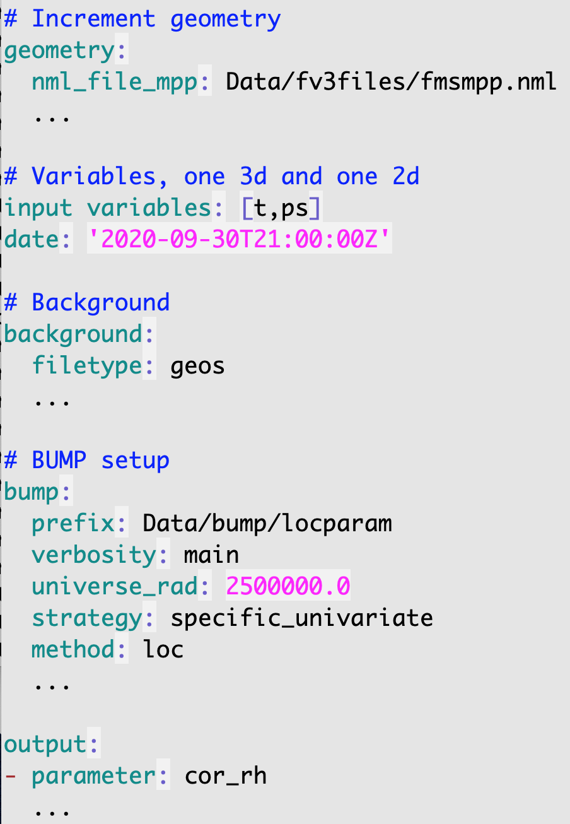
BUMP Configuration: Localization
App: fv3jedi_parameters.x localization_parameters_fixed.yaml logfile
Specify resolution
Increment variables
Perform localization function

Slide 7
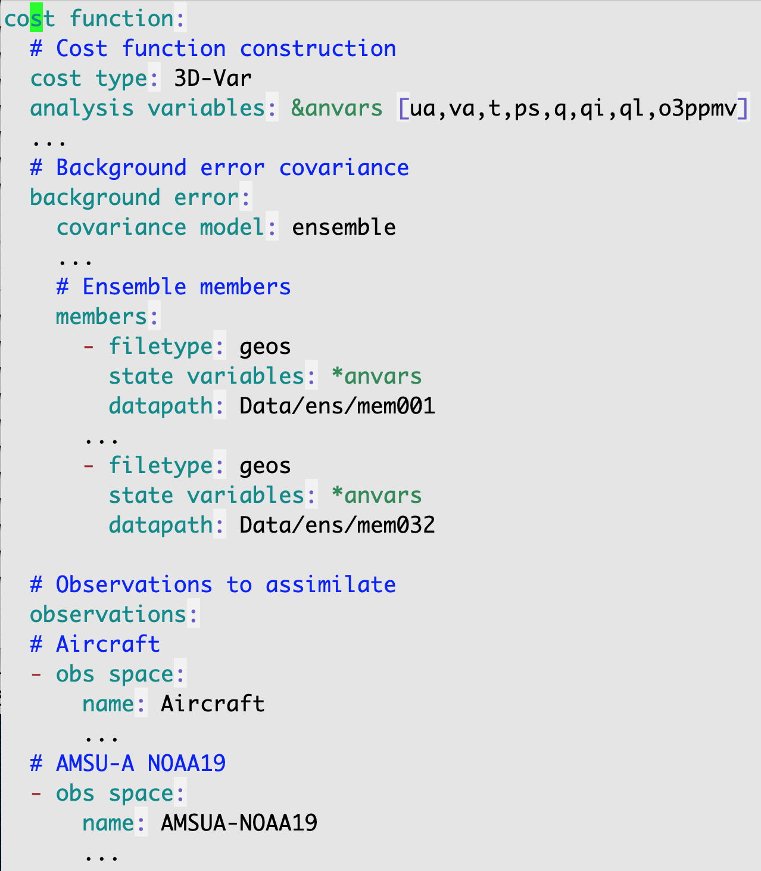
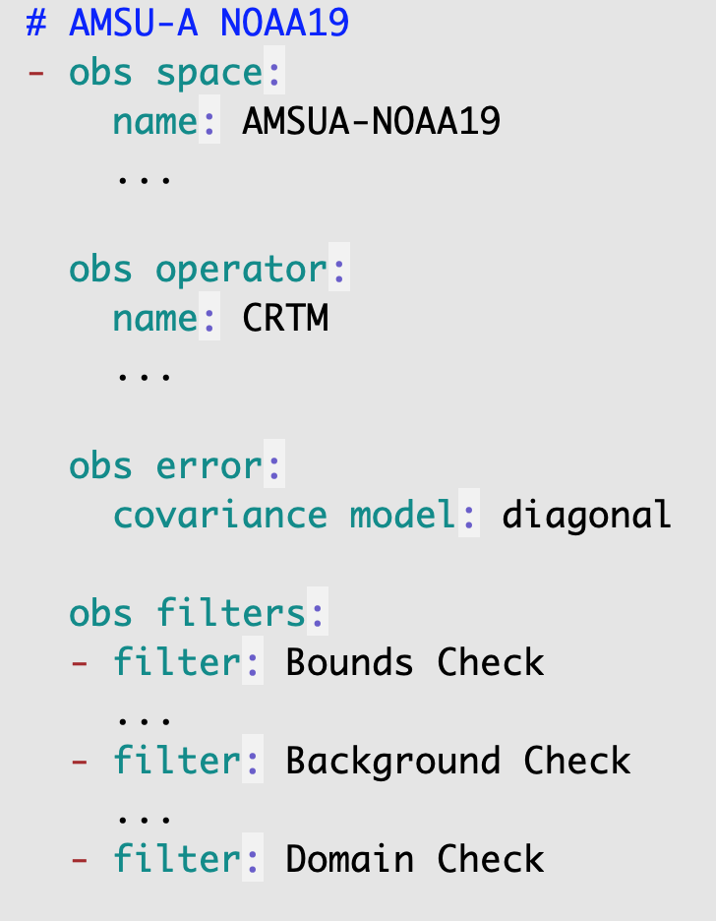
3DEnVar Configuration: Cost function
App: fv3jedi_var.x 3denvar.yaml logfile
3DVar technique
Variables
Model component (Jb)
Obs component (Jo)

Slide 8
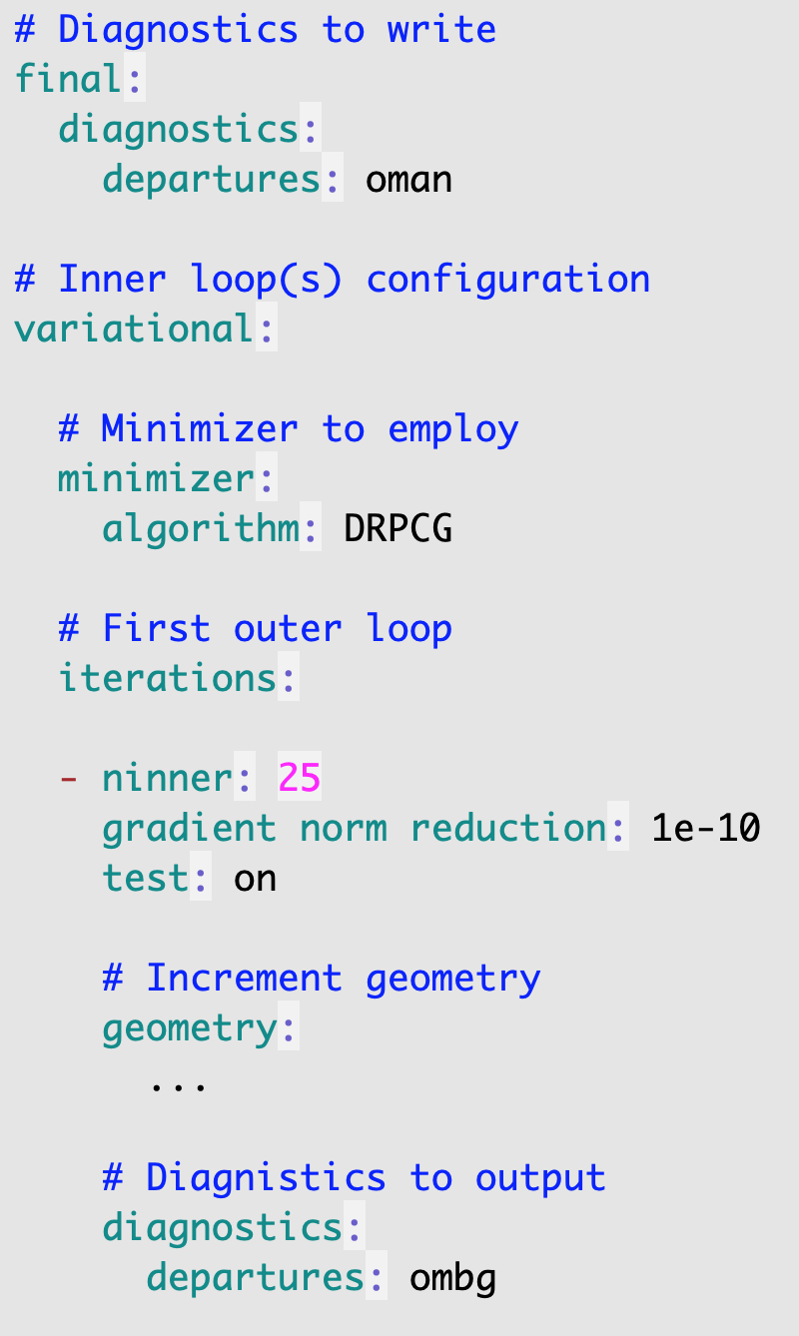
3DEnVar Configuration (continued)
App: fv3jedi_var.x 3denvar.yaml logfile
Minimization algorithm (many available)
Iteration control (outer, inner loops)

Slide 9
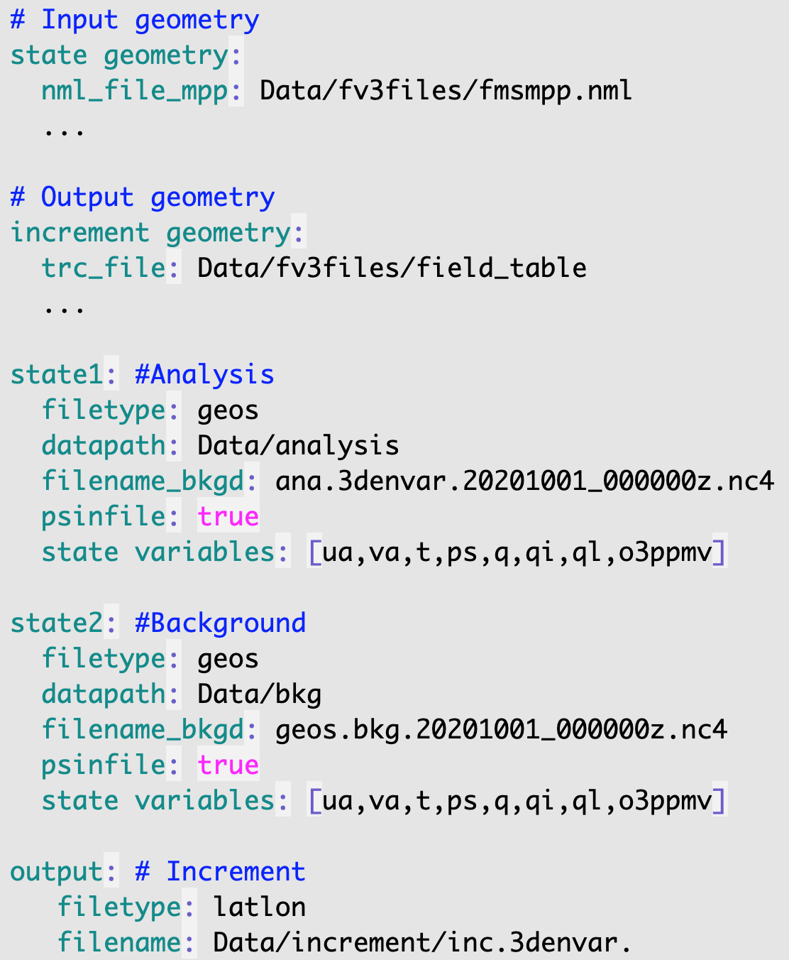
Increment Diagnostic Configuration
App: fv3jedi_diffstates.x create_increment_3denvar.yaml logfile
Grid resolutions
Variables for diagnostics
Output format

Slide 10
Eckit: YAML API
Eckit provides a Configuration class (C++)
eckit/src/eckit/config/Configuration.h
Constructor (with a filename argument) parses a YAML file and builds a configuration object in memory
Configuration object has methods to read the key-value pairs
JEDI Documentation on configuration
Fckit provides a Fortran interface to the eckit API
New OOPS Parameter class provides object storage and management of parameter specifications

Slide 11
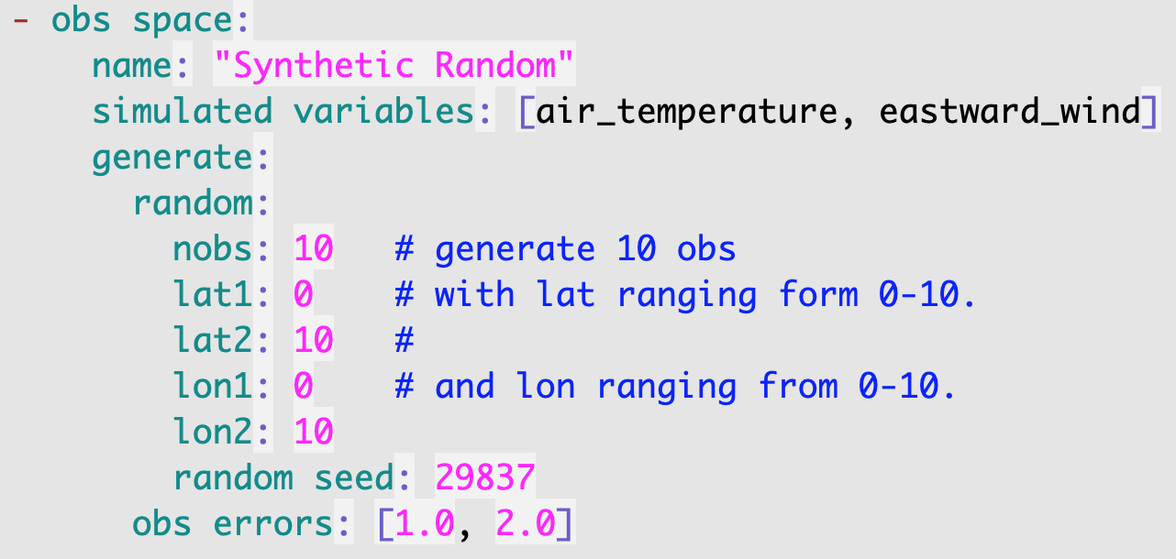
Eckit: YAML API
Object contains a single key at the top-level
“obs space”
Keys “name”, “simulated variables” and “generate” are nested one level down
Keys”random” and “obs_errors” are nested two levels down
Sample file
Use “.” to specify nesting:
Key: “obs space.generate.random.nobs”
Value: 10

Slide 12
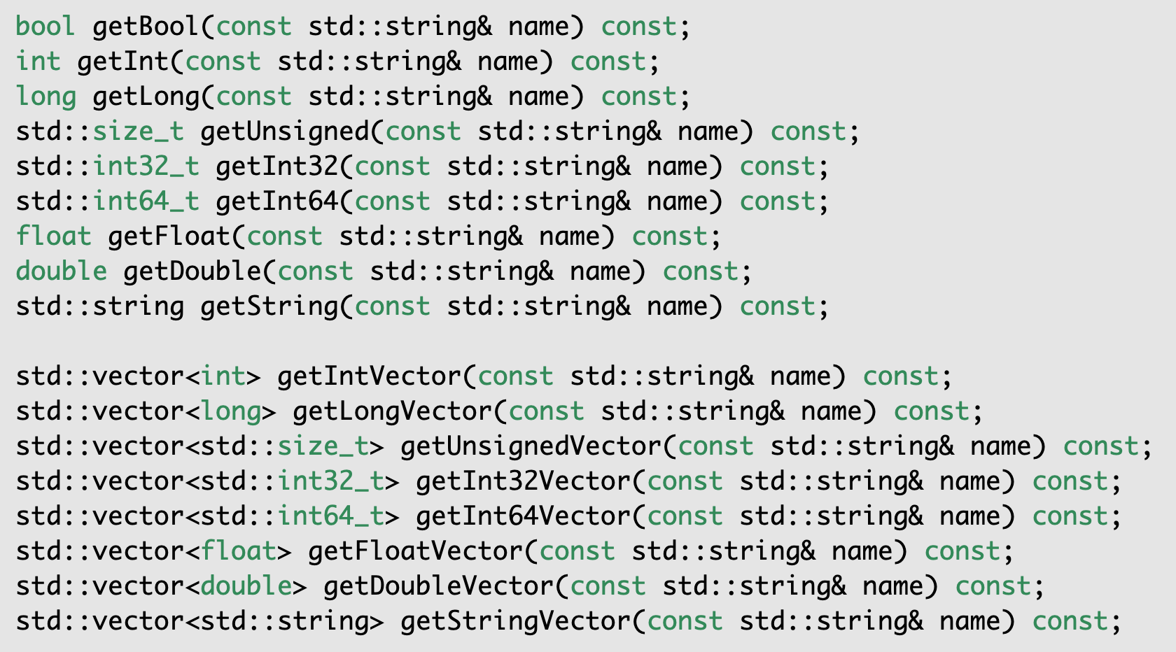
Eckit: YAML API
Eckit provides access routines to read YAML key-value pairs
eckit/src/eckit/config/Configuration.h
… to read these key-value pairs
Use these methods…

