Slide 1
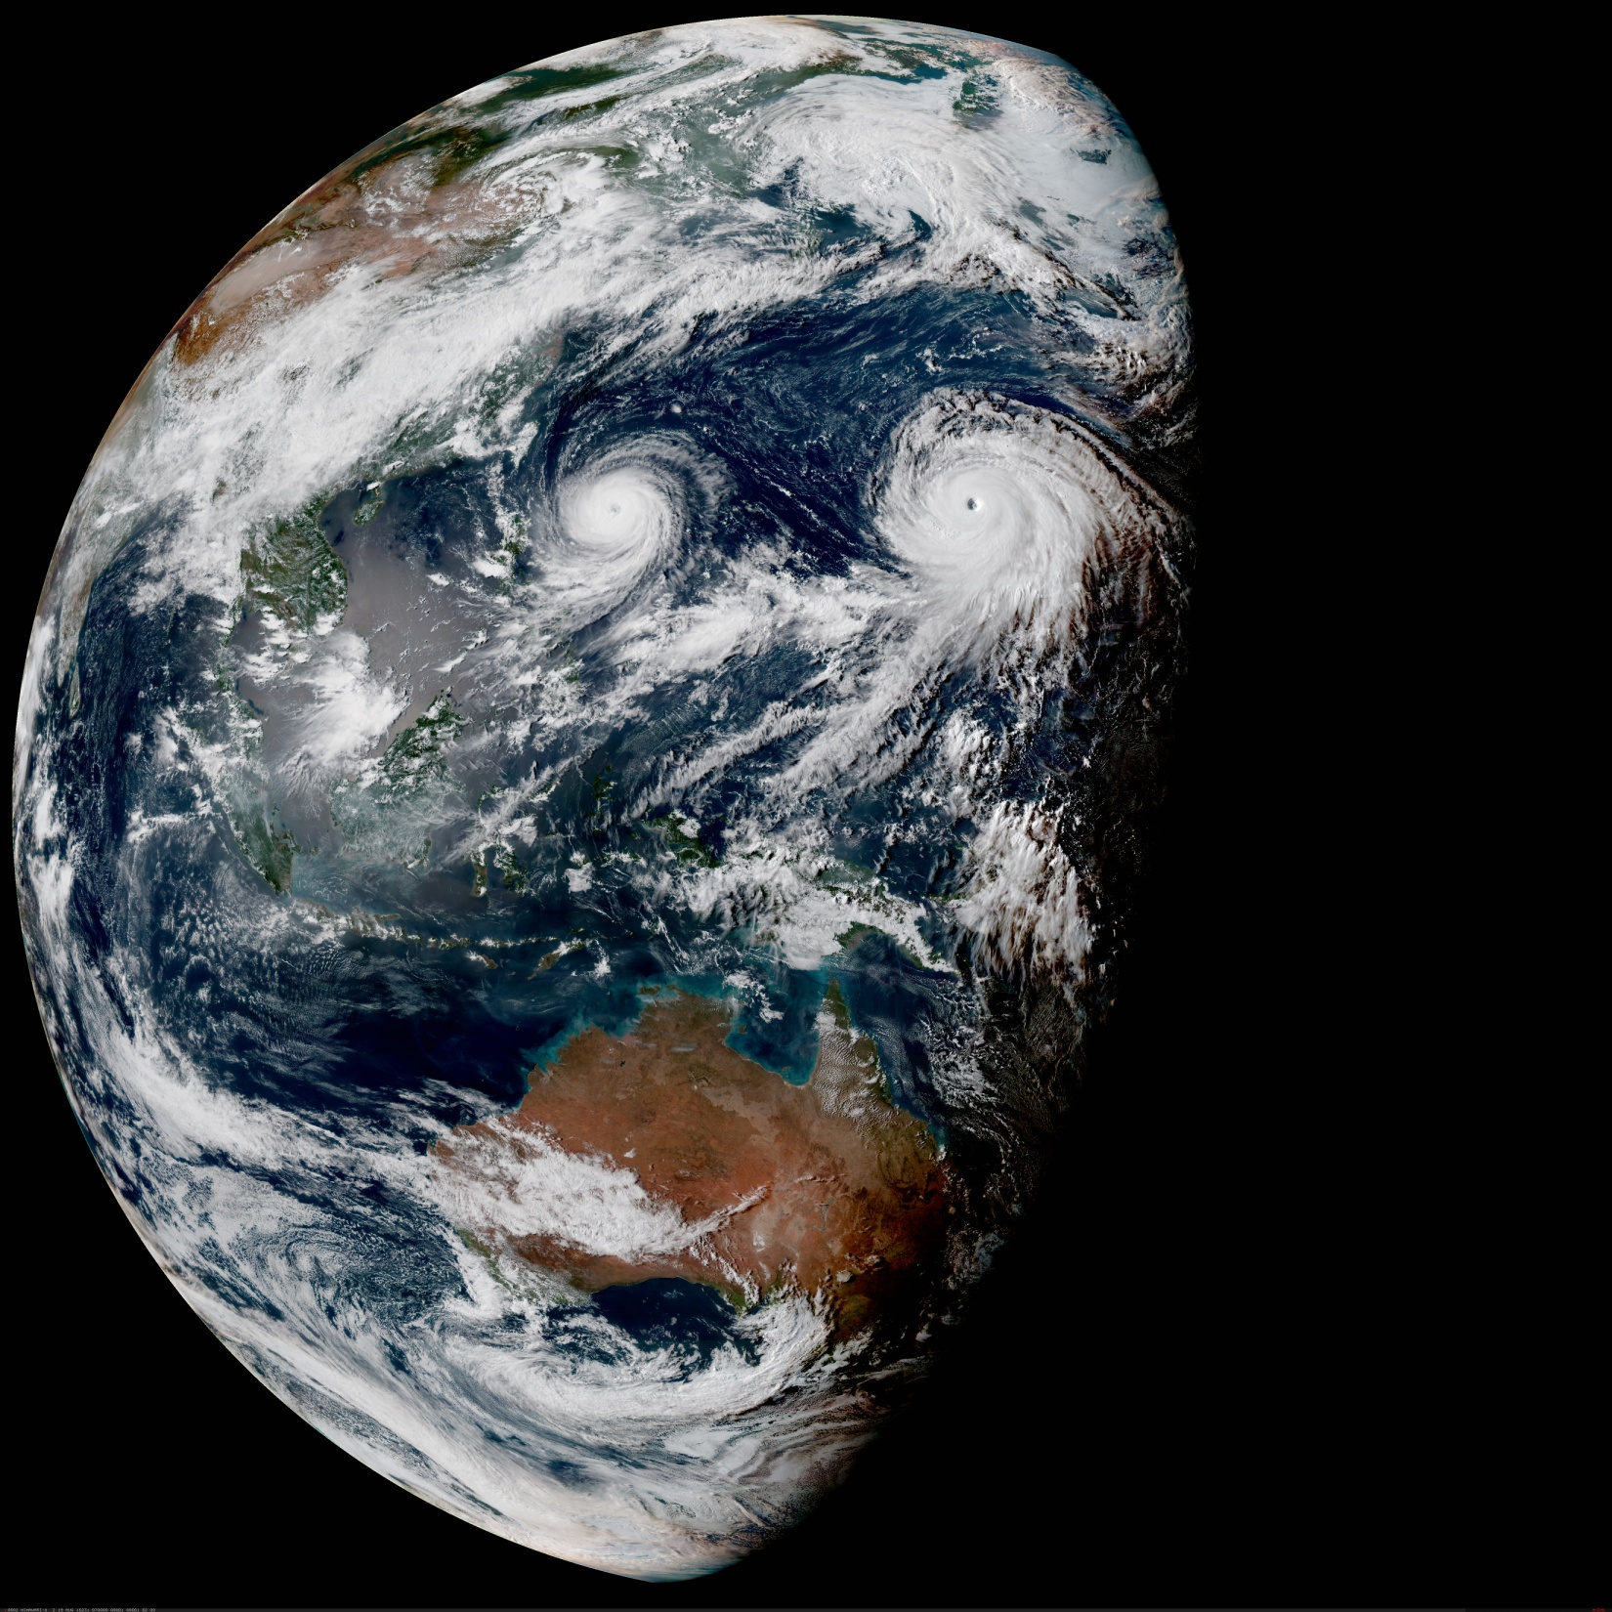
The Joint Effort for Data assimilation Integration (JEDI)
Why and How?
Joint Center for Satellite Data Assimilation (JCSDA)
JEDI Academy – 16-20 November 2020

Slide 2
The Joint Center for Satellite Data Assimilation (JCSDA)

Slide 3
Joint Center for Satellite Data Assimilation
A multi-agency research center created to improve the use of satellite data for analyzing and predicting the weather, the ocean, the climate and the environment.
Collaborative organization funded by
NOAA/NWS
NOAA/NESDIS
NOAA/OAR
NASA/GMAO
US Navy
US Air Force

Slide 4
Joint Center for Satellite Data Assimilation
A multi-agency research center created to improve the use of satellite data for analyzing and predicting the weather, the ocean, the climate and the environment.
Organized by projects:
CRTM (Community Radiative Transfer Model)
JEDI (Joint Effort for Data assimilation Integration)
SOCA (Sea-ice Ocean Coupled Assimilation)
OBS (Improved use of Observations)
LAND (Land surface Data Assimilation)

Slide 5
JCSDA: Same Mission, New Approach
The JCSDA mission remains the same. However, as compared with the time of JCSDA’s founding (c.2000), the rapid evolution of operational NWP toward coupled models and assimilation systems, combined with the expected proliferation of new observations from components of the Earth system other than the atmosphere, demand new and more unified approaches to algorithm development, observation processing, and maintenance of software.
Major increases in the number of atmospheric sounder radiances with real-time data delivery for operational NWP
Relatively few new data types for NWP, but improved usage of the above, still primarily atmospheric data types.
Increasing numbers and diversity of observations from multiple components of the Earth system
Funding of the JCSDA, CRTM, new observations put into the NCEP system (e.g. AIRS).
All-sky, all-surface radiances, hybrid DA techniques, transition other data types, reorg. of JCSDA for future challenges.
Coupled DA, of various flavors, becomes the standard. Benefits of OO coding, JEDI, coupling and mutualizing algorithms.
2000
2010
2020
2030
The JCSDA is taking a proactive approach to current and future satellite data assimilation challenges to reposition the research and operational communities in the US to take full advantage of the coming era of full Earth system prediction.

Slide 6
Joint Effort for Data assimilation Integration (JEDI)

Slide 7
JEDI is a Joint Effort
JEDI core-team: Anna Shlyaeva, Benjamin Ménétrier, Claude Gibert, Clémentine Gas, Dan Holdaway, Mark Miesch, Mark Olah, Maryam Abdi, Rick Grubin, Ryan Honeyager, Steve Herbener, Xin Zhang, Yannick Trémolet
JEDI contributors (in last year): Andrew Collard, Ben Ruston, Byoung-Joo Jung, Chris Harrop, Cory Martin, David Davies, David Rundle, David Simonin, Emily Liu, Guillaume Vernières, Hailing Zhang, Hamideh Ebrahimi, Hui Shao, JJ Guerrette, Jeff Whitaker, Jim Rosinski, Junmei Ban, Louis Kouvaris, Louis Wicker, Marek Wlasak, Mariusz Pagowski, Mike Cooke, Ming Hu, Rahul Mahajan, Sarah King, Sergey Frolov, Steve Sandbach, Steve Vahl, Travis Sluka, Virginie Buchard, Will McCarty, Wojciech Śmigaj, Yali Wu, Yanqiu Zhu, Yaswant Pradhan, Yunheng Wang
Representing: JCSDA, NOAA/EMC, NOAA/ESRL, NASA/GMAO, NCAR, UKMO, NRL
And about 160 padawans who attended four JEDI Academies (more soon!)

Slide 8
JEDI: Motivations and Objectives
Reduce duplication of effort between JCSDA partners
Adding new observations (UFO and IODA)
Implementation of new DA algorithms (OOPS)
Bring all components of Earth-system in one DA system
Develop DA algorithms once for all components (OOPS)
Enable future coupled DA developments (OOPS)
For research and operations (and O2R2O)

Slide 9
JEDI: Approach
Modern DA systems are too complex for any one person to grasp entirely
Collaborative developments
Separation of concerns
Modernize software
Speed-up future developments
Ease maintenance
Increase portability and efficiency

Slide 10
Object Oriented Prediction System (OOPS)
Generic, portable, model-agnostic DA system
Use object-oriented and generic programing
Each model implements pre-defined abstract interfaces
Separation of concerns
Abstract Layer - OOPS
Forecast
4D-Var
EnKF
…
Uses
State
Model
Covariance
Obs.
Implements
Lorenz
FV3 + GSI
MOM6
…
Notes:
Different models, different algorithms and applications.

Slide 11
JEDI: Abstraction and Genericity
Abstract Layer
Generic Algorithms
Forecast
4D-Var
EDA
EnKF
…
Abstract, model-agnostic DA system
Uses
Abstract Interfaces
State
Model
Covariance
…
Obs. Operator
Obs. Space
OOPS is complemented by generic (shared) components.
Generic Layer
Generic Implementations
Implements
SABER
UFO
IODA
Specific Implementations
MOM6
FV3
NEPTUNE
…
CRTM
GNSSRO
…

Slide 12
JEDI Model Interfaces

Slide 13
Model design
Between model “steps” OOPS calls post-processors
OOPS manages when post-processors are called
Post-processing removed from model code (separation of concerns)
Post-processors isolate data assimilation from the model (separation of concerns)
Computing simulated observations H(x)
Jc-DFI, …
Post-processors do not modify the State
create(…)
Setup
(lots of stuff)
initialize(…)
Timestep
step(…)
finalize()
Clean-up
(sometimes)
destruct()

Slide 14
Models Interfacing
MODEL | TYPE | CENTER
FV3GFS | Atmosphere | NOAA-EMC
GEOS | Atmosphere | NASA-GMAO
FV3GFS GSDChem | Atmospheric chemistry | NOAA-ESRL
GEOS-AERO | Atmospheric aerosols | NASA-GMAO
MPAS | Atmosphere | NCAR
WRF | Atmosphere | NCAR
LFRic | Atmosphere | Met Office (UK)
UM | Atmosphere | Met Office (UK)
MOM6 | Ocean | NOAA-EMC
SIS2 | Sea ice | NOAA-EMC
CICE6 | Sea ice | NOAA-EMC
NEPTUNE | Atmosphere | NRL
QG | Toy model | ECMWF
Lorenz 95 | Toy model | ECMWF
Shallow Water | Toy model | NOAA-ESRL

Slide 15
JEDI Observations Interfaces

Slide 16
Unified Forward Operator (UFO)
Share observation operators between JCSDA partners and reduce duplication of work
Taking the model agnostic approach one level down into the observation operators
Faster use of new observing platforms
Regular satellite missions are expensive
Cube-sat have short expected life time
Include users and instruments science teams
Unified Forward Operator (UFO)
Build a community app-store for observation operators

Slide 17
Observation Operators
State
Observations
Obs. Operators
In most (all) existing systems, observation operators directly access state/model data
Observation operators, and as a result DA systems, are very model specific

Slide 18
Unified Forward Operator (UFO)
Same separation of concerns principles that lead to the design of OOPS
Obs. Locations
Variables
State
Obs. Operators
Observations
Field Values
at Locations
JEDI/UFO introduces standard interfaces between models and observations
Observation operators are independent of the model and can easily be shared, exchanged, compared

Slide 19
UFO Observation “filters”
Abstract “observation filters” are called before and after the obs. operator
Observation filters are generic and have access to
Observation values and metadata
Model values at observations locations (GeoVaLs)
Simulated observation value and diagnostics (for post-filter)
Their own private data
Filters are written once and used with many observation types
Generic filters already exist for:
Gross error check, background check, blacklisting, thinning…
Entirely controlled from yaml configuration file(s)
More filters will be developed as needed
Generic filters should cover most needs

Slide 20
JEDI Observations Handling

Slide 21
Typical Observation Data Flow
Plots
Monitoring
Plots
Monitoring?
Plots?
Diagnostics?
Plots
Diagnostics
Toolset 1
Toolset 2
Toolset 3?
Toolset 4
Format 1
Format 2
Format 3
Format 4
Decoding
Pre-proc.
Pre-proc.
@ DA time
DA
Observer
DA
Solver
GTS
Network
Obs.
files
Obs.
files
Obs.
files
Diag.
files
Research
Save
Save
Save?
Save
Tape
Tape
Tape
Tape
This is not sustainable:
maintenance and evolution are impossible
does not fit possible evolution of DA methods (continuous assimilation)

Slide 22
Observation Data Flow with IODA
Plots
Diagnostics
Monitoring
GTS
Network
Decoding
IODA
DA
Pre-processing
One observation data handling interface across the whole NWP chain, ideally across the entire memory hierarchy (memory, disk, archive)

Slide 23
JEDI Working Practices
Many people, many organizations, many models
How is fast progress possible?

Slide 24
Infrastructure, working practices
Project methodology inspired by Agile/SCRUM
Adapted to distributed teams and part time members
Work in small manageable increments with constant feedback
Collaborative environment
Easy access to up-to-date source code (github)
Easy exchange of information (zenhub)
Pull requests and code reviews (all developers actively involved)
Regular meetings by video
Code sprints (8-10 developers working together on a specific topic)
Object-oriented programming and independence of code components (separation of concerns)

Slide 25
Code and repositories
NEPTUNE
UFO (Unified Forward Operator)
The ‘app-store’ of model-agnostic observation operators
OOPS (Object Oriented Prediction System)
Full data assimilation generic algorithms
CRTM (Community Radiative Transfer Model)
Accurately and efficiently simulate satellite radiances
FV3GFS
CRTM
GEOS
OOPS
UFO
MPAS
IODA (Interface for Observation Data Access)
Performs all the I/O of the observations
IODA
LFRic
SABER (System-Agnostic Background Error Representation)
Generic background error covariance (incl. BUMP)
SABER
WRF
MOM6
Abstract interfaces (separation of concerns) are the most important aspect of the design
The end of the monolithic gigantic jumble of code
CICE5

Slide 26
Infrastructure, working practices
Enforce software quality
Correctness, coding norms, efficiency
Continuous Integration, Testing framework
Toolbox for writing tests
Automated running of tests (on pull requests)
Effort on portability
Flexible build system (ecbuild, cmake-based)
Automatically run tests with several compilers
JEDI available in containers (singularity, charliecloud)
Documentation
Doxygen, sphynx, (readthedocs)

Slide 27
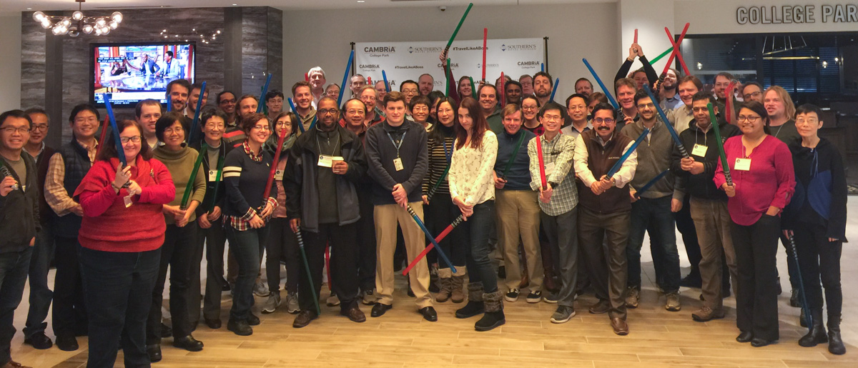
Bringing people in: JEDI Academy
June 2018, Nov. 2018, June 2019, Feb. 2020
4 days of lectures and practical sessions with the code

Slide 28
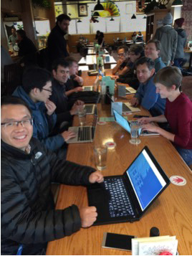
Bringing people in: Code Sprints
One specific topic
Gather 8-10 people in a room for 1 or 2 weeks
Develop solutions (not a workshop)
Efficient use of part time contributors
Involve people from partner institutions
Very motivating (before, during, after)
JCSDA, NCAR, GMAO, OAR, EMC, Météo-France, Met Office, NRL
NCAR, JCSDA, OAR, EMC, NRL, NASA

Slide 29
Final Comments

Slide 30
Long term collaborations
Collaborative work implies/requires
Quick code reviews (a few hours to a few days)
Code is in, doesn’t mean it is used in operations
Distinguish steps
Technical developments
Scientific evaluation
Move to operations
With constant feedback (Agile, DevOps)
JEDI is making DA tools available to (operational) JCSDA partners.

Slide 31
Final Comments
JEDI is bringing modern software development technologies and working practices to the data assimilation community
The technologies in use are all proven in the software industry
Changing working habits/practices is the most challenging aspect, it takes time…
In the future joint data assimilation environment:
Technical infrastructure is shared as much as possible
Common components (H, B, R…) are made available to all the partners when/where it makes sense
Each partner keeps their own applications and choice of components and data assimilation algorithm they use
The keys to success are separation of concerns and interfaces

