Slide 1
ecBuild, ctest, debug and adding test
Joint Center for Satellite Data Assimilation (JCSDA)
JEDI Academy – November 16, 2018

Slide 2
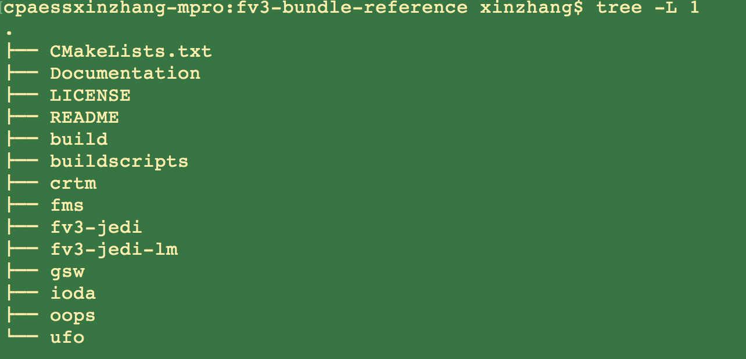
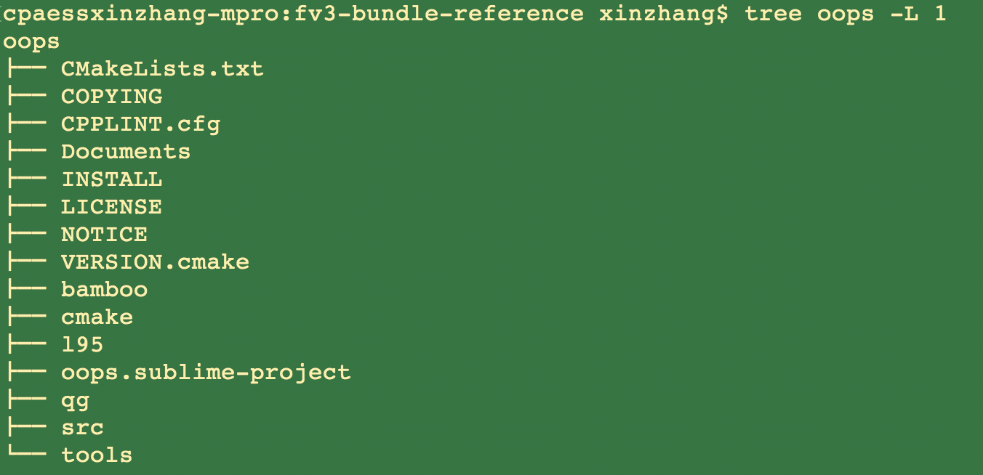
Structure of fv3-bundle building system

Slide 3
ecBuild
https://github.com/ecmwf/ecbuild
A CMake-based build system, consisting of a collection of CMake macros and functions that ease the managing of software build systems.
There is no actual build required for this software. It is a collection of text files, scripts and CMake files.
ecBuild/cmake must be called from an out-of-source build directory and forbids in-source builds.

Slide 4
Usage
ecbuild [option...] [--] [cmake-argument...] <path-to-source>
- -prefix=<prefix>
Set the install path to <prefix>.
--build=<build-type>
Set the build-type to <build-type>: debug; release; bit
--log=<log-level>
Set the ecbuild log-level: DEBUG; INFO; WARN, ……
e.g. :
> mkdir build
> cd build
> ecbuild --build=debug /path/of/the/source

Slide 5
fv3-bundle bundle building system

Slide 6
ecBuild Bundle
A bundle is used to build a number of projects together.
Each subproject needs to be declared with a call to ecbuild_bundle
The order of projects is important and needs to respect dependencies: ( if project B depends on project A, A should be listed before B in the bundle)
Subprojects are configured and built in order.

Slide 7
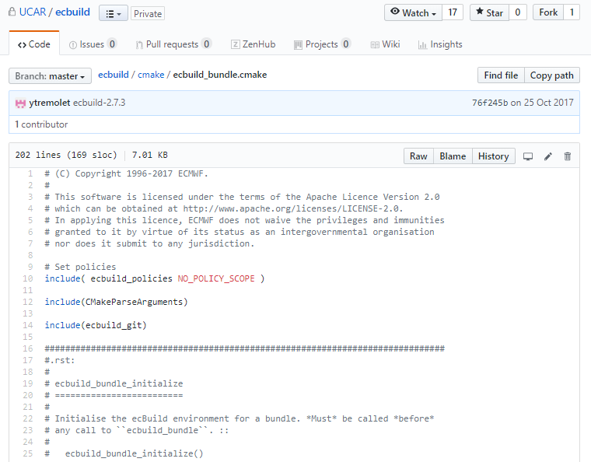
Structure of CMakeLists.txt using ecBuild
### header
cmake_minimum_required( VERSION 3.3.2 FATAL_ERROR )
project(oops C CXX Fortran)
set( CMAKE_MODULE_PATH ${CMAKE_MODULE_PATH} "${CMAKE_CURRENT_SOURCE_DIR}/cmake" )
include( ecbuild_bundle )
ecbuild_bundle_initialize()
ecbuild_requires_macro_version( 2.7 )
### Sources
### finalize

Slide 8
Structure of CMakeLists.txt using ecBuild
### header
cmake_minimum_required( VERSION 3.3.2 FATAL_ERROR )
project(oops C CXX Fortran)
set( CMAKE_MODULE_PATH ${CMAKE_MODULE_PATH} "${CMAKE_CURRENT_SOURCE_DIR}/cmake" )
include( ecbuild_bundle )
ecbuild_bundle_initialize()
ecbuild_requires_macro_version( 2.7 )
### Sources
ecbuild_bundle( PROJECT eckit GIT "https://github.com/ECMWF/eckit.git" TAG 0.18.5 )
ecbuild_bundle( PROJECT fckit GIT "https://github.com/ECMWF/fckit.git" TAG 0.5.0 )
ecbuild_bundle( PROJECT crtm SOURCE “${HOME}/jedi/crtm" BRANCH develop UPDATE )
……
ecbuild_bundle( PROJECT fms GIT "https://github.com/JCSDA/fms.git" BRANCH develop UPDATE )
ecbuild_bundle( PROJECT fv3 GIT "https://github.com/JCSDA/fv3.git" BRANCH develop UPDATE )
ecbuild_bundle( PROJECT fv3-jedi GIT "https://github.com/JCSDA/fv3-jedi.git" BRANCH develop UPDATE )
### finalize
ecbuild_bundle_finalize()
The order does matter !

Slide 9
Structure of fv3-bundle building system

Slide 10
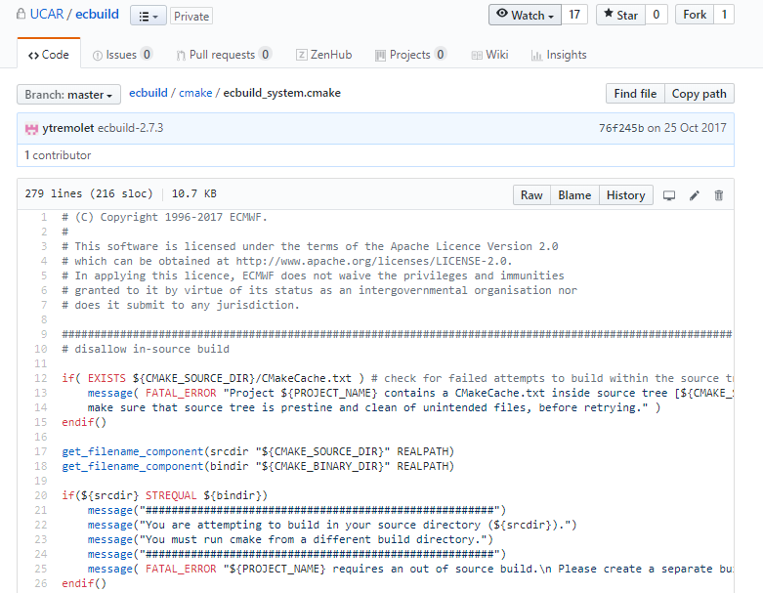
Structure of CMakeLists.txt using ecBuild
# header
cmake_minimum_required( VERSION 3.3.2 FATAL_ERROR )
project(oops C CXX Fortran)
set( CMAKE_MODULE_PATH ${CMAKE_MODULE_PATH} "${CMAKE_CURRENT_SOURCE_DIR}/cmake" )
include( ecbuild_system NO_POLICY_SCOPE )
ecbuild_requires_macro_version( 2.7 )
# open project
# sources
# finalize project

Slide 11
Structure of CMakeLists.txt using ecBuild
# header
# open project
ecbuild_declare_project() # initialize an ecBuild project
# sources
# finalize project

Slide 12
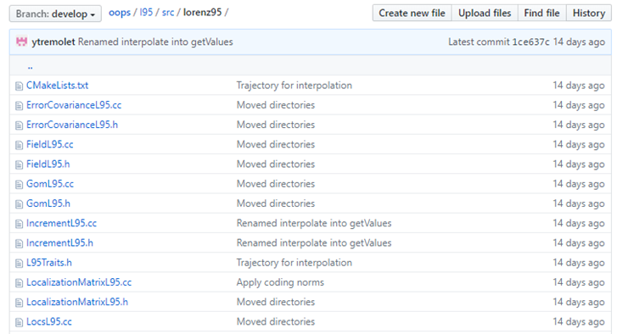
Structure of CMakeLists.txt using ecBuild
ecbuild_add_library ( TARGET lorenz95
SOURCES
ErrorCovarianceL95.cc
ErrorCovarianceL95.h
FieldL95.cc
FieldL95.h
…………
LocalizationMatrixL95.cc
LocalizationMatrixL95.h
LIBS oops
INSTALL_HEADERS LISTED
LINKER_LANGUAGE ${OOPS_LINKER_LANGUAGE} )
# header
# open project
# sources
add_subdirectory (lorenz95 )
add_subdirectory ( executables )
# finalize project

Slide 13
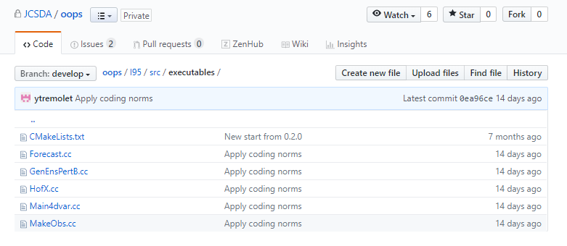
Structure of CMakeLists.txt using ecBuild
ecbuild_add_executable ( TARGET l95_forecast.x
SOURCES Forecast.cc
LIBS lorenz95 )
ecbuild_add_executable ( TARGET l95_genpert.x
SOURCES GenEnsPertB.cc
LIBS lorenz95 )
ecbuild_add_executable ( TARGET l95_4dvar.x
SOURCES Main4dvar.cc
LIBS lorenz95 )
ecbuild_add_executable ( TARGET l95_makeobs.x
SOURCES MakeObs.cc
LIBS lorenz95 )
ecbuild_add_executable ( TARGET l95_hofx.x
SOURCES HofX.cc
LIBS lorenz95 )
# header
# open project
# sources
add_subdirectory (lorenz95 )
add_subdirectory ( executables )
# finalize project

Slide 14
Structure of CMakeLists.txt using ecBuild
# header
# open project
# sources
# pkgconfig exports (optional)
# finalize project

Slide 15
Structure of CMakeLists.txt using ecBuild
# header
# open project
# sources
# finalize project
ecbuild_install_project( NAME ${PROJECT_NAME} )
# print the summary of the configuration
ecbuild_print_summary()

Slide 16
Structure of CMakeLists.txt using ecBuild
# header
cmake_minimum_required( VERSION 3.3.2FATAL_ERROR )
project( oops C CXX Fortran )
set( CMAKE_MODULE_PATH ${CMAKE_MODULE_PATH} "${CMAKE_CURRENT_SOURCE_DIR}/cmake" )
include( ecbuild_system NO_POLICY_SCOPE )
ecbuild_requires_macro_version( 2.7 )
# open project
ecbuild_declare_project()
# sources
add_subdirectory( lorenze95 )
add_subdirectory( executables )
# finalize project
ecbuild_install_project( NAME ${PROJECT_NAME} )
ecbuild_print_summary()

Slide 17
Add Dependencies
# header
cmake_minimum_required( VERSION 3.3.2FATAL_ERROR )
project( oops C CXX Fortran )
set( CMAKE_MODULE_PATH ${CMAKE_MODULE_PATH} "${CMAKE_CURRENT_SOURCE_DIR}/cmake" )
include( ecbuild_system NO_POLICY_SCOPE )
ecbuild_requires_macro_version( 2.7 )
# open project
ecbuild_declare_project()
# Dependencies
......
......
# sources
add_subdirectory( lorenze95 )
add_subdirectory( executables )
# finalize project
ecbuild_install_project( NAME ${PROJECT_NAME} )
ecbuild_print_summary()
# Boost, use cmake command
set( Boost_MINIMUM_VERSION "1.47" )
find_package( Boost ${Boost_MINIMUM_VERSION} REQUIRED
COMPONENTS unit_test_framework )
include_directories( ${Boost_INCLUDE_DIR} )
# LAPACK, use ecbuild_add_option
ecbuild_add_option( FEATURE LAPACK
DESCRIPTION "Linear Algebra PACKage"
REQUIRED_PACKAGES "LAPACK REQUIRED" )
if (NOT HAVE_LAPACK)
ecbuild_error("LAPACK_LIBRARIES not defined")
endif()
# eckit, Use another CMake project as a
# dependency by either building it from source or searching for it.
ecbuild_use_package( PROJECT eckit VERSION 0.18.0 REQUIRED )
include_directories( ${ECKIT_INCLUDE_DIRS} )

Slide 18
JEDI working Philosophy
Test everything that could possibly break
--XP maxim
JEDI developers are going to be constantly writing and running many small tests.
JEDI’d like to run the tests in a variety of different platforms with different compilers.

Slide 19
Basic ctest usage in JEDI
https://jointcenterforsatellitedataassimilation-jedi-docs.readthedocs-hosted.com/en/latest/developer/building_and_testing/unit_testing.html#
List all available tests
ctest –N
Singularity JCSDA-singularity-master-latest.simg:~/jedi/build/ufo-bundle> ctest -N
Test project /home/xinzhang/jedi/build/ufo-bundle
Test #1: eckit_test_config_resource
Test #2: eckit_test_config_configuration
Test #3: eckit_test_container_sharedmemarray
Test #4: eckit_test_container_btree
Test #5: eckit_test_container_bloomfilter
Test #6: eckit_test_container_trie
Test #7: eckit_test_container_densemap
Test #8: eckit_test_container_cache_lru
Test #9: eckit_test_container_benchmark_densemap
Test #10: eckit_test_filesystem_multihandle
……

Slide 20
Basic ctest usage in JEDI
Run a group of tests, for example, run all tests with the names having “ufo”
ctest -R ufo [-j4]
Singularity JCSDA-singularity-master-latest.simg:~/jedi/build/ufo-bundle> ctest -R ufo
Test project /home/xinzhang/jedi/build/ufo-bundle
Start 225: test_ufo_geovals
1/9 Test #225: test_ufo_geovals .................. Passed 1.38 sec
Start 226: test_ufo_amsua
2/9 Test #226: test_ufo_amsua .................... Passed 2.38 sec
Start 227: test_ufo_radiosonde
3/9 Test #227: test_ufo_radiosonde ............... Passed 0.37 sec
Start 228: test_ufo_insitutemperature
……
Start 231: test_ufo_aod
7/9 Test #231: test_ufo_aod ...................... Passed 0.89 sec
Start 232: test_ufo_obsop_seaice_tlad
8/9 Test #232: test_ufo_obsop_seaice_tlad ........ Passed 1.88 sec
Start 233: test_ufo_obsop_rsonde_tlad
9/9 Test #233: test_ufo_obsop_rsonde_tlad ........***Exception: SegFault 0.49 sec
89% tests passed, 1 tests failed out of 9

Slide 21
Debug failed test
Run specific failed test
export OOPS_DEBUG=1 ! Turn on the debug log
export OOPS_TRACE=1 ! Turn on the trace log
ctest -R test_ufo_obsop_rsonde_tlad
Check the log (under build directory)
cat Testing/Temporary/LastTest.log
Start testing: Jun 03 03:05 UTC
----------------------------------------------------------
233/233 Testing: test_ufo_obsop_rsonde_tlad
233/233 Test: test_ufo_obsop_rsonde_tlad
Command: "/home/xinzhang/jedi/build/ufo-bundle/ufo/test/test_ufo_obsop_rsonde_tlad" "--" "testinput/radiosonde.json"
Directory: /home/xinzhang/jedi/build/ufo-bundle/ufo/test
"test_ufo_obsop_rsonde_tlad" start time: Jun 03 03:05 UTC
Output:
----------------------------------------------------------
Configuration input file is: testinput/radiosonde.json
Full configuration is:YAMLConfiguration[path=testinput/radiosonde.json, root={test_framework_runtime_config => --log_level=test_suite , window_begin => 2010-01-01T00:00:00Z , window_end => 2010-01-02T00:00:00Z , LinearObsOpTest => {testiterTL => 10 , toleranceTL => 1.0e-8 , toleranceAD => 1.0e-12} , Observations => {ObsTypes => ({ObsType => Radiosonde , ObsData => {ObsDataIn => {obsfile => Data/diag_t_01_wprofiles.nc4}} , GeoVaLs => {norm => 8471.883687854357 , random => 0 , filename => Data/diag_t_01_wprofiles.nc4} , rmsequiv => 254.50117867804789 , tolerance => 1.0e-8 , ObsBias => {}})}}]
……

Slide 22
Debug with kdbg in Singularity
Build with debug option
ecbuild - -build=debug ../../fv3-bundle
Run with kdbg (optional)
cd /home/xinzhang/jedi/build/ufo-bundle/ufo/test
kdbg test_ufo_obsop_rsonde_tlad -a testinput/radiosonde.json
Kdbg does not support parallel applications ( or we are not aware of )

Slide 23
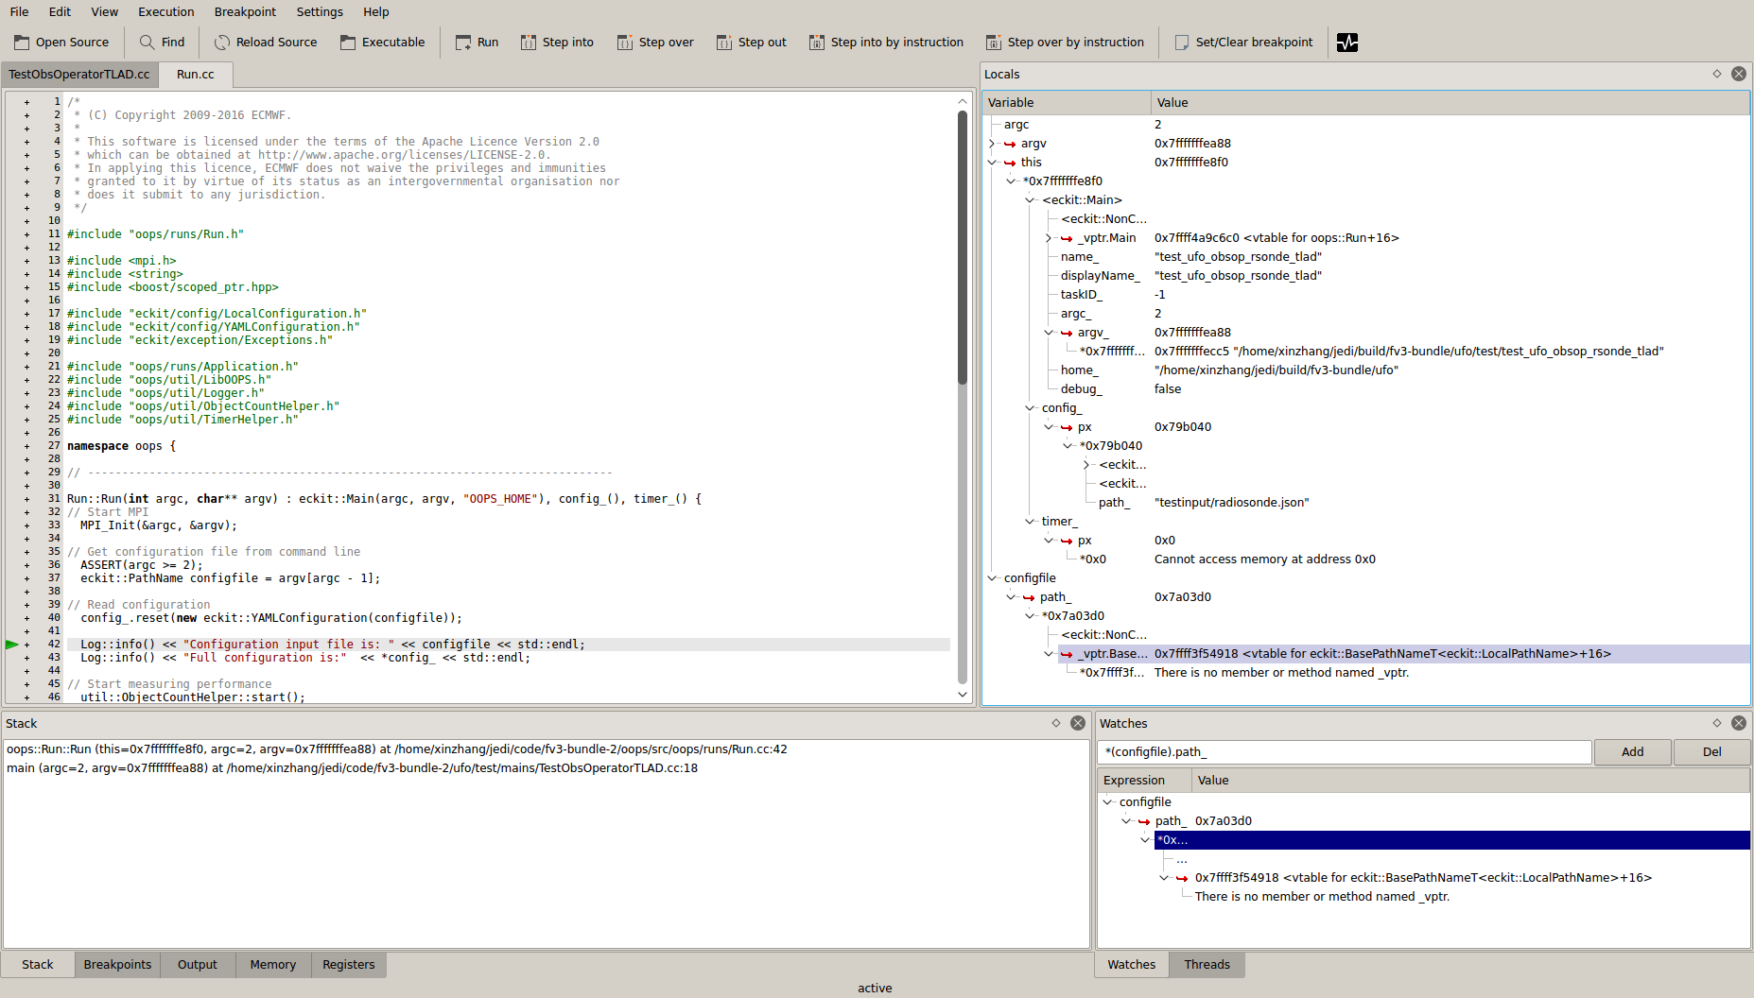
Debug with kdbg in Singularity

Slide 24
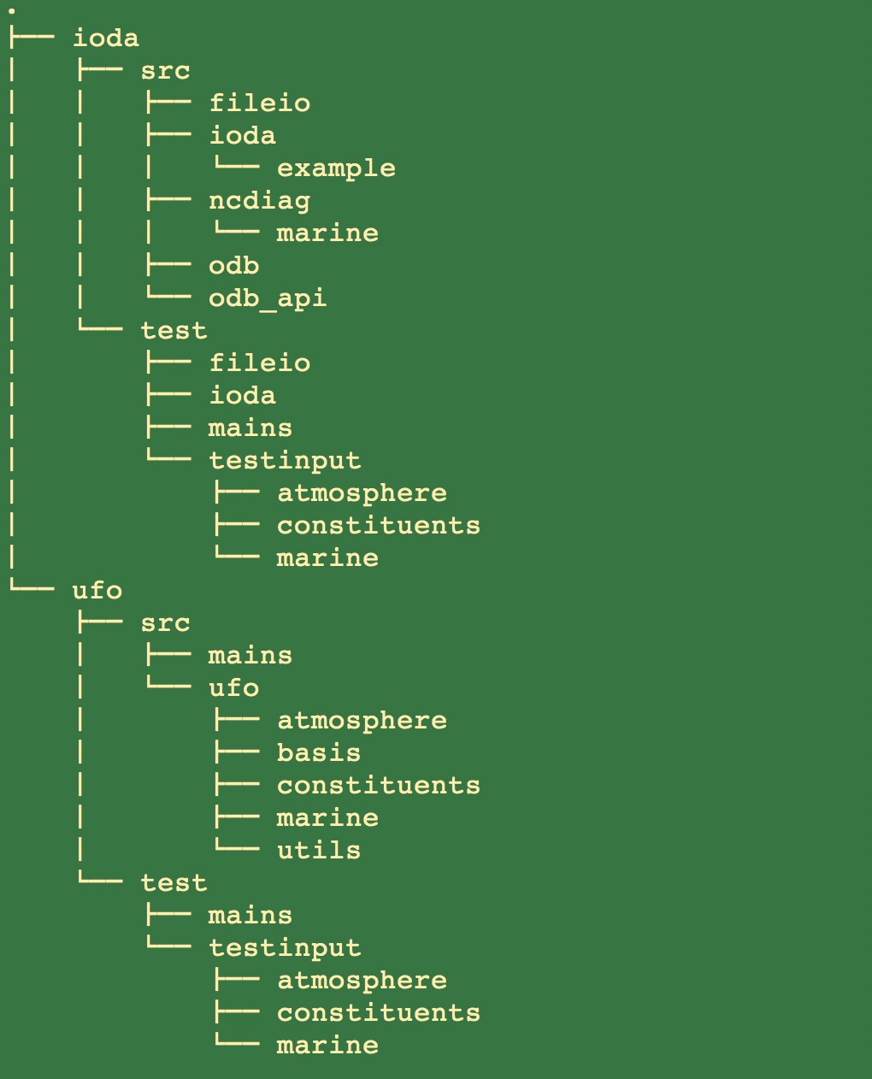
Testing Directory Governance
The governance of the JEDI Testing Framework is to have the test directory mirror the source directory such that each of the main C++ classes defined in the source directory has a corresponding test.

Slide 25
Add a test with Boost Unit Test

Slide 26
Basics of Boost Test
// Define our Module name (prints at testing)
#define BOOST_TEST_MODULE "Jedi_Academy"
// VERY IMPORTANT - include this last
#include <boost/test/included/unit_test.hpp>
BOOST_AUTO_TEST_CASE(CTestCase_1)
{
float x = 9.5f;
BOOST_CHECK(x == 0.0f);
BOOST_CHECK_EQUAL((int)x, 9);
BOOST_CHECK_CLOSE(x, 9.5f, 0.0001f); // Checks differ no more then 0.0001%
}
With this macro (BOOST_AUTO_TEST_CASE), it automatically implement any registration steps. The macro creates and registers the test case with the name CTestCase_1 automatically.
StartRunning 1 test case...
Entering test module "Jedi_Academy"
prog.cc(4): Entering test case "CTestCase_1"
prog.cc(7): info: check int(1.0) == 1 has passed
prog.cc(4): Leaving test case "CTestCase_1"; testing time: 325us
Leaving test module "Jedi_Academy"; testing time: 455us
*** No errors detected
0
Finish

Slide 27
Basics of Boost Test Suite
#define BOOST_TEST_MODULE "Jedi_Academy"
#include <boost/test/included/unit_test.hpp>
BOOST_AUTO_TEST_SUITE (Nov2018)
BOOST_AUTO_TEST_CASE(test1)
{
std::string logo;
logo = "Jedi_Academy";
BOOST_CHECK(logo.size() == 0);
}
BOOST_AUTO_TEST_CASE(test2)
{
std::string logo;
logo = "Jedi_Academy";
BOOST_REQUIRE_EQUAL('J', logo[0]);
}
BOOST_AUTO_TEST_SUITE_END()
Entering test module "Jedi_Academy"
prog.cc(4): Entering test suite "Nov2018"
prog.cc(6): Entering test case "test1"
prog.cc(10): error: in "Nov2018/test1": check s.size() == 0 has failed
prog.cc(6): Leaving test case "test1"; testing time: 208us
prog.cc(13): Entering test case "test2"
prog.cc(17): info: check 'J' == s[0] has passed
prog.cc(13): Leaving test case "test2"; testing time: 144us
prog.cc(4): Leaving test suite "Nov2018"; testing time: 438us
*** 1 failure is detected in the test module "Jedi_Academy"
Leaving test module "Jedi_Academy"; testing time: 492us
201
Finish

Slide 28
Boost Test with Fixture
#define BOOST_TEST_MODULE "Jedi_Academy"
#include <boost/test/included/unit_test.hpp>
#include <iostream>
struct JEDI {
JEDI() : logo("Jedi_Academy") { std::cout << "setup" << std::endl; }
~JEDI() { std::cout << "teardown" << std::endl; }
std::string logo;
};
BOOST_AUTO_TEST_SUITE (Nov2018)
BOOST_FIXTURE_TEST_CASE (test1, JEDI)
{
BOOST_CHECK(logo.size() == 0);
}
BOOST_AUTO_TEST_CASE (test2)
{
std::string logo;
logo = "Jedi_Academy";
BOOST_REQUIRE_EQUAL (‘J’, logo[0]);
}
BOOST_AUTO_TEST_SUITE_END()
Start
Running 2 test cases...
Entering test module "Jedi_Academy"
prog.cc(11): Entering test suite "Nov2018"
prog.cc(13): Entering test case "test1"
setup
prog.cc(16): error: in "Nov2018/test1": check logo.size() == 0 has failed
teardown
prog.cc(13): Leaving test case "test1"; testing time: 358us
prog.cc(19): Entering test case "test2"
prog.cc(23): info: check 'J' == s[0] has passed
prog.cc(19): Leaving test case "test2"; testing time: 206us
prog.cc(11): Leaving test suite "Nov2018"; testing time: 676us
Leaving test module "Jedi_Academy"; testing time: 733us *** 1 failure
is detected in the test module "Jedi_Academy"
201
Finish

Slide 29
Add a test with eckit unit test

Slide 30
Adding a new C++ test in JEDI
#include "eckit/testing/Test.h”
#include "eckit/types/Types.h"
using namespace eckit;
using namespace eckit::testing;
namespace eckit {
namespace test {
CASE( "test_configuration_interface" ) {
…
EXPECT( conf.get("manager", manager) );
EXPECT( name == std::string("Wiske") );
EXPECT( office == 3 );
}
CASE( "Hash a configuration" ) {
…….
EXPECT( is_approximately_equal( d , 777.7, 0.0001 ) ); // accept 0.0001% tolerance
……
}
} // namespace test
} // namespace eckit
// ---------------------------------------------
int main(int argc, char **argv)
{
return run_tests ( argc, argv );
}
CMakeLists.txt:
….
….
ecbuild_add_test( TARGET eckit_test_config_resource
SOURCES test_resource.cc
ARGS -integer 100 -listlong 88,99,11,22
LIBS eckit )…
…

Slide 31
Adding a new C++ test in JEDI
With SECTIONs
#include "eckit/testing/Test.h”
#include "eckit/types/Types.h"
using namespace eckit;
using namespace eckit::testing;
namespace eckit {
namespace test {
CASE( ”Case_1" ) {
SECTION( ”sec_1") {
………
}
SECTION( ”sec_2") {
……….
}
}
} // namespace test
} // namespace eckit
// ---------------------------------------------
int main(int argc, char **argv)
{
return run_tests ( argc, argv );
}

Slide 32
Add a test with fckit unit test

Slide 33
Adding a new Fortran test in JEDI
#include "fckit/fctest.h"
TESTSUITE( array )
TEST( test_array_view1d )
use fckit_array_module, only: array_view1d
use, intrinsic :: iso_c_binding
integer(c_int32_t) :: array_int32_r2(20,10)
integer(c_int32_t), pointer :: view(:)
write(0,*) "test_array_view1d"
view => array_view1d(array_int32_r2)
FCTEST_CHECK_EQUAL( size(view), 200 )
END_TEST
TEST( test_array_stride )
use fckit_array_module, only: array_stride, array_strides
use, intrinsic :: iso_c_binding
integer(c_int32_t) :: array_int32_r2(20,10)
write(0,*) "test_array_stride"
FCTEST_CHECK_EQUAL( array_stride(array_int32_r2,1), 1 )
FCTEST_CHECK_EQUAL( array_stride(array_int32_r2,2), 20 )
FCTEST_CHECK_EQUAL( array_strides(array_int32_r2), ([1,20]) )
END_TEST
END_TESTSUITE
CMakeLists.txt:
….
….
add_fctest( TARGET fckit_test_resource
LINKER_LANGUAGE Fortran
SOURCES test_resource.F90
ARGS -integer 10 -long 5000000000 -float 0.123456
DEFINITIONS ${FCKIT_DEFINITIONS}
CONDITION HAVE_ECKIT
LIBS fckit)
…
…

Slide 34
Adding a new Fortran test in JEDI
with Init and Finalize
#include "fckit/fctest.h”
TESTSUITE(fckit_test_log)
! define a function to be called before any other test
TESTSUITE_INIT
use fckit_module
implicit none
call fckit_main%init()
END_TESTSUITE_INIT
! define a function to be called after any other test
TESTSUITE_FINALIZE
use fckit_module
implicit none
call fckit_main%final()
END_TESTSUITE_FINALIZE
TEST( test_fortran_unit )
…..
….
END_TEST
TEST( test_file )
…..
….
END_TEST
END_TESTSUITE

Slide 35
Adding a new Fortran test in JEDI
With Fixture
#include <fckit/fctest.h>
module TestFixture
use, intrinsic :: iso_c_binding
use kinds
implicit none
type(c_ptr) :: ptr1 = c_null_ptr
type(c_ptr) :: ptr2 = c_null_ptr
end module
TESTSUITE_WITH_FIXTURE(TestSuiteName, TestFixture)
TESTSUITE_INIT
END_TESTSUITE_INIT
TESTSUITE_FINALIZE
END_TESTSUITE_FINALIZE
TEST( test_fortran_unit )
…..
….
END_TEST
END_TESTSUITE

Slide 36
Add a test with Boost unit test
Manually register tests

Slide 37
Adding a new test in JEDI
Create a File for your Test Application
Define A Test Fixture
Define Your Unit Tests
Register your Unit Tests with Boost
Create an Executable
Create a Configuration File
Register all files with CMake and CTest
https://jointcenterforsatellitedataassimilation-jedi-docs.readthedocs-hosted.com/en/latest/developer/building_and_testing/adding_a_test.html

Slide 38
Adding a new test in JEDI
Create a File for your Test Application
if have a new class in UFO
fv3-bundle/ufo/src/ufo/mydir/MyClass.h
create a file that will contain the test application
fv3-bundle/ufo/test/mydir/MyClass.h

Slide 39
Adding a new test JEDI
Define A Test Fixture
test fixtures are generally used to create objects as directed by the relevant sections of the configuration file, for use with the unit tests
it would be advisable to begin by defining a test::MyClassFixture class in test/mydir/MyClass.h to facilitate the creation of useful objects as specified in the configuration file. For many more examples see the various files in oops/src/test/interface.

Slide 40
Adding a new test in JEDI
Define Your Unit Tests
define the unit tests themselves as functions within test/mydir/MyClass.h
template <typename MODEL> void testStateConstructors() { typedef StateFixture<MODEL> Test_; typedef oops::State<MODEL> State_; const double norm = Test_::test().getDouble("norm-file"); const double tol = Test_::test().getDouble("tolerance"); const util::DateTime vt(Test_::test().getString("date")); // Test main constructor const eckit::LocalConfiguration conf(Test_::test(), "StateFile"); boost::scoped_ptr<State_> xx1(new State_(Test_::resol(), conf)); BOOST_CHECK(xx1.get()); const double norm1 = xx1->norm(); BOOST_CHECK_CLOSE(norm1, norm, tol); BOOST_CHECK_EQUAL(xx1->validTime(), vt); [...]

Slide 41
Adding a new test in JEDI
Register your Unit Tests with Boost
In order for Boost to run your tests, you have to generate a Boost test suite. This is achieved by means of the register_tests() method of test::MyClass
template <typename MODEL> class Increment : public oops::Test { public: Increment() {} virtual ~Increment() {} private: std::string testid() const {return "test::Increment<" + MODEL::name() + ">";} void register_tests() const { boost::unit_test::test_suite * ts = BOOST_TEST_SUITE("interface/Increment"); ts->add(BOOST_TEST_CASE(&testIncrementConstructor<MODEL>)); ts->add(BOOST_TEST_CASE(&testIncrementCopyConstructor<MODEL>)); ts->add(BOOST_TEST_CASE(&testIncrementTriangle<MODEL>)); ts->add(BOOST_TEST_CASE(&testIncrementOpPlusEq<MODEL>)); ts->add(BOOST_TEST_CASE(&testIncrementDotProduct<MODEL>)); ts->add(BOOST_TEST_CASE(&testIncrementAxpy<MODEL>)); boost::unit_test::framework::master_test_suite().add(ts); } };

Slide 42
Adding a new test in JEDI
Create an Executable
Executables for each test are generally located in the test/executables directory of each JEDI repository, though sometimes this directory is called test/mains.
Create an oops::Run object
Create an oops::Application object (in our example, this would be test::MyClass)
Pass the Application object to the execute() method of the Run object
#include "oops/runs/Run.h" #include "../mydir/MyClass.h" int main(int argc, char ** argv) { oops::Run run(argc, argv); test::MyClass tests; run.execute(tests); return 0; };

Slide 43
Adding a new test in JEDI
Create a Configuration File
Along with the executable, the configuration file is the way to tell JEDI what you want it to do.
the proper place to put it is in the test/testinput or test/mydir/testinput directory.
call our configuration file test/testinput/myclass.json.

Slide 44
Adding a new test in JEDI
Register all files with CMake and CTest
In steps 1-6 above we have created or modified three files, namely the source code for our tests, test/mydir/MyClass.h, the executable test/executables/TestMyClass.cc, and the configuration file test/testinput/myclass.json
editing the file test/CMakeLists.txt.
add your input file, test/testinput/myclass.json to json/yaml list
register your test with CTest. We can do this with a call to ecbuild_add_test() in the test/CMakeLists.txt file.
ecbuild_add_test( TARGET test_myrepo_myclass BOOST SOURCES executables/TestMyClass.cc ARGS "../testinput/myclass.json" LIBS myrepo )

