Slide 1
Model Interfacing and getValues

Slide 2
Introduction
OOPS provides the algorithms that combine generic building blocks into applications such as variational assimilation, forecast, EnKF, FSOI etc.
OOPS (by design) knows nothing about the actual implementation of the building blocks and carries no information about the underlying data. Instead these have to implemented by each model wanting to use the algorithms through the use of C++ templates.
Since all (common) models are Fortran based these templated C++ methods call some Fortran and the actual data of the objects is stored at the Fortran level.
This talk describes the structure of the model from the FV3-JEDI perspective but applies to almost all models.

Slide 3
Models Interfacing Status
 | State | 3D H(x) | M(x) | 4D H(x) | 3D-Var | 3D-Var FGAT | TL/AD | 4D-Var | 4DEnVar
FV3 | ✓ | ✓ | ✓ | ✓ | ✓ | ✓ | ✓ | ✓ | N/A
FV3-GFS (NOAA) | ✓ | ✓ | ✓ (IO) | ✓ | ✓ | ✓ | ✓ (DRY) | ✓ (DRY) | ✓
FV3-GEOS (NASA) | ✓ | ✓ | ✓ (IO) | ✓ | ✓ | ✓ | ✓ | ✓ | ✓
MPAS (NCAR) | ✓ | ✓ | ✓ |  | ✓ |  | N/A | N/A | ✓
WRF (NCAR/NOAA) | ✓
LFRic (UKMO) | ✓ | ✓ |  |  | ✓ |  | N/A | N/A
NAVGEM (NRL) | ✓
NEPTUNE (NRL) | ✓ |  |  |  |  |  | N/A | N/A
CICE5 (JCSDA/NOAA) | ✓ | ✓ | ✓ (IO) | ✓ | ✓ | ✓ | N/A | N/A | ✓
MOM6 (JCSDA/NOAA) | ✓ | ✓ | ✓ (IO) | ✓ | ✓ | ✓ | N/A | N/A | ✓
✓ = technically working ✓ = in progress or simplified version

Slide 4
Model Classes
CLASS | DESCRIPTION
Geometry | Generates and contains grid information, processor layout etc.
State | The variables by which the increment will interact with the model and all operations.
Increment | The variables adjusted by the minimization, linear algebra needed for data assimilation.
Model | Interaction with the nonlinear forecast model.
Linear Model | Interaction with the tangent linear and adjoint versions of the forecast model.
Error Covariance | Multiply the increment by the error covariance model.
Localization | Application of a localization matrix.
Change Variables | Factory for changing variables.

Slide 5
Model component hierarchy
MODEL
GFS, GEOS or FV3-JEDI-LM
FV3
Get GeoVaLs
UFO
IODA
STATE
GEOMETRY
LINEAR MODEL
FV3-JEDI-LM
INCREMENT
COVARIANCE/LOC
BUMP (OOPS)
UNSTRUCT GRID
VARIABLE CHANGE
MULTIGRID POISSON SOLVER

Slide 6
Class file structure
All the model (and UFO) classes follow basically the same file structure:
StateFV3JEDI.h
fv3jedi_state_interface_mod.F90
State.h
(OOPS)
StateFV3JEDI.cc
fv3jedi_state_mod.f90
StateFV3JEDIFortran.h
90% of the time you only work in this last box. Other boxes are only modified when the interface changes (rare).

Slide 7
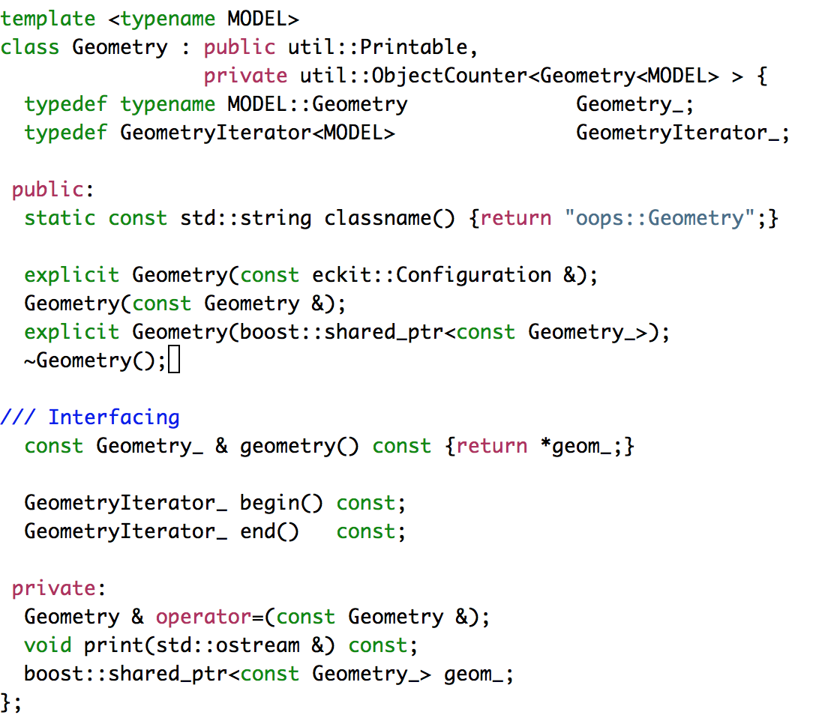
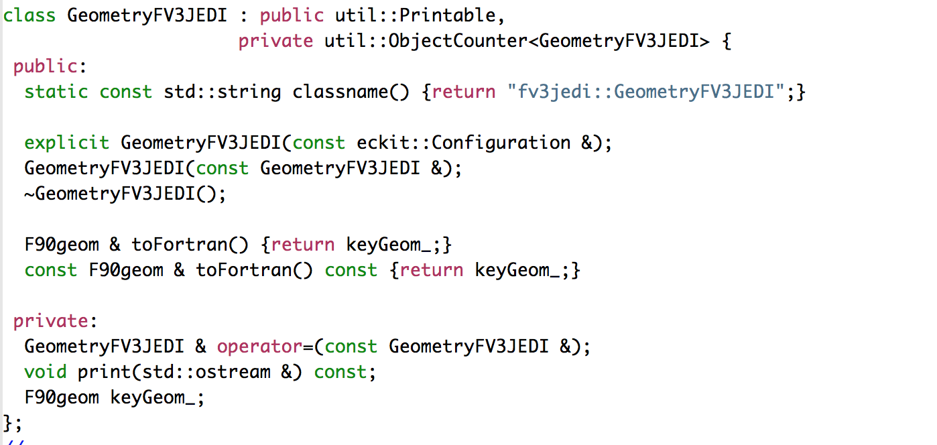
Geometry Class: OOPS vs. FV3-JEDI
OOPS
FV3-JEDI

Slide 8
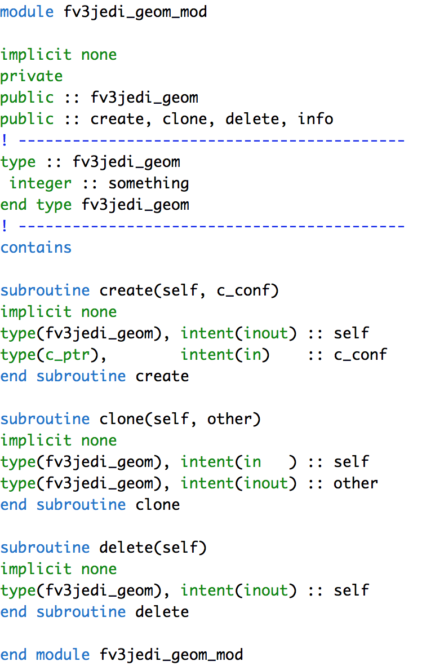
Geometry: Fortran interfaces

Slide 9
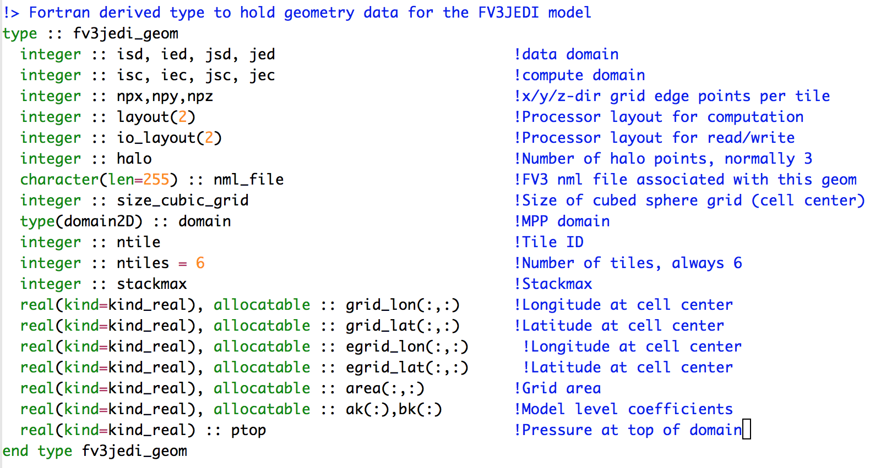
Geometry Class: Fortran Type

Slide 10
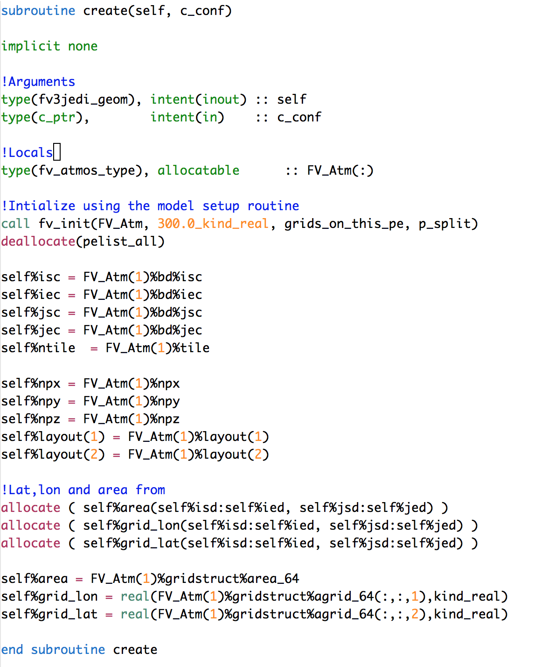
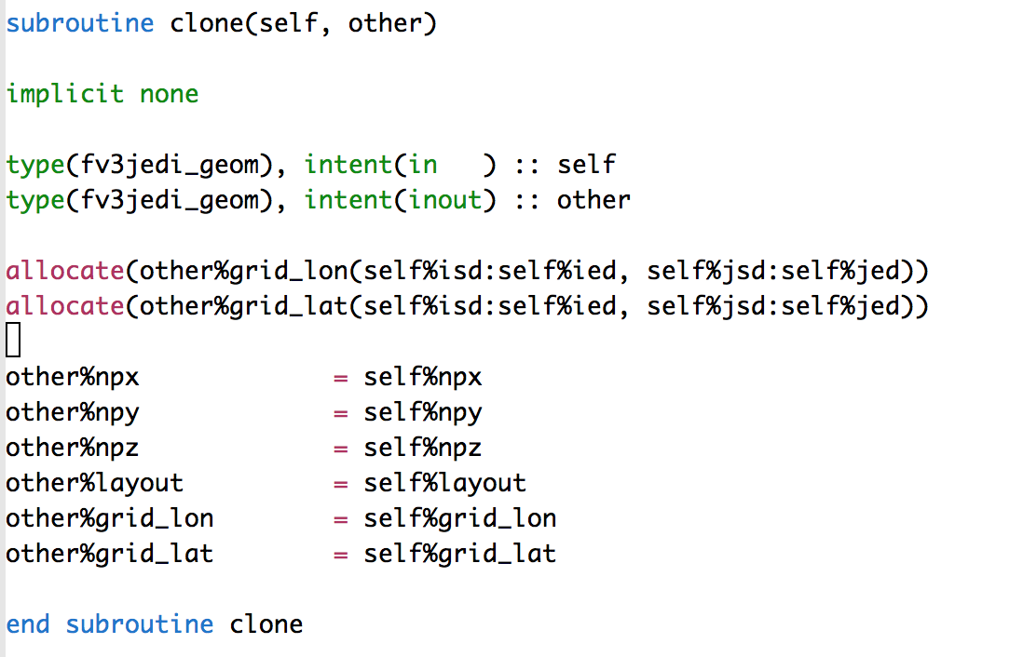
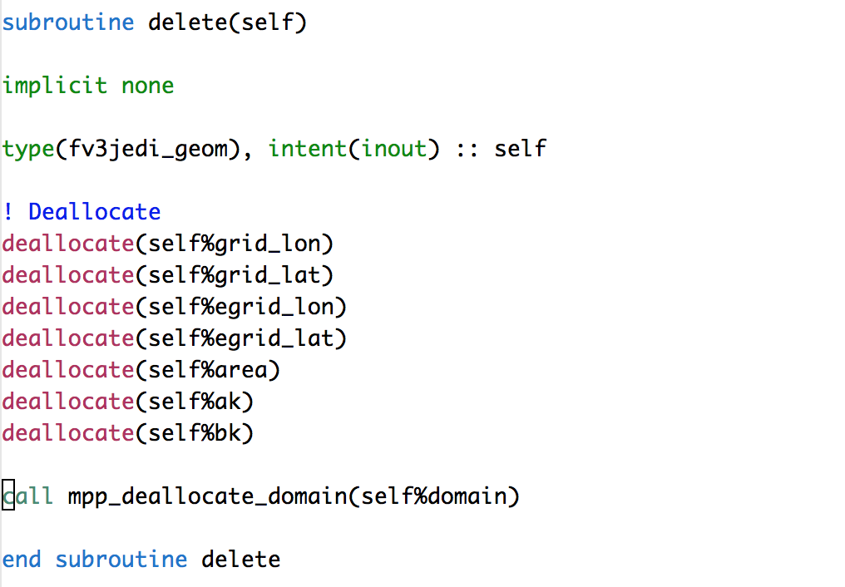
Geometry Class: Fortran Methods
Call to dynamical core

Slide 11
State and Increment: File Structure (Fields)
State Utilities
fv3jedi_state_mod.f90
State IO
Get Values
Common IO
MAPL
Increment IO
fv3jedi_inc_mod.f90
NEMS
Increment Utilities

Slide 12
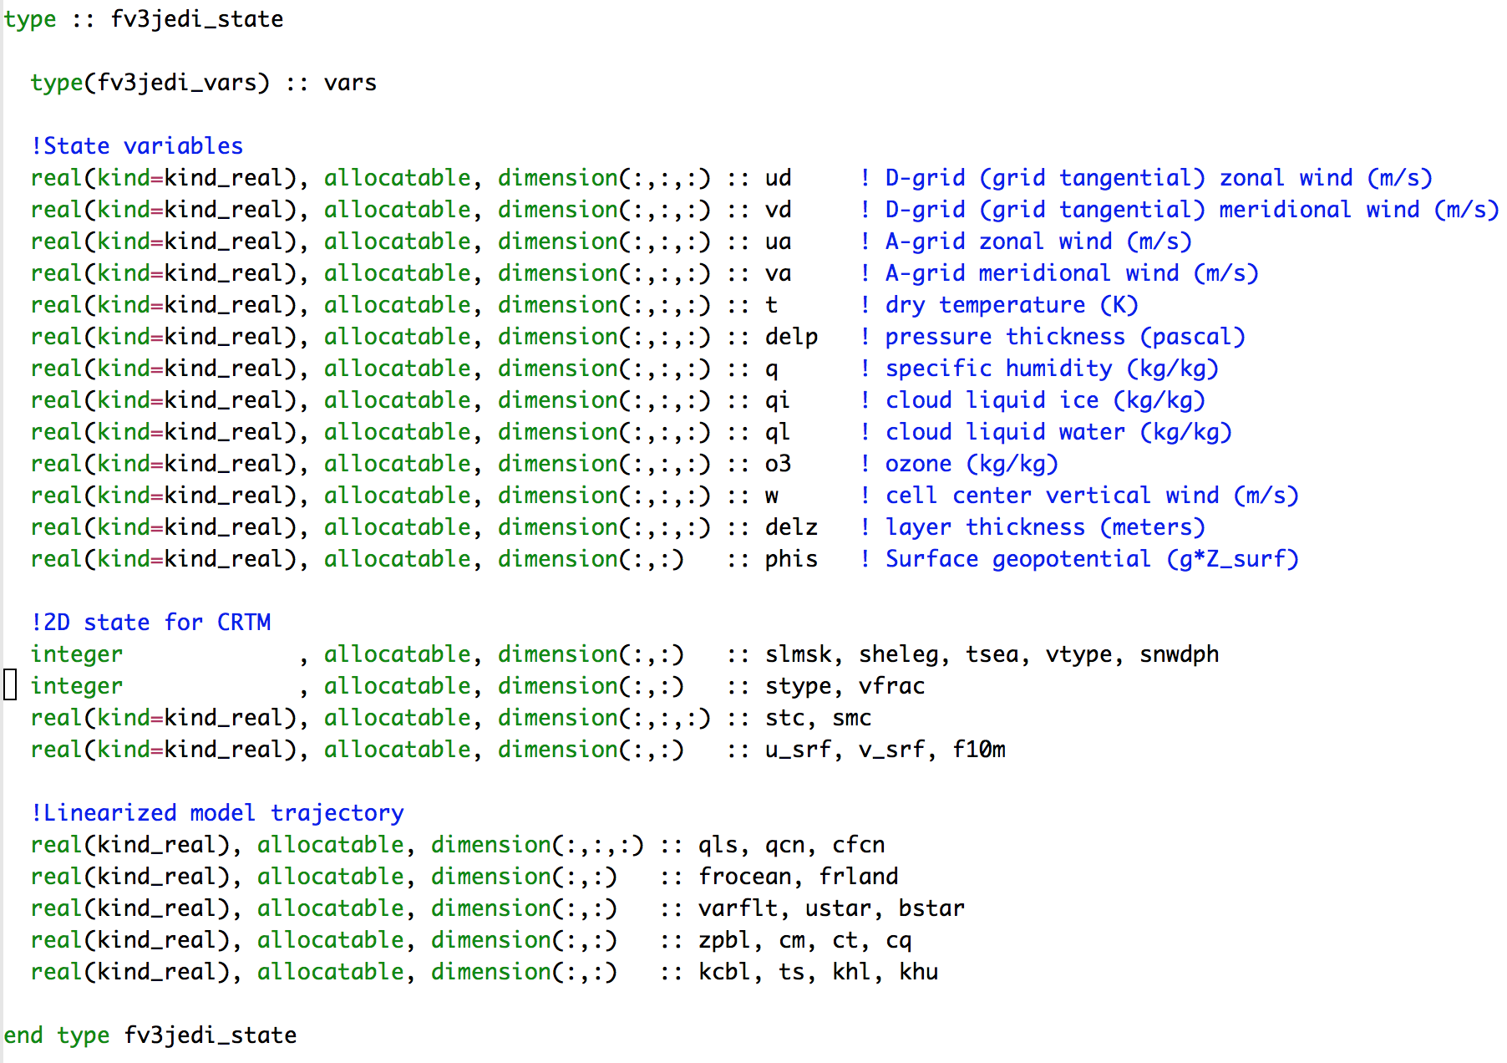
State: Fortran type
Variables that drive the model and interact with the increment
CRTM variables
TLM/ADM trajectory

Slide 13
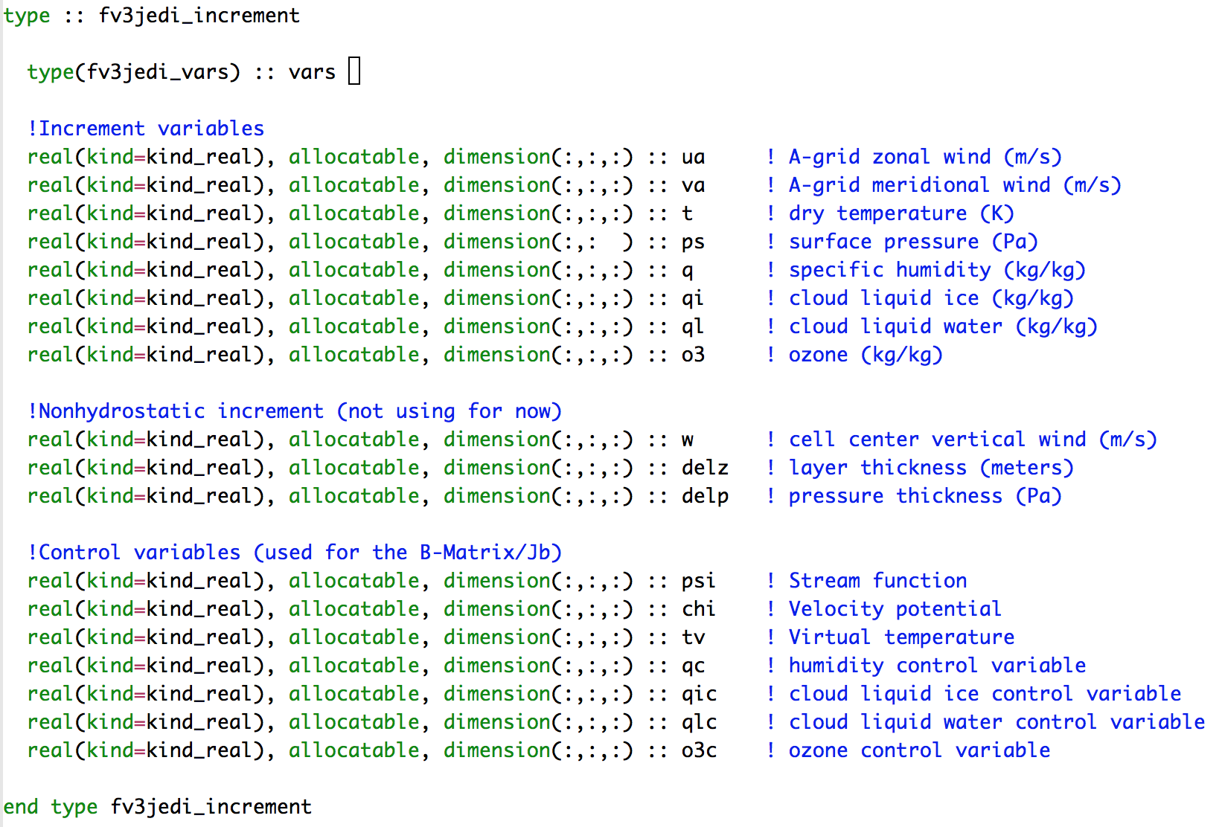
Increment: Fortran type
Increment variables that interact with M, M^{T}
Non-hydrostatic
Control variables

Slide 14
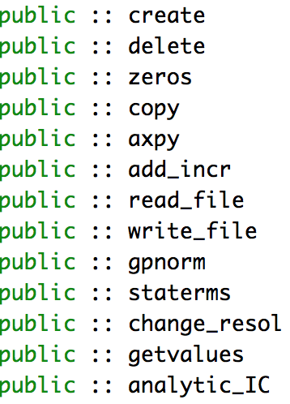
State and Increment: Methods
State
Increment

Slide 15
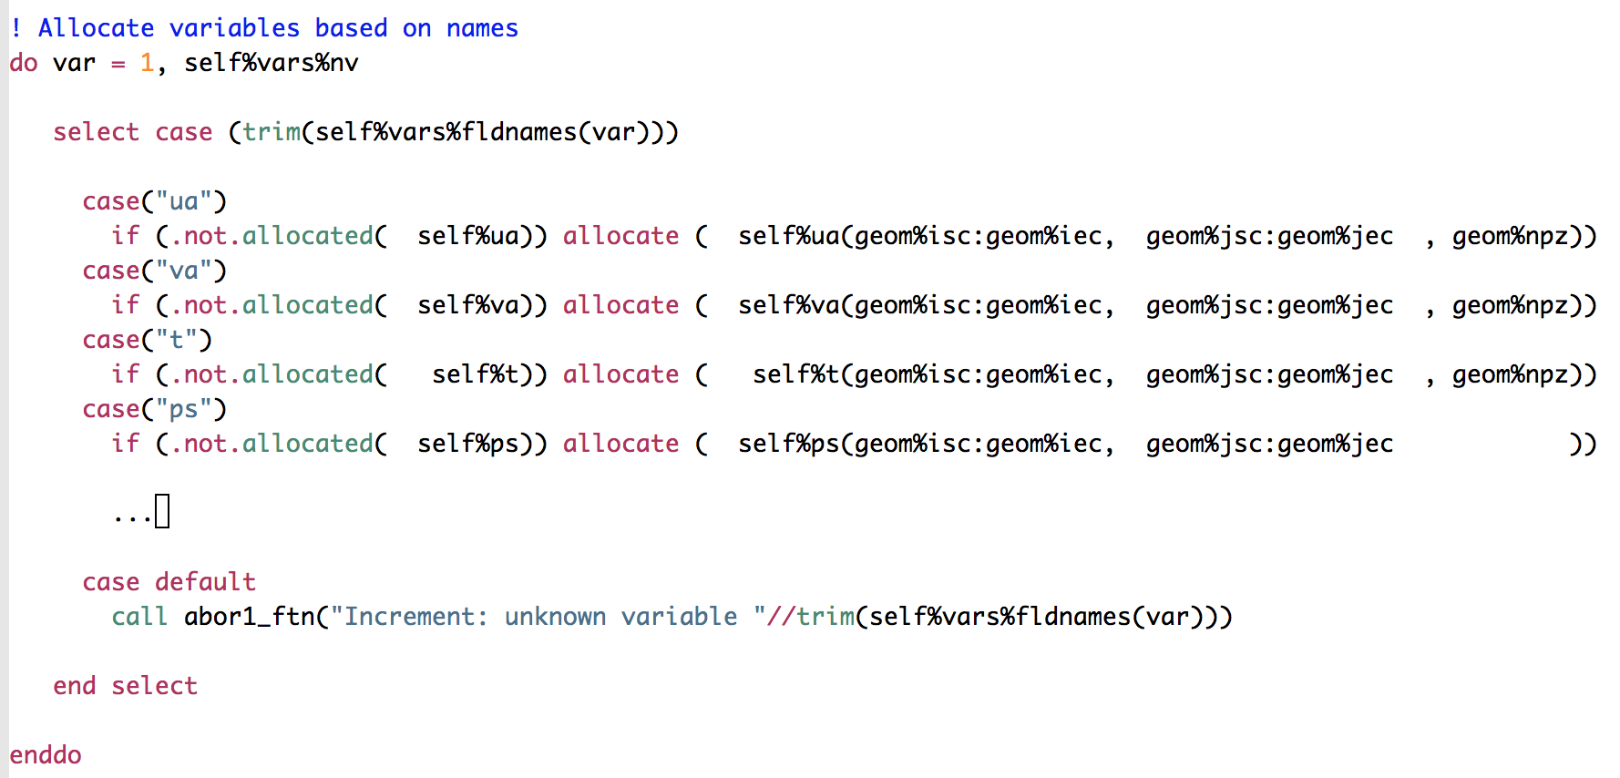
State and Increment: field allocation
The fields to be allocated are controlled from the configuration file.

Slide 16
State and Increment: field use
Fields are only acted upon if allocated.

Slide 17
Model Class
Data assimilation, and particularly 4D-Var, relies on strong interaction with the forecast model.
Outer loops.
Model trajectory.
H(x) where x is a 4D state.
Weak constraint.
The data assimilation knows the window length, when to call post processors, and what is needed from the model. The time stepping and driving of the model is therefore most naturally controlled from JEDI.

Slide 18
Outer Loop
Data assimilation outer loop
IAU
GEOMETRY
STATE
INCREMENTAL
DA
FORECAST
POST PROCESSORS
H(x)
INIT
STEP
FINALIZE
H trajectory
M trajectory
Constraints (DFI, Bias)
Create
Init
Run
Finalize
Variables passed using copy or pointer:
u, v, T, q, dp, q_{i}, q_{l}, o3, (q_{s}, q_{c}, w, dz) + traj

Slide 19
JEDI simplifies the forecast model
No data assimilation methods are needed in the forecast model. Development of interpolation adjoints, backwards running clocks and the conversion of increments to model state would no longer be needed in the forecast models. This separation of concerns would accelerate development for both DA and model developers.
No need to take into account the post-processor inside every forecast model or convert the model state to UFO/JEDI.
Little redesign of the model would be required to handle forecasting of multiple outer loops and no model infrastructure needed for inner loop integrations.

Slide 20
FV3-JEDI: three models with one interface
FV3-JEDI can be used to perform data assimilation for three different models: FV3-JEDI-LM, GEOS and GFS. We implement three nonlinear model classes with identical interfaces and compile only the model we want to run.
FV3-JEDI-LM is primarily the linearized model: the TLM and adjoint of FV3, convection, cloud and boundary layer turbulence. But provides other useful nonlinear functionality:
Run something realistic without access to GFS or GEOS.
Faster regression testing and continuous integration.
Checkpoint of code used to generate the TLM and adjoint versions.
CMake allows each implementation to only be compiled if the underlying model is found. If GOES or GFS is found those interfaces will be compiled, if not then FV3-JEDI-LM will be used for the nonlinear model.

Slide 21
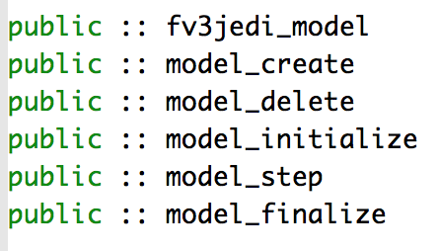
Model class (FV3-JEDI-LM)
Depending on the model the interaction between JEDI and the model can be quite minimal.
Methods to be implemented create, initialize, step and finalize the model.

Slide 22
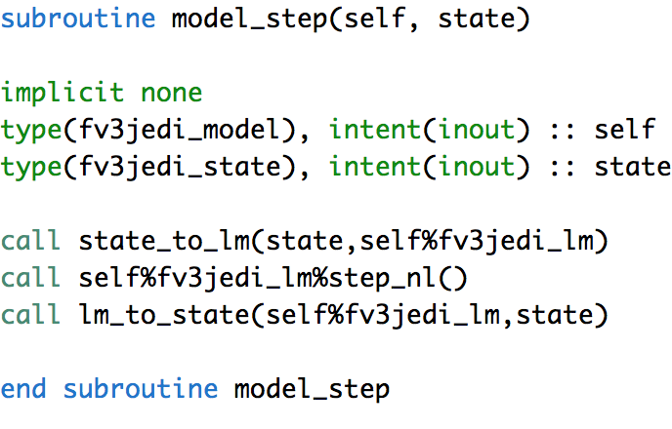
Model step
STATE
MODEL
MODEL STEP (EXTERNAL)
MODEL
STATE
TRAJ & PPs
Can be pointer or copy. Usually a copy to account for differences in precision

Slide 23
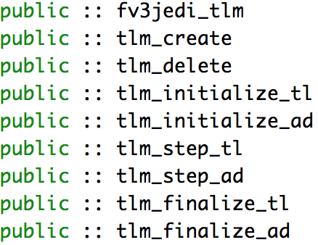
TLM class (FV3-JEDI-LM)
Per outer loop
CREATE
INIT_TL
FINALIZE_AD
STEP_TL
STEP_AD
Every call
FINALIZE_TL
INIT_AD
DELETE

Slide 24
GetValues
Get Values is the routine by which the model provides the GeoVaLs to the generic part of the observation operator (UFO).
It can be thought of as the grid dependent part of the observation operator – providing the variables called for by UFO at the locations of the observations.
The observations operators to be instantiated are chosen through the YAML, if getValues does not recognize the variable being asked for the system should abort.

Slide 25
OOPS – UFO – IODA – MODEL: the interface advantage
JEDI/UFO introduces standard interfaces between the model and observation worlds.
Observation operators are independent of the model, easy sharing, exchange and comparison.
Observation Locations
Observation space
MODEL
State & Increment
Variables
Observation operator
IODA
OOPS
Observation vector
GeoVals: State values at locations
UFO

Slide 26
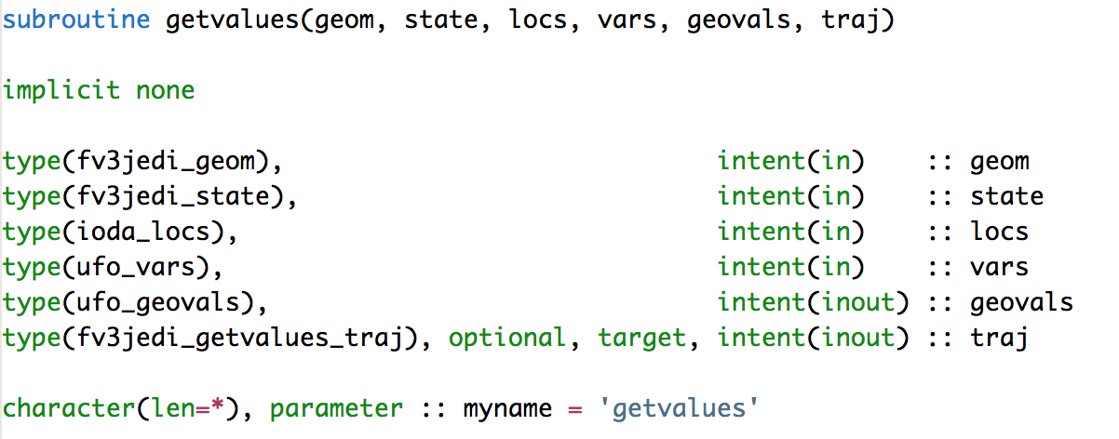
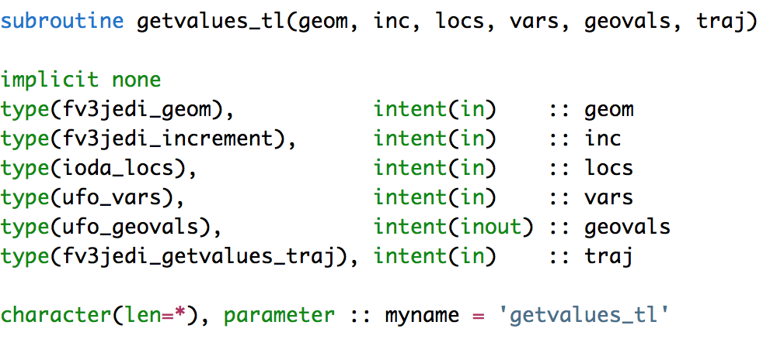
getValues: Fortran interfaces
Geometry
State/increment
Locations
Variables
Geo Values
Trajectory for TL/AD

Slide 27
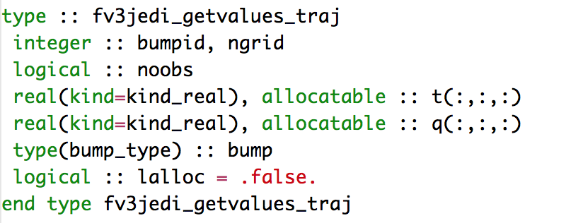
getValues: Trajectory
Interpolation weights.
State to linearize about for variable changes.

Slide 28
GetValues: algorithm
Compute weights for interpolation
Loop over UFO variables
Select case on variable
Convert variable and prepare interpolation
Loop over levels
Interpolate to locations
end (levels)
End (variables)

Slide 29
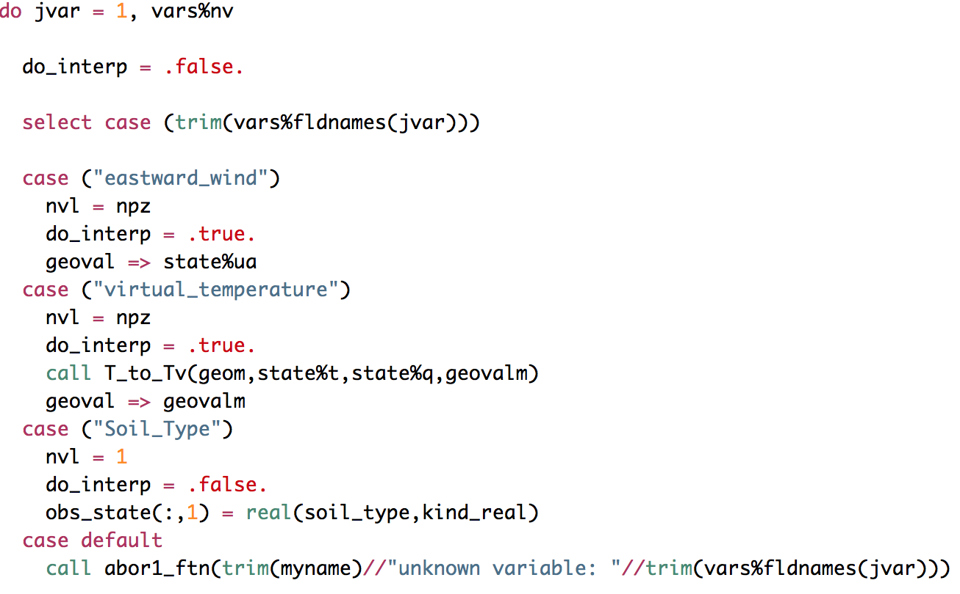
getValues: prepare state/increment variable
Loop over variables
Flag on whether to interpolate
Set number of levels for variable and interpolation flag.
Transform the variable if need be
Some variables use integration or aren’t float.
ABORT

Slide 30
getValues: allocate GeoVaLs
The model has to allocate the GeoVaLs since it knows the number of model levels.

Slide 31
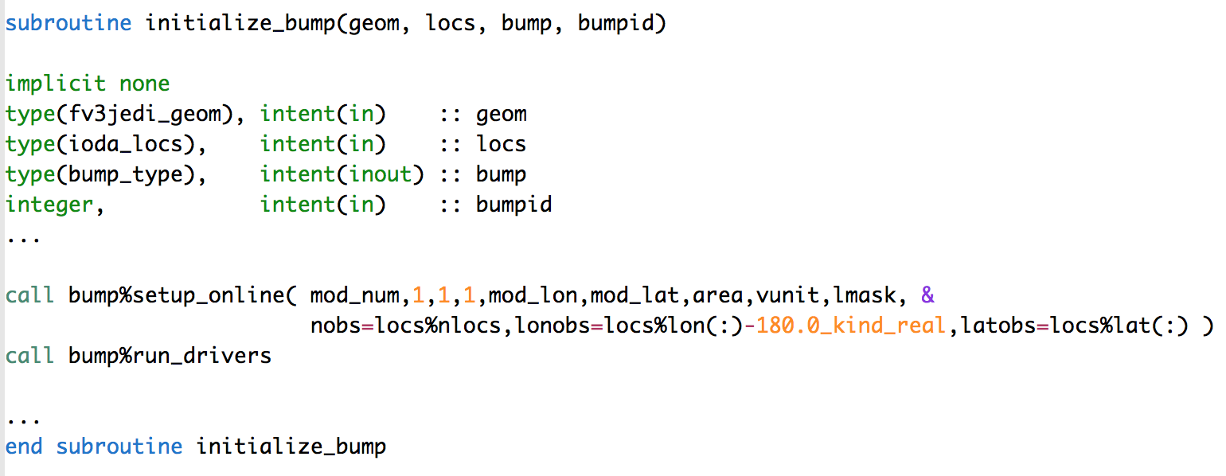
getValues: creating interpolation weights
Unstructured vector of model grid points.

Slide 32
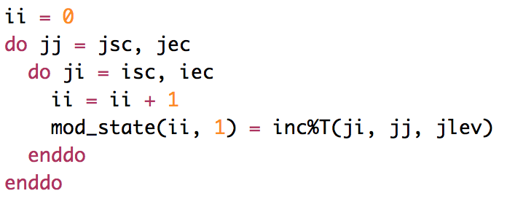
getValues: applying interpolation weights
Step 1: Convert to vector. Same structure as grid is organized when passed to BUMP setup.
Call BUMP
Fill up GeoVaLs with locations in current time bin.

Slide 33
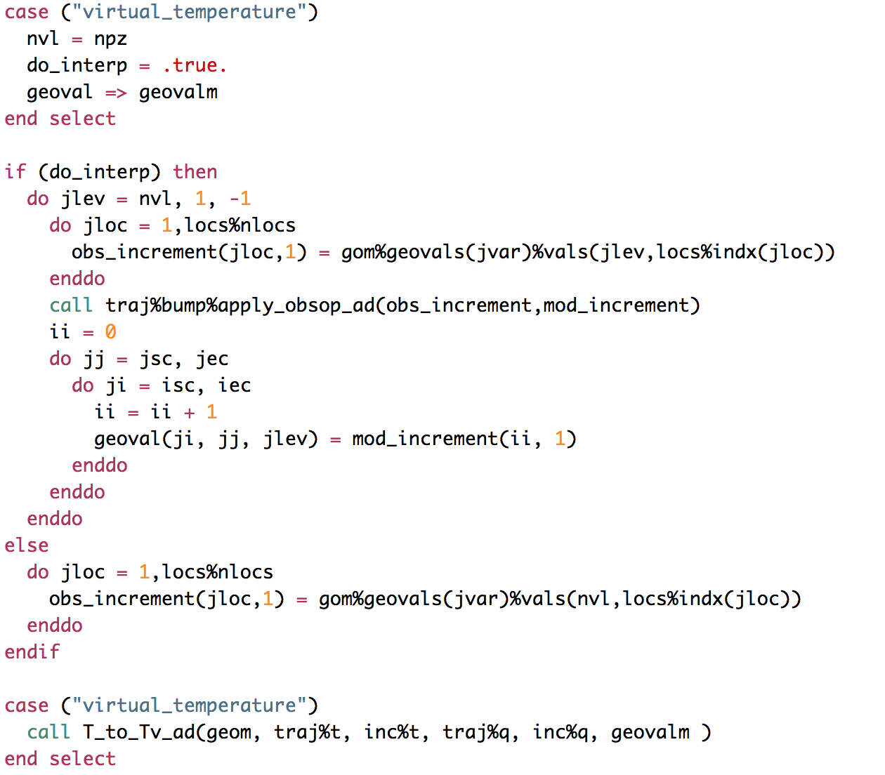
getValues: adjoint
1. Set pointer
2. Apply interpolation weights
3. Convert back to increment.

Slide 34
Guidelines for adding a new model interface
Do not try to start from scratch, instead make a copy of an existing model, FV3, QG or L95.
Rename everything to the match the model being added.
Remove everything in the Fortran routines and make sure things compile.
Gradually add things back in starting with geometry, fields then model and covariance.
Aim to be producing a simple forecast and then 3D-Var, then 4D h(x) etc etc.

Slide 35
Building
MODEL | BUNDLE | PLATFORMS RUN ON
FV3-JEDI | YES | AWS, Singularity, Docker, NASA Discover, NOAA Theia
SOCA (MOM-6 + CICE5) | YES | Singularity, Docker, NASA Discover, NOAA Theia.
MPAS | YES (NO MODEL) | UCAR Cheyenne, Singularity

Slide 36
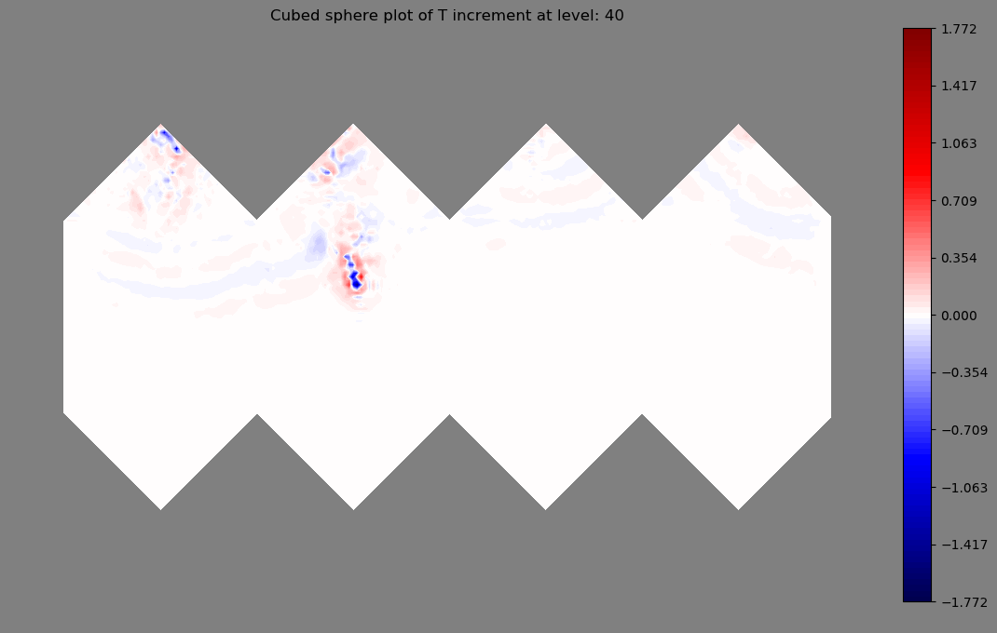
4D-Var with FV3 and AMSU-A
4D-Var on native cube-sphere grid
4D-Var run with satellite data, no adjustments
Use FV3 TL/AD from GMAO

Slide 37
Questions?

