Slide 1
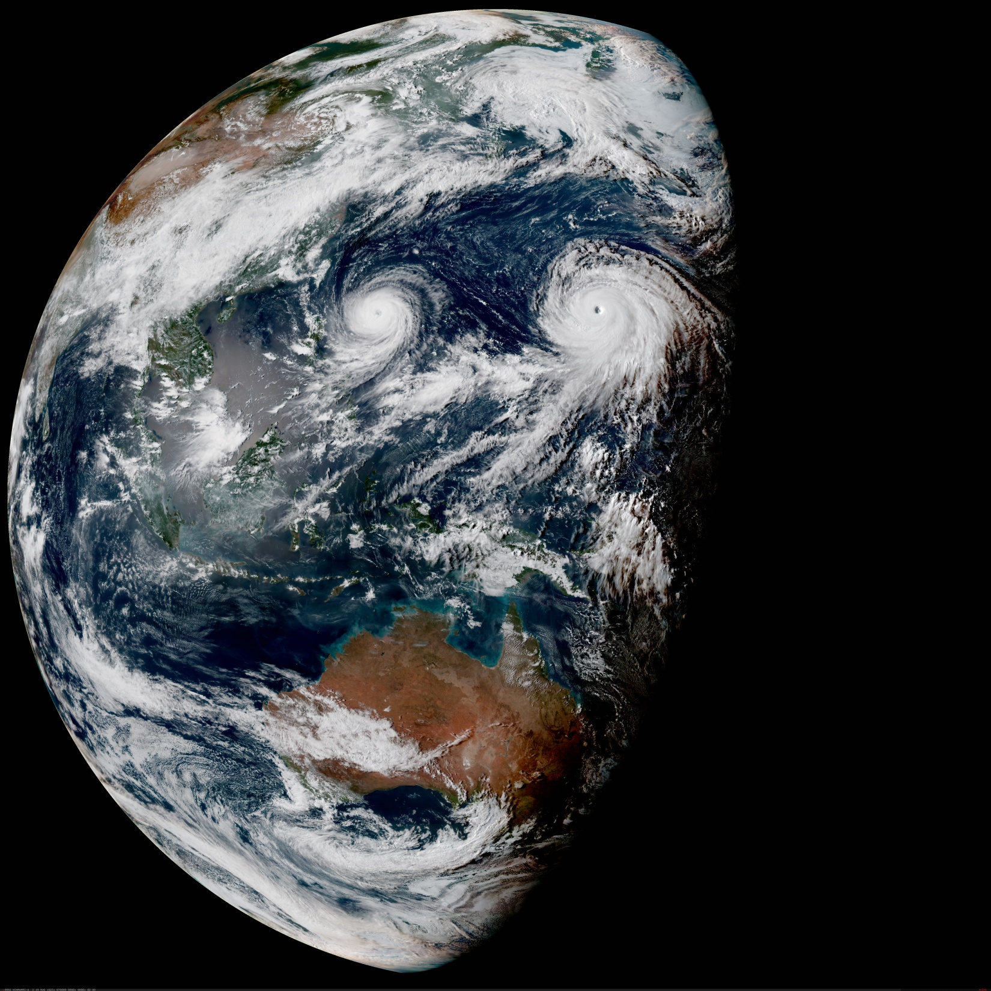
The Joint Effort for Data assimilation Integration (JEDI)
Observation Operators (UFO)
Joint Center for Satellite Data Assimilation (JCSDA)
JEDI Academy - 10-13 June 2019

Slide 2
Unified Forward Operator (UFO)
Share observation operators between JCSDA partners and reduce duplication of work
Taking the model agnostic approach one level down into the observation operators
Faster use of new observing platforms
Regular satellite missions are expensive
Cube-sat have short expected life time
Include users and instruments science teams
Unified Forward Operator (UFO)
Build a community app-store for observation operators

Slide 3
UFO contributors
Andrew Collard, Anna Shlyaeva, Ben Johnson, BJ Jung,
Cory Martin, Dan Holdaway, David Davies, David Rundle,
David Simonin, Emily Liu, Francois Vandenberghe,
Guillaume Vernieres, Hailing Zhang, Haixia Liu, Hamideh Ebrahimi,
Hui Shao, Hyun-Chul Lee, Jim Rosinski, JJ Guerrette, Li Bi,
Marek Wlasak, Mariusz Pagowski, Mark Miesch, Mark Olah,
Maryam Abdi-Oskouei, Ming Hu, Rahul Mahajan, Ricardo Todling,
Russ Treadon, Steve Herbener, Steve Vahl, Travis Sluka, Xin Zhang,
Yali Wu, Yannick Tremolet, Yanqiu Zhu

Slide 4
OOPS interfaces implemented in UFO
GeoVaLs
Locations
ObsOperator
LinearObsOperator
ObsFilter
ObsAuxControl
ObsAuxIncrement
ObsAuxCovariance
ObsOperator related classes, implemented once for all
ObsOperators
QC related classes
Bias correction related classes

Slide 5
Interpolated model state (GeoVaLs)
getValues
ObsOperator
State $x$
GeoVaLs
ObsVector $H(x)$
(model-aware part)
(model-agnostic part)
MODEL
Model (or grid)-aware part: horizontal interpolation of state variables that ObsOperator needs to compute $H(x)$.
Model-agnostic part: everything that ObsOperator needs to do after getting model fields interpolated to observation location.
UFO

Slide 6
Interpolated model state (GeoVaLs)
GeoVaLs are vertical profiles of requested model variables at observation x-y-t location. Forward operator defines which variables it needs from the model to compute H(x)).
Examples:
radiances: vertical profiles of t, q, ozone, pressure; surface variables: wind, SST, land properties, etc.
radiosondes/aircrafts: vertical profiles of pressure (to do vertical interpolation), t, u, v, q
sea ice concentration retrieval: sea ice concentrations for different ice thickness categories
SST retrieval: SST (observation operator becomes an identity in this case)

Slide 7
Currently implemented ObsOperators
Short description | Where in ufo | Name in the factory
Interface to CRTM | ufo/src/ufo/crtm | CRTM
Interface to CRTM AOD | ufo/src/ufo/crtm | Aod
Interface to RTTOV | ufo/src/ufo/rttov | RTTOV
Vertical interpolation in log-pressure (can be used for radiosondes, aircrafts, satwinds) | ufo/src/ufo/atmvertinterp | Radiosonde Aircraft Satwind
GNSSRO bending angle following GSI | ufo/src/ufo/gnssro/BndGSI | GnssroBndGSI
GNSSRO refractivity following GSI | ufo/src/ufo/gnssro/RefGSI | GnssroRef
GNSSRO bending angle ROPP1D | ufo/src/ufo/gnssro/BndROPP1D | GnssroBndROPP1D
GNSSRO bending angle ROPP2D | ufo/src/ufo/gnssro/BndROPP2D | GnssroBndROPP2D
“Identity” ObsOperator (horizontal interpolation) | ufo/src/ufo/identity | Surface SeaSurfaceTemp

Slide 8
ObsOperator Factory
ObsOperators are created at runtime using a factory class.
Which ObsOperators are created and used is determined by yaml file:
ObsTypes:
- ObsSpace: ...
ObsOperator:
name: CRTM # name in ObsOperator factory
...
- ObsSpace: ...
ObsOperator:
name: Radiosonde # name in ObsOperator factory

Slide 9
ObsOperator Factory
Names in ObsOperator factory are defined at the beginning of Obs<Operator>.cc file, for example in ufo/src/ufo/crtm/ObsRadianceCRTM.cc:
static ObsOperatorMaker<ObsRadianceCRTM> makerCRTM_("CRTM");
ObsTypes:
- ObsSpace: ...
ObsOperator:
name: CRTM # name in ObsOperator factory

Slide 10
ObsOperator interface (from OOPS)
template <typename MODEL>
class ObsOperator : public util::Printable,
private boost::noncopyable,
private util::ObjectCounter<ObsOperator<MODEL> > {
public:
ObsOperator(const ObsSpace_ &, const eckit::Configuration &);
~ObsOperator();
/// Obs Operator
void simulateObs(const GeoVaLs_ &, ObsVector_ &, const ObsAuxControl_ &) const;
/// Interfacing
const ObsOperator_ & obsoperator() const {return *oper_;}
/// Other
const Variables & variables() const; // Required inputs variables from Model
Locations_ locations(const util::DateTime &, const util::DateTime &) const;
private:
void print(std::ostream &) const;
boost::scoped_ptr<ObsOperator_> oper_;
};

Slide 11
ObsOperator::variables()
ObsOperator specifies list of variables that are requested from the model.
Sometimes it’s dependent on what needs to be simulated in the ObsOperator. In the example below, one would need air_temperature, eastward_wind and air_pressure (for interpolation) from the model:
ObsTypes:
- ObsSpace:
...
simulate:
variables: [air_temperature, eastward_wind]
ObsOperator:
name: Radiosonde

Slide 12
ObsOperator::locations()
ObsOperator specifies list of locations where it needs GeoVaLs (observation locations).
Currently all UFOs (except ROPP2D) use the same method (implemented once in ObsOperatorBase – no code duplication!) for creating a list of locations. This method queries ObsSpace about latitude, longitude and time of observations and fills in Locations class.

Slide 13
LinearObsOperators and Factory
LinearObsOperators are created at runtime using a factory class, like ObsOperators.
LinearObsOperators are created with the same name as ObsOperators and use the same yaml section for initialization:
ObsTypes:
- ObsSpace: ...
ObsOperator:
name: CRTM # name in ObsOperator and LinearObsOperator
# factories
...

Slide 14
LinearObsOperator interface
template <typename MODEL>
class LinearObsOperator : public util::Printable,
private boost::noncopyable,
private util::ObjectCounter<LinearObsOperator<MODEL> > {
public:
LinearObsOperator(const ObsSpace_ &, const eckit::Configuration &);
~LinearObsOperator();
/// Interfacing
const LinearObsOper_ & linearobsoperator() const {return *oper_;}
/// Obs Operators
void setTrajectory(const GeoVaLs_ &, const ObsAuxControl_ &);
void simulateObsTL(const GeoVaLs_ &, ObsVector_ &, const ObsAuxIncrement_ &) const;
void simulateObsAD(GeoVaLs_ &, const ObsVector_ &, ObsAuxIncrement_ &) const;
/// Other
const Variables & variables() const; // Required inputs variables from LinearModel
private:
void print(std::ostream &) const;
boost::scoped_ptr<LinearObsOperBase_> oper_;
};

Slide 15
LinearObsOperator::variables()
Similar to ObsOperator, LinearObsOperator specifies list of variables that are requested from the model for computing TL and AD.
Note: ObsOperator::variables can be different from LinearObsOperator::variables, for example:
Vertical interpolation ObsOperator:
ObsOperator requests air_temperature and air_pressure,
LinearObsOperator only updates air_temperature.
CRTM:
ObsOperator requests a lot of surface variables,
LinearObsOperator doesn’t update any of those

Slide 16
Other LinearObsOperator methods
LinearObsOperator::setTrajectory: calculates the Jacobian $H= {\left.\frac{∂H}{∂x}\right|}_{x=x_{0}}$
Input: GeoVaLs $x_{0}$ (variables specified in nonlinear obs operator)
LinearObsOperator::simulateObsTL
Input: GeoVaLs $dx$ (variables specified in TL/AD)
Output: ObsVector $Hdx$
LinearObsOperator::simulateObsAD
Input: ObsVector $dy$
Output: GeoVals $H^{T}dy$ (variables specified in TL/AD)

