Slide 1
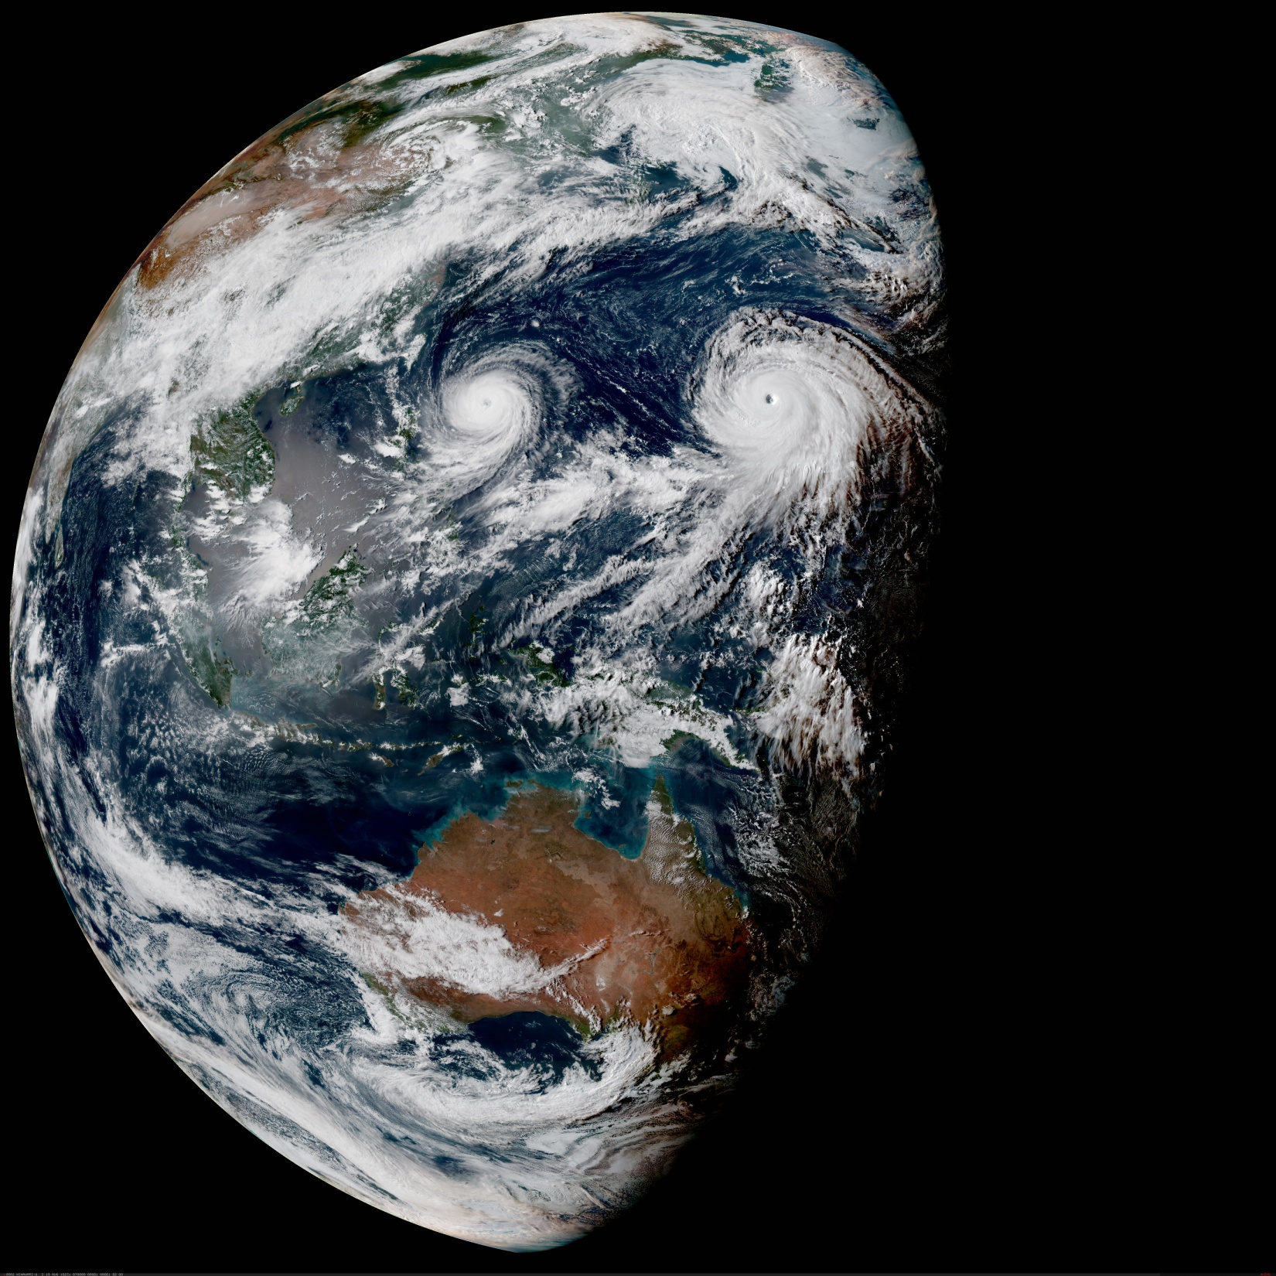
The Joint Effort for Data assimilation Integration (JEDI)
From Objectives to Code Design
Joint Center for Satellite Data Assimilation (JCSDA)
JEDI Academy - 10-13 June 2019

Slide 2
JEDI: Motivations and Objectives
Develop a unified data assimilation system:
From toy models to Earth system coupled models
Unified observation (forward) operators (UFO)
For research and operations (including O2R2O)
Share as much as possible without imposing one approach (one system, multiple methodologies/configurations)
Objective of this talk: How is such a system designed?

Slide 3
Basic Building Blocks

Slide 4
OOPS Analysis and Design
What is data assimilation?
Data assimilation is finding the best estimate (analysis) of the state of a system given a previous estimate of the state (background) and recent observations of the system.
States properties:
Input, output (raw or post-processed).
Move forward in time (using the model).
Copy, assign.
Observations properties:
Input, output.
Simulate observation given a state (observation operator).
Copy, assign.
No need to know how operations are performed, or how states or observations are represented and stored.

Slide 5
OOPS Analysis and Design
Example: variational data assimilation
The 4D-Var problem, and the algorithm to solve it, can be described with a very limited number of entities:
Vectors: x, y, d=y-H(x) g=▽J and δx.
Covariance matrices: B, R (and possibly Q).
Two operators and their linearized counterparts M, M, M^{T}, H, H, H^{T}.

Slide 6
OOPS Analysis and Design
Increments:
Basic linear algebra operators,
Evolve forward in time linearly and backwards with adjoint.
Compute as difference between states, add to state.
Departures:
Basic linear algebra operators,
Compute as difference between observations, add to observations,
Compute linear variations in observation equivalent as a result of variations of the state (linearized observation operator).
Output (for diagnostics).
Covariance matrices:
Setup,
Multiply by matrix (and possibly its inverse).

Slide 7
OOPS Analysis and Design
All data assimilation methods require the same limited number of entities.
For future (unknown) developments these entities should be easily reusable.
These entities are the basic (abstract) classes that define the system.
No details about how any of the operations are performed, how data is stored or what the model represents: separation of concerns.

Slide 8
OOPS Analysis and Design
OOPS is independent of the underlying model and physical system.
Flexibility (including yet unknown future development) requires that this goes both ways.
The components do not know about the high level algorithm being run:
All actions driven by the top level code,
All data, input and output, passed by arguments.
Interfaces must be general enough to cater for all cases, and detailed enough to be able to perform the required actions.

Slide 9
Abstract interface example
Abstract Model class public interface:
class Model : public util::Printable {
public:
Model(const Geometry_ &, const eckit::Configuration &);
virtual ~Model();
// Run the forecast
void forecast(State_ &, const ModelAux_ &,
const util::Duration &, PostProcessor<State_> &) const;
// Information and diagnostics
const util::Duration & timeResolution() const;
const oops::Variables & variables() const;
};

Slide 10
Separation of Concerns
Abstract Layer - OOPS
Forecast
4D-Var
EnKF
PF
…
Generic
Applications
Uses
State
Model
Covariance
Observations
Abstract building blocks
Implements
Lorenz
FV3 + GSI
MOM6
…
Systems
Abstract interfaces are the most important aspect of the design

Slide 11
Separation of concerns
OOPS is independent of the underlying model and physical system.
Components exist independently of the algorithm driving them.
Interfaces are the most important aspect. They enforce the separation of concerns and are designed first.
OOPS stops at the level of the calls to the forecast model but the same principle could be applied at any level (for example UFO).

Slide 12
Unified Forward Operator (UFO)
Same separation of concerns principles that lead to the design the rest of OOPS
Obs. Locations
Variables
State
Obs. Operators
Observations
Field Values
at Locations
JEDI/UFO introduces standard interfaces between models and observations
Observation operators are independent of the model and can easily be shared, exchanged, compared

Slide 13
Data Assimilation Algorithms

Slide 14
Cost Function Design
Naive approach:
One object for each term of the cost function.
Compute each term (or gradient) and add them together.
Problem: The model is run several times (Jo, Jc, Jq)
Another naive approach:
Run the model once and store the full 4D state.
Compute each term (or gradient) and add them together.
Problem: The full 4D state is too big (for operational use).
A feasible approach:
Run the model once.
Compute each term (gradient) as the model is running.
Add all the terms together.

Slide 15
Cost Function Implementation
One class for each term (more flexible).
Call a method on each object on the fly while the model is running.
Uses the PostProcessor structure.
Finalize each term and add the terms together at the end.
Saving the model linearization trajectory is also handled by a PostProcessor.
Each formulation derives from an abstract CostFunction base class.
Code duplication: it was decided to keep 3D-Var and 4D-Var for readability.
The terms can be re-used (or not), 4D-En-Var was added in a few hours.
OO is not magic and will not solve scientific questions by itself.
Scientific questions (localization) remain but scientific work can start.
Weeks of work would have been necessary in traditional systems.

Slide 16
Post Processors
PostProcessors are called regularly during model integration
The presence or not of post processing does not affect the forecast
PostProcessors isolate the model code from many other unrelated aspects (separation of concerns)
Examples:
Output of forecast fields
Generation of products for users
Computation of filtered state (for DFI)
Generation of trajectory for linearized models
Generation of simulated observations
Diagnostics
…

Slide 17
Post Processors
template<typename MODEL>
void Model<MODEL>::forecast(State_ & xx, const ModelAux_ & maux,
const util::Duration & len,
PostProcessor<State_> & post) const {
const util::DateTime end(xx.validTime() + len);
Log::info() << "Model:forecast: forecast starting: " << xx << std::endl;
this->initialize(xx);
post.initialize(xx, end, model_->timeResolution());
post.process(xx);
while (xx.validTime() < end) {
this->step(xx, maux);
post.process(xx);
}
post.finalize(xx);
this->finalize(xx);
Log::info() << "Model:forecast: forecast finished: " << xx << std::endl;
}

Slide 18
Observers
Observer is a PostProcessor that simulates observations:
At each step, GeoVaLs are populated from the State
In the finalization, simulated observations are generated from GeoVaLs
The observation filters are applied
template <typename MODEL>
void Observer<MODEL>::doFinalize() {
Log::trace() << "Observer::doFinalize start" << std::endl;
filters_->priorFilter(*gvals_);
hop_.simulateObs(*gvals_, yobs_, ybias_);
filters_->postFilter(yobs_);
Log::trace() << "Observer::doFinalize done" << std::endl;
}

Slide 19
Observations Processing Flow
CostFunction::evaluate
CostJo::initialize
ObsFilters::ObsFilters
Observer::Observer
ObsOperator::variables
ObsFilters::requiredGeoVaLs
CostFunction::runNL
Model::forecast
Observer::initialize
GeoVaLs::GeoVaLs
loop over time steps
Observer::process
State::getValues
end loop over time steps
Observer::finalize
ObsFilters::priorFilter
ObsOperator::simulateObs
ObsFilters::postFilter
CostJo::finalize
ObsErrors::ObsErrors
ydep=ysimul-yobs
Create and configure filters
Create and configure observer
Gather list of required GeoVaLs
Create GeoVaLs
Fill GeoVaLs
Call prior filters
Simulate observations
Call post filters
Setup R, compute Jo

Slide 20
From Abstract to Concrete

Slide 21
Interface classes
All model or observation specific classes are wrapped into an interface class
Using the C++ templates this is not strictly necessary but provides a convenient place to group all interfaces and make them visible
Each interface class contains a (smart) pointer to the actual implementation in the “model trait” and passes calls down
The interface layer is also used to instrument the code
Timing statistics
Trace execution
Interface classes are all in oops/src/oops/interface

Slide 22
Interface classes
Example of a method in an interface class:
template<typename MODEL>
void State<MODEL>::getValues(const Locations_ & locs,
const Variables & vars,
GeoVaLs_ & gvals) const {
Log::trace() << "State<MODEL>::getValues starting" << std::endl;
util::Timer timer(classname(), "getValues");
state_->getValues(locs.locations(), vars, gvals.geovals());
Log::trace() << "State<MODEL>::getValues done" << std::endl;
}
Trace method on
entry and exit
Timer will be destructed
when going out of scope
Constructor and
destructor do the work
Method of specific implementation is called, with actual arguments

Slide 23
Top Level Code

Slide 24
JEDI: Main Programs
All JEDI/OOPS applications have exactly one argument
Which is a yaml (or json) configuration file
Standard C++ main
Run object for technical setup: read yaml configuration, start MPI, start loggers…
int main(int argc, char ** argv) {
oops::Run run(argc, argv);
oops::Variational<qg::QgTraits> var;
run.execute(var);
return 0;
}
Create Application object:
This is where the model is
determined
Execute Application

Slide 25
JEDI: Applications
The Application for variational DA is in
src/oops/runs/Variational.h
The Variational class inherits from Application (it is an application)
Applications are the normal mode of execution
Unit tests are specific applications that run tests for a given class
The main program manages tests and adds test reporting
This is hidden for most users and developers

