Slide 1
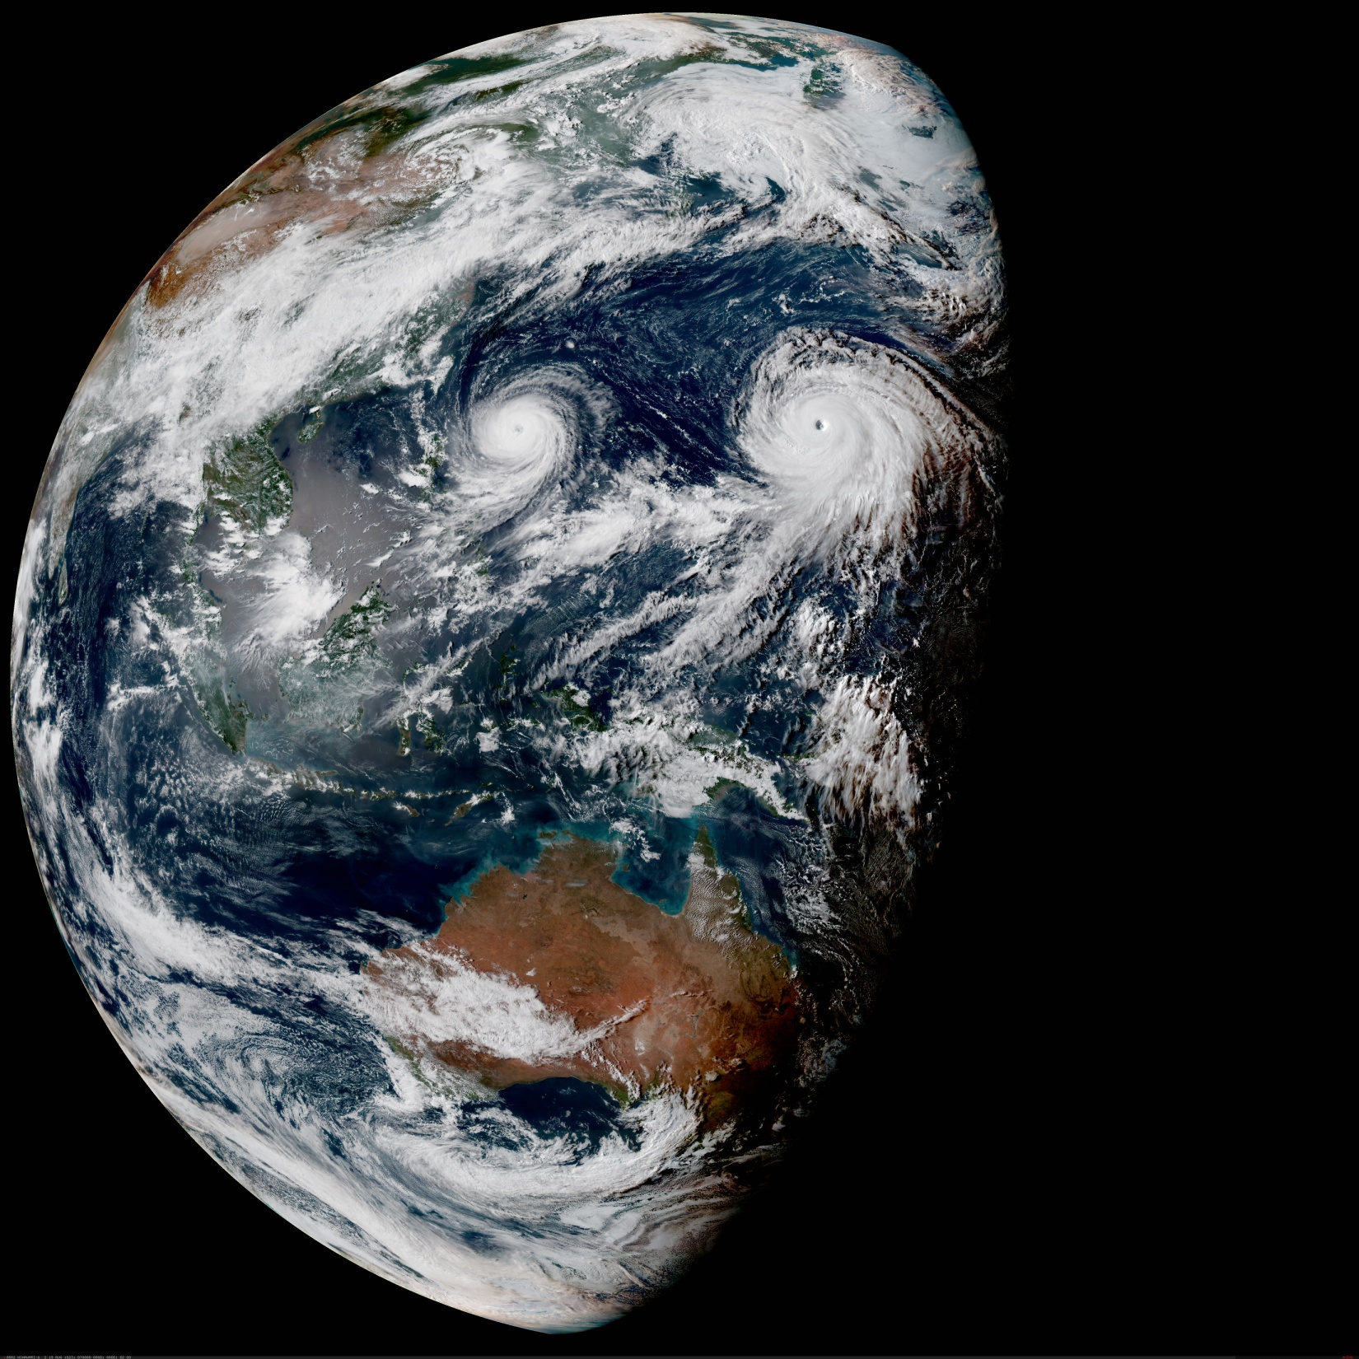
The Joint Effort for Data assimilation Integration (JEDI)
Interface for Observation Data Access
(IODA) Subsystem
Joint Center for Satellite Data Assimilation (JCSDA)
JEDI Academy – 16-20 November 2020

Slide 2
JEDI Overview
FV3 (GFS+GOES)
(NOAA/NASA)
A Next-Generation Unified
DA System
(credit: M. Miesch)
Radiosondes
Enables high leverage
MPAS
(NCAR)
Radiance
(AMSU-A, …)
For example, add your model
IODA
NEPTUNE
(NRL)
Aircraft
Then you have access to:
Obs data
Forward operators
DA flows
Etc.
LFRic
(UKMO)
Aerosols
(AOD)
OOPS
SABER (BUMP)
UFO
CRTM
IODA
MOM6
(JCSDA/NOAA)
Sea Ice
(fraction, thickness)
…
…

Slide 3
Interface for Observation Data Access (IODA)
UFO/JEDI requires access to observation data
Separation of concerns: isolate science from data storage
Three levels:
Long term storage (historic database, R2D2)
Files on disk (one DA cycle)
In memory handling of observations
Two environments:
Plotting, analyzing, verifying on workstation
DA and other HPC applications (MPI, threads, GPUs…)

Slide 4
Observation Data Handling
Large
Small
Slow
Fast
Tape | Disk | SSD | NVRAM | RAM | Cache | Register
Some OSs
Compiler
MARS + FDB
Ideally, we want uniform and easy access to observation data
Can we hide the complexity of the memory hierarchy from scientists (separation of concerns)?
Files could become irrelevant in the future

Slide 5
Observation Data Flow with IODA
Plots
Diagnostics
Monitoring
GTS
Network
Decoding
IODA
DA
Pre-processing
One observation data handling interface across the whole NWP chain

Slide 6
Access to Observations
H(x_{a})
Uniform view and interface for observation data access
Interface for Observation Data Access based on this abstract view
Abstract representation, not necessarily actual storage structure
Locations
H(x_{b})
QC flags
Obs. Error
Obs. Value
Latitude
Longitude
Height
DateTime
Station ID
…
T U V Q …
Group by
- flight
- ascent
- station
...
Ch1 Ch2 Ch3 Ch4 Ch5 …
Obs. type
Experiment Id
…
Channel frequencies
…
Variables

Slide 7
Variable Naming
IODA schematic consists of tables containing variables
The names of the tables are referred to as Groups
ObsValue, ObsError, PreQC, HofX, MetaDat, etc.
A specific variable is denoted by a group name plus a variable name
Two styles of specifying these pairs
Group, Variable
Variable@Group
JCSDA OBS project is working on defining a consistent naming convention
Group, Variable | Variable@Group
MetaData, latitude | latitude@MetaData
ObsValue, air_temperature | air_temperature@ObsValue
HofX, brightness_temperature | brightness_temperature@HofX

Slide 8
IODA Requirements
Requirement | IODA Status
Flexible | Currently handles conventional, radiance, chemisty, GNSSRO, GSI, land, and marine obs types
Access to data and meta data | Providing support for ~20 filter operations (constructed from generic filter ops in UFO), plus support for obs operators for the ~30 obs types
Efficient I/O | Running larger DA runs using 10s of millions of observations
Efficient compression | This is work in progress, compression is adequate but not
Portable | GNU, Intel and Clang compilers; OpenMPI, MPICH2, IMPI MPI implementations Running on supercomputers (Hera, Discover, Cheyenne, S4), AWS EC2 instances, and on laptops (mac, linux)
Security | Installation/execution can be done behind firewalls. NRL is successfully operating in the mode
Support analysis | Have capability to write netcdf giving access to a variety of diagnostic tools
Data import | Currently handle Netcdf, BUFR, GRIB, Marine binary profile and text file types, from various sources including GSI, NCEP, METAR, GODAS and GODAE
Ease of use | Simple interface (get, put) for direct access by obs operators, and access via obs vectors
Reliability | Running larger DA runs using 10s of millions of observations
Replicate existing functionality | GSI conversion path includes extraction of H(x) and filtering results from GSI runs for comparison with JEDI results, all obs assimilated by GSI have been converted for use in JEDI

Slide 9
Current state of IODA
ioda-converters
ioda
NCEP
(BUFR)
bufr2ioda
File Interface
(IodaIO)
GODAE
(Binary)
Archive, File
(IODA)
profile2ioda
Met Office
(ODB)
Memory
(ObsSpace)
odb2ioda
…
Diagnostics
…

Slide 10
Objects related to observations
Variational minimization:
$$J\left(∆x\right)=\frac{1}{2}{∆x}^{T}B^{−1}∆x+ \frac{1}{2}{\left(y_{o}−H\left(x_{b}+∆x\right)\right)}^{T}R^{−1}\left(y_{o}−H(x_{b}+∆x) \right)$$
Kalman filter:
${∆x}_{a}=BH^{T}{\left(HBH^{T}+R\right)}^{−1}$ $\left(y_{o}−H(x_{b})\right)$
Observation vectors: $y_{o}$, $H\left(x_{b}\right), H\left(x_{b}+∆x\right)$, ($y_{o}−H\left(x_{b}+∆x\right)),\left(y_{o}−H(x_{b})\right)$ terms
Observation space: collection of observation vectors

Slide 11
IODA Implements the ObsSpace Interface
Abstract Layer (OOPS)
Generic
applications
Forecast
3DVar
4DVar
EDA
EnKF
…
Uses
Interface layer
State
Model
Covariance
…
Obs Operator
Obs Space
Implements
Specific implementations
FV3
MOM6
MPAS
…
SABER
UFO
IODA

Slide 12
IODA-OOPS C++ Class Relationship
OOPS provides an abstract interface layer
Templated classes
Allows multiple implementations of underlying concrete classes
IODA provides concrete classes that implement two of the OOPS interface classes
ObsVector
Holds quantities such as y and H(x)
ObsSpace
Analogous to a mathematical space that contains vectors
Provides an interface to observation data stored in files

Slide 13
IODA Class Structure
OOPS
OOPS
ObsSpaces<MODEL>
spaces_[]
…
ObsVector<MODEL>
ObsSpace<MODEL>
data_
obsdb_
IODA
ObsVector
…
ObsSpace
obsdb_
values_
database_
Obs Vector Data
Obs Database

Slide 14
Multiple Observation Spaces and Vectors
The total observation vector (e.g., y) is chopped up into pieces according to observation type
Different observation types require different algorithms to simulate those observations
Radiosonde
Radiance
AOD
UFO holds ObsOperator objects that implement the various observation simulation algorithms
OOPS manages these pieces with Observations, ObsSpaces and ObsOperators collector classes
Corresponding ObsOperator and ObsVector objects get paired up and OOPS chains these pieces together for the cost function minimization step

Slide 15
IODA Data Flow
y
H(x)
x
Observer
OOPS
UFO
IODA
Observations
Observations
ObsOperators
ObsVector
ObsVector
ObsOperator
ObsVector
ObsVector
ObsOperator
Obs Data
ObsSpace

Slide 16
Interface for Observation Data Access
The IODA API is used to access data:
C++
std::vector<double> lats;
obspace.get_db("MetaData", "latitude", lats);
std::vector<float> viewing_angle;
obspace.get_db("MetaData", "sensor_view_angle", viewing_angle);
nlocs = obsspace_get_nlocs(obsdb)
allocate(obsValue(nlocs))
call obsspace_get_db(obsdb, "ObsValue", "bending_angle", obsValue)
allocate(obselev(nlocs))
call obsspace_get_db(obsdb, "MetaData", "station_elevation", obselev)
Fortran
The API is independent of the file format or internal structure
All applications (including plotting and diagnostics) should be based on this API

Slide 17
YAML: ObsSpace Initialization
Two methods of initialization
Read from IODA file (for operations or testing)
Algorithmically generate (for OSSE)
Use variational cost function as example
$$J\left(∆x\right)=\frac{1}{2}{∆x}^{T}B^{−1}∆x+ \frac{1}{2}{\left(y_{o}−H\left(x_{b}+∆x\right)\right)}^{T}R^{−1}\left(y_{o}−H(x_{b}+∆x) \right)$$
← J_{o}

Slide 18
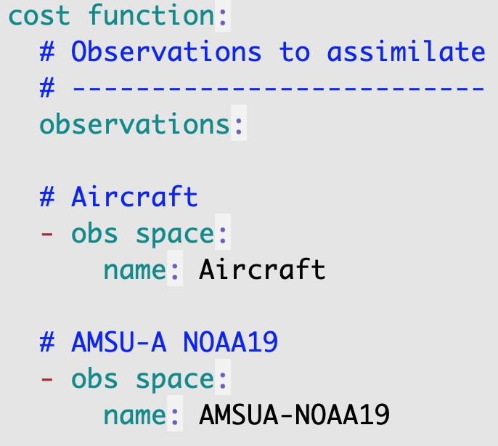
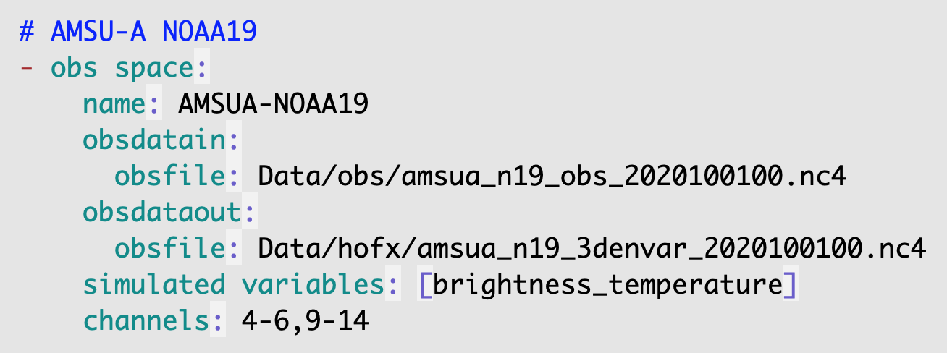
YAML: ObsSpace initialization from file
obsdataout is optional
Flexible channel selection (single, range)
List of ObsSpaces by obs type

Slide 19
YAML: Observation grouping, sorting
Grouping is for keeping a set of observations ”atomic”
Groups stay intact during distribution of observations across MPI tasks
Example: A single radiosonde profile
Sorting applies to each group
Useful for filters such as those based on gradients
Example: Remove radiosonde obs that exhibits too great a change from
its neighbors

Slide 20
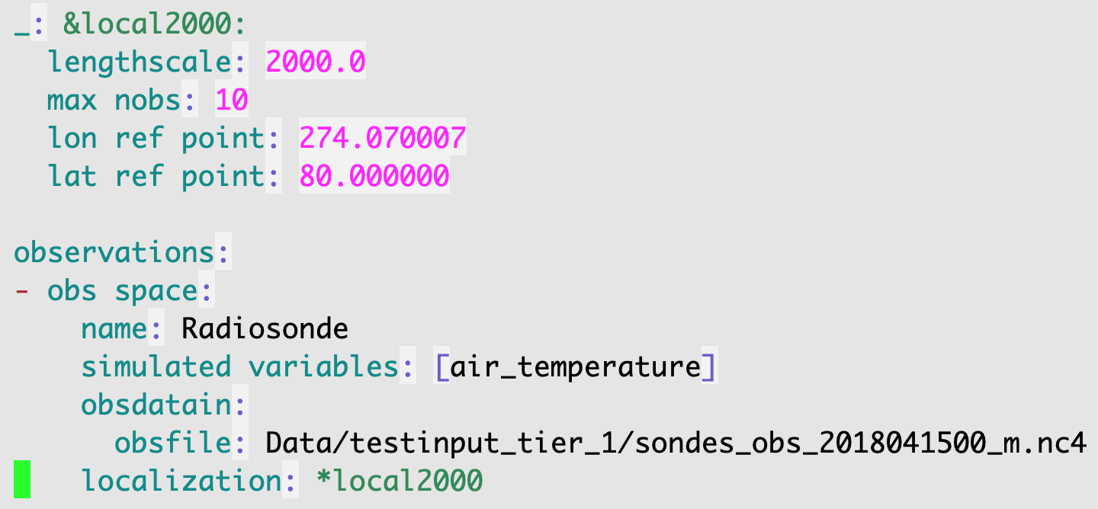
YAML: Observation localization
Used for LETKF applications
Create a subset of obs based on proximity to a given location
Example shows “repeated block” syntax in YAML

Slide 21
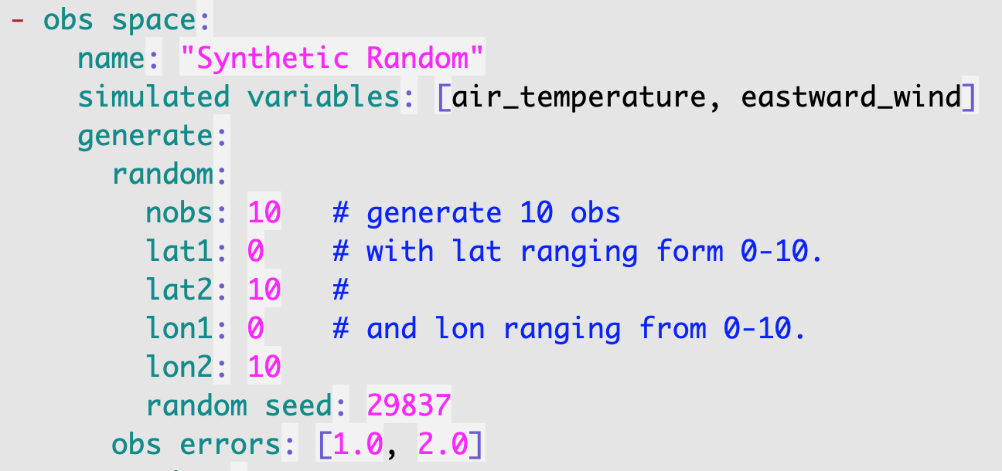
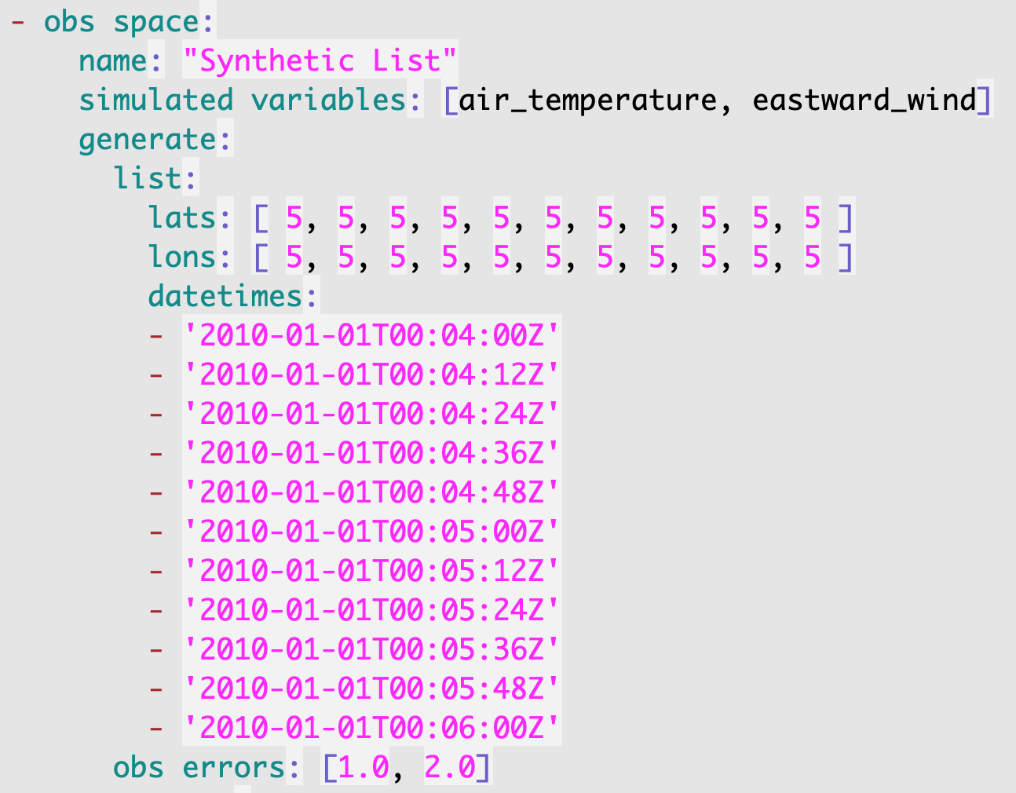
YAML: ObsSpace algorithmic initialization
Random values within specified ranges
Copy directly from configuration
Useful for OSSE
Quickly throw together a small set of observations
No IODA file required
Examples show configuration for H(x) application that auto-generates obs values
Will soon be adding a feature that allows the specification of the complete ObsSpace in YAML

Slide 22
IODA Converters
Obs category | Language | Input file type | Obs types
Chemistry | Python | Netcdf | VIIRS AOD, TROPOMI
Conventional | Python | Netcdf, text | Aircraft, Radiosonde, METAR
GNSSRO | Fortran | BUFR | GNSSRO
GSI | Python | Ncdiag | Conventional, Radiance (all types handled by GSI)
Land | Python | GRIB | IMS surface
GODAS, GODAE Marine | Python | Netcdf, Binary | ArgoClim2, SST, Profile, Ship, Trak, ADT, In-situ, SSS
NCEP Marine | Python | BUFR | Ship, buoy, SST, etc
NCEP Radiance | C++, Fortran | BUFR | Radiance (MHS, AMSU-A), Available soon

Slide 23
IODA Observations Types (so far)
Conventional Observation Types | Radiance Observation Types
Aircraft | AMSU-A | SBUV-2
Radiosonde | ABI | VIIRS AOD
Radar | AHI | Cryosat
Sfc | AIRS | ICEC
SfcShip | ATMS | SEVERI
VAD wind | CRIS | SNDR
Wind profiler | GNSSRO | Satwind
Marine insitu temp | HIRS-4 | Scatwind
Marine profiler | IASI | SMAP
Marine SST | MHS | Marine SST

Slide 24
Conclusion
IODA is currently handling ~30 obs types, with 10’s of millions of observations being assimilated
Goal of having a single observation handling interface across the NWP chain is progressing well
At this point, IODA is handling the different aspects of the NWP chain with no known roadblocks
We will soon be introducing a new implementation of IODA that will enable:
Continued performance and capacity enhancement
Efficient multi-dimensioned variable handling (eg. locations X channels)
Test features such as specifying the entire contents of an ObsSpace in the configuration YAML file

