Slide 1


JEDI and C++
Ryan Honeyager
honeyage@ucar.edu
June 23, 2021

Slide 2
Why Use C++?
We want JEDI to provide an abstract interface layer that separates the state, model, covariances, observation operators, et cetera from their specific implementations.
We want to take advantage of many new libraries and capabilities that are available in other languages.
We want to write fast code that can be implemented in an operational context.

Slide 3
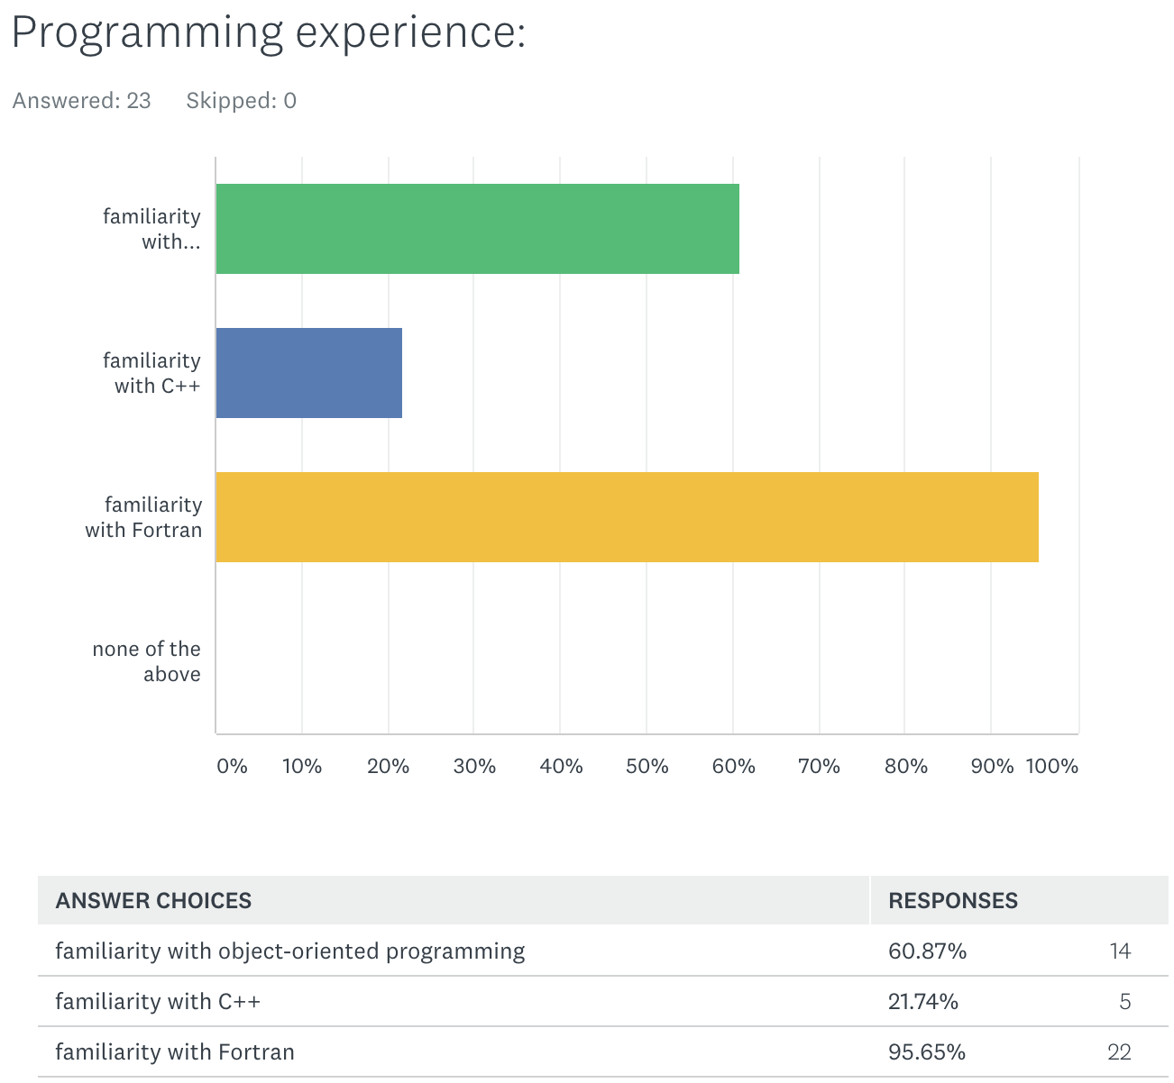
Survey Results

Slide 4
C++ Resources
Tutorials (easier):
http://www.cplusplus.com/doc/tutorial/
https://www.geeksforgeeks.org/
How to write good, modern C++ (moderate):
https://isocpp.github.io/CppCoreGuidelines/CppCoreGuidelines
http://www.stroustrup.com/resource-model.pdf
C++ reference (technical):
https://en.cppreference.com/
Libraries:
https://www.boost.org/
http://eigen.tuxfamily.org/

Slide 5
A Really Terse Development of Programming
In the beginning, there were calculators. They had a few logic gates and maybe a register or two of memory.
1948 – First assembler. Used one-letter mnemonics in place of binary instructions.
1954 – First FORTRAN. 95% reduction in code length vs assembly languages.
  Fortran 66 supported program units (SUBROUTINE, FUNCTION), several data types, library functions, flow control, comments, basic I/O, go-tos, and variable names up to 6 characters in length.

Slide 6
A Really Terse Development of Programming
1972 – First release of C, based on B and BCPL.
1979 – K&R C “standard”, and 1989/1990 – ANSI C standard
Convergent development with Fortran – many similar features.
Differences from Fortran:
  C extensively uses memory pointers.
  C can pass data by value, reference or by pointer.
  C frequently relies on a simple macro pre-processing language.
  Different array indices.
  C-Fortran data structure compatibility is still being standardized.

Slide 7
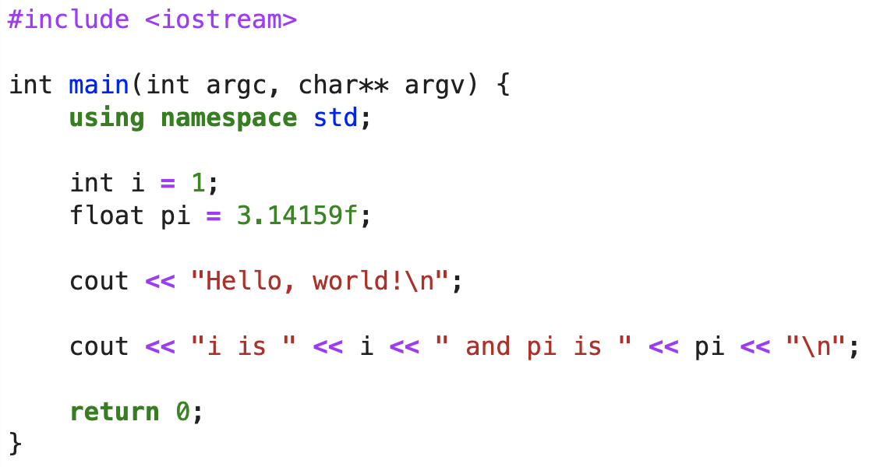
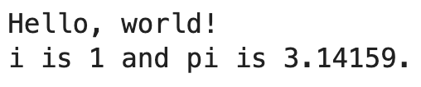
Hello, World!

Slide 8
Anatomy of a Function
Return type (if there is one). Otherwise, use type void.
The function name is followed by parentheses which enclose any input values required by the function when it executes. Each value needs a type and a name.
int custom_function(int num_values, const int* values)
{
int retval = 1;
size_t i;
if (!num_values) return 0;
for (i=0; i<num_values; ++i) {
retval *= values[i];
}
return retval;
}
Variables
A pointer to a memory region containing zero or more integers. “values” is declared “const”, which means that it will not be modified by the function.
Body is enclosed in curly braces.

Slide 9
C++ Namespaces and Scoping
Functions and variables can be grouped under a scope (a logical group).
namespace oops
{
void doSomething();
int doSomethingElse();
int someNumber;
namespace dates {
int getCurrentMonth();
int getCurrentYear();
}
}
namespace ioda
{
void doSomething();
int someNumber;
}
Points:
If an identifier is not declared in a namespace, then it is part of the global namespace.
Namespaces may be nested.
oops::doSomething() and ioda::doSomething() are distinct functions.
oops::someNumber and ioda::someNumber are distinct variables.
What if you do not want to always type the namespace’s name?
The using directive allows all names in a namespace to be used without the namespace name as an explicit qualifier.
Ex:
  using namespace oops;
  doSomethingElse();
  int todaysMonth = dates::getCurrentMonth();

Slide 10
Objects and Classes
Image credit: http://www.trytoprogram.com/cplusplus-programming/class-object/

Slide 11
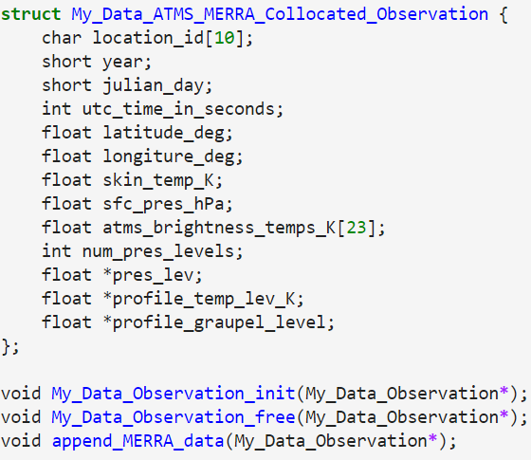
An Evolution of C-style Structs into Objects
Structs are a way to encapsulate groups of data together.
Structs can contain fundamental types, pointers, and other structs.
As structs become more complex, then you start to have to add in support functions to construct, deallocate and otherwise manipulate objects.

Slide 12
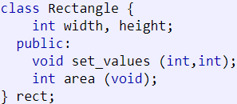
C++ Objects and Classes
What is an object?
It’s an instance of a class / the working entity of a class.
What is a class?
It is a template or blueprint about the capabilities of what an object can do.
This declares a class (i.e. a type) called Rectangle and an object (i.e. a variable) of this class, called rect.
The class has four members: width, height, set_values, and area.
The class name (Rectangle) and the object name (rect) are different.
Similar to: int a;

Slide 13
C++ Objects and Classes
Why use objects?
Encapsulation
  Keep resources (records) together. Tie functions with the data that they work with.
Abstraction
  Hide unnecessary implementation details from the end-user of the object.
Inheritance
  Derive characteristics and functionality from another object.
Polymorphism
  Use the same interface to operate on different types of objects.

Slide 14
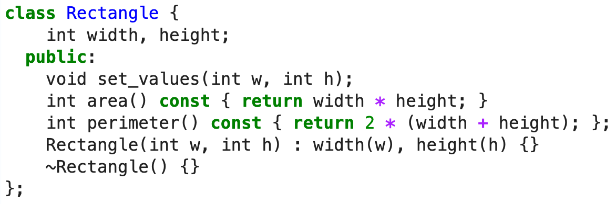
Encapsulation and Abstraction
Abstraction
By default, class members are “private”, which means that external consumers cannot access members directly.
width, height are private.
A consumer of the Rectangle class won’t be able to modify them directly. Instead, they must go through the set_values function.
set_values, area and perimeter are public.
Encapsulation
The area and perimeter functions are bound to the class.

Slide 15
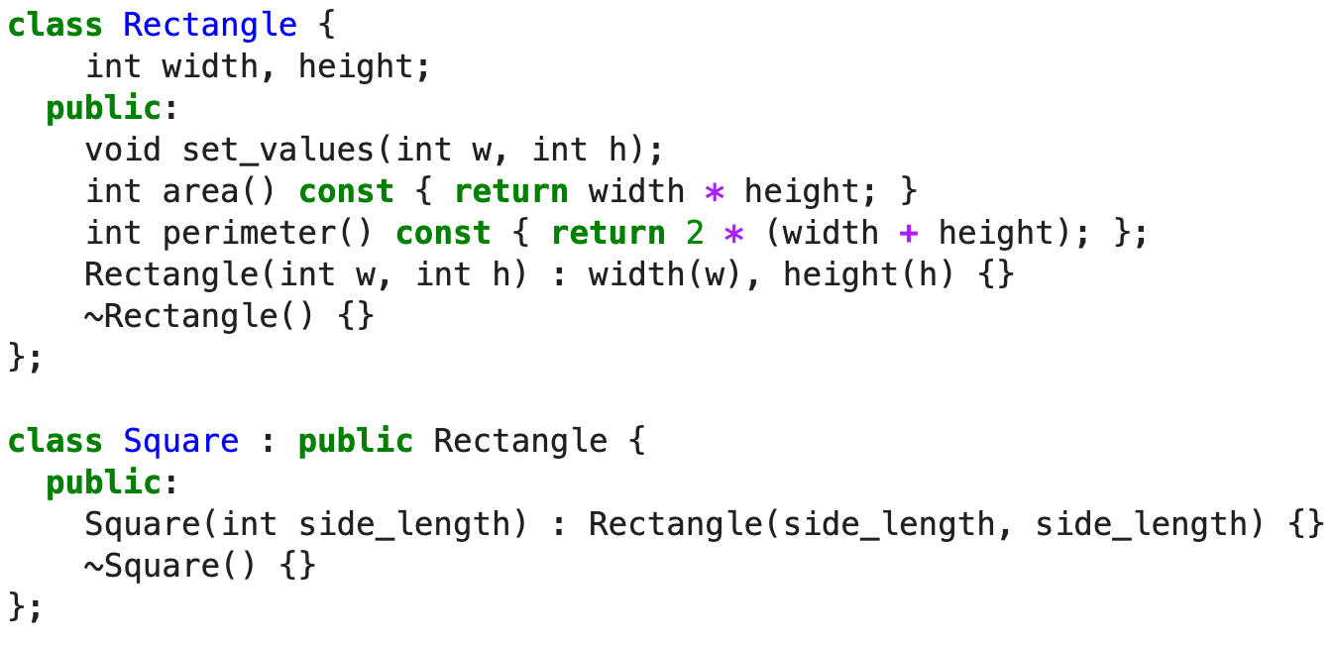
Inheritance

Slide 16
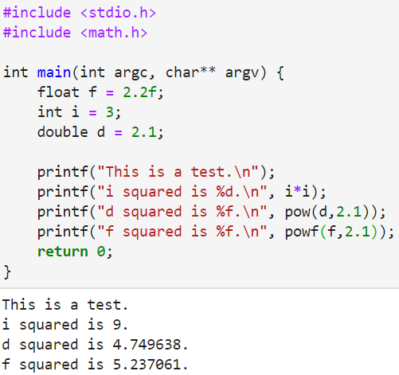
Polymorphism: Function Overloading
In C:
We want to take a power of a number. We must use differently-named functions to do the same thing for different types.

Slide 17
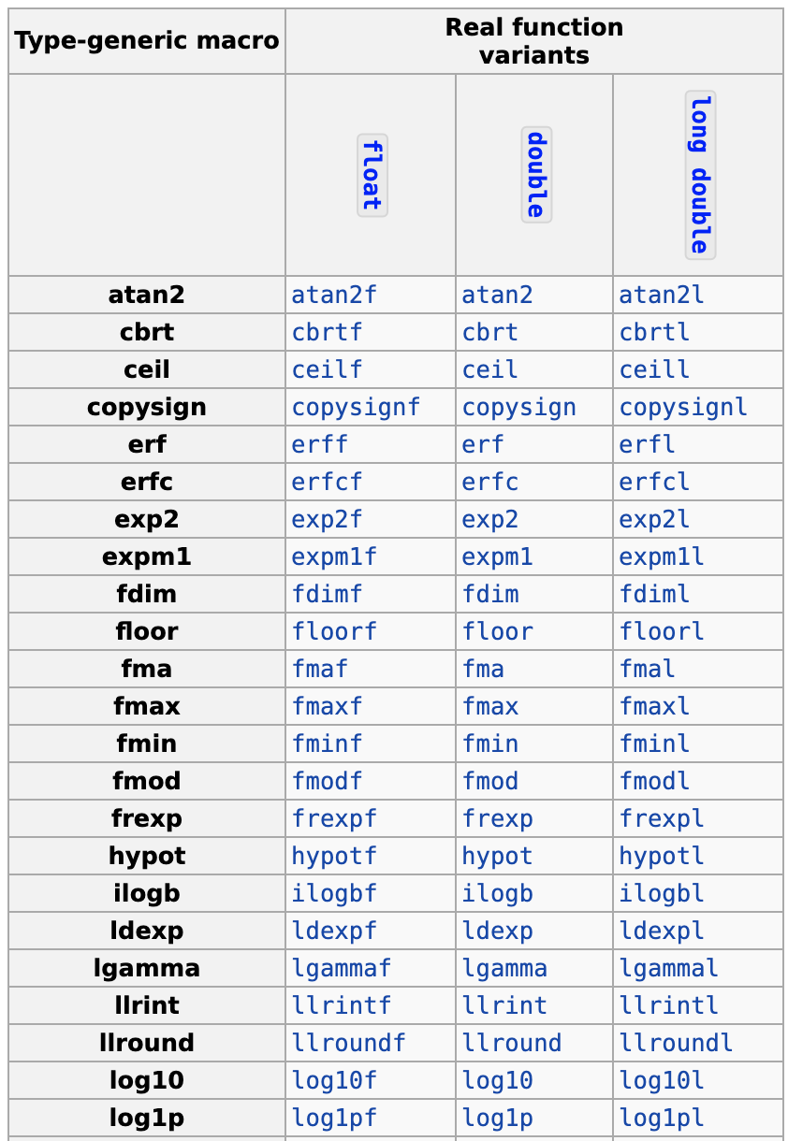
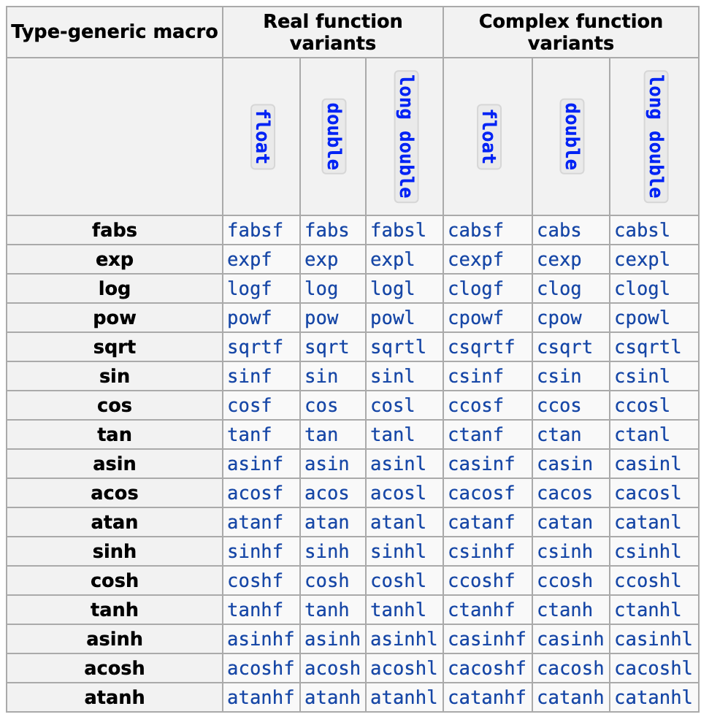
A Few C Limitations

Slide 18
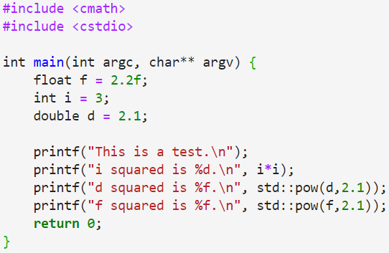
Polymorphism: Function Overloading
In C++:

Slide 19
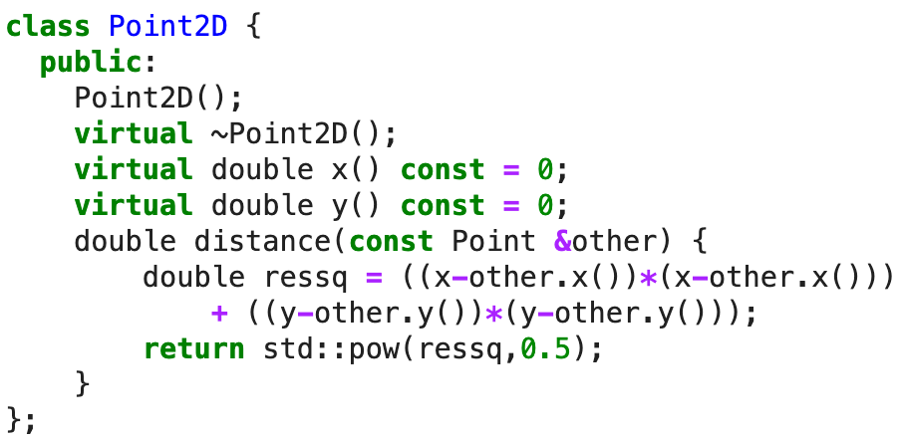
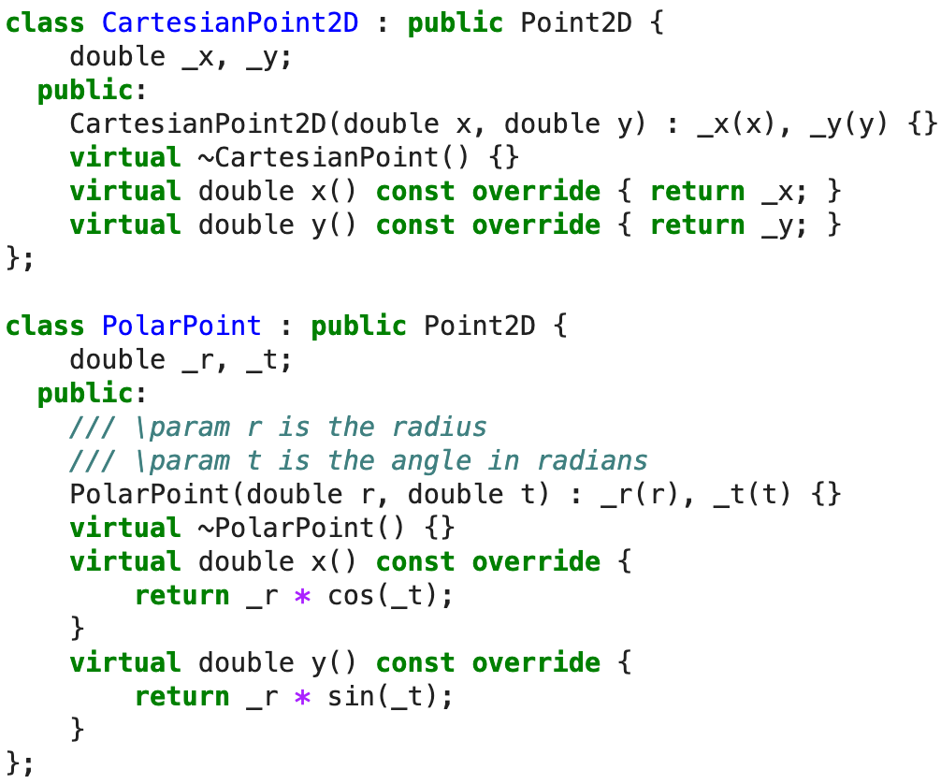
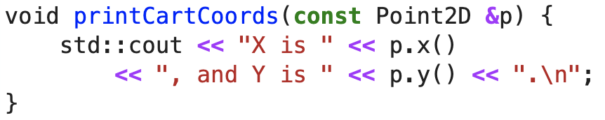
Polymorphism: Class Overloading

Slide 20
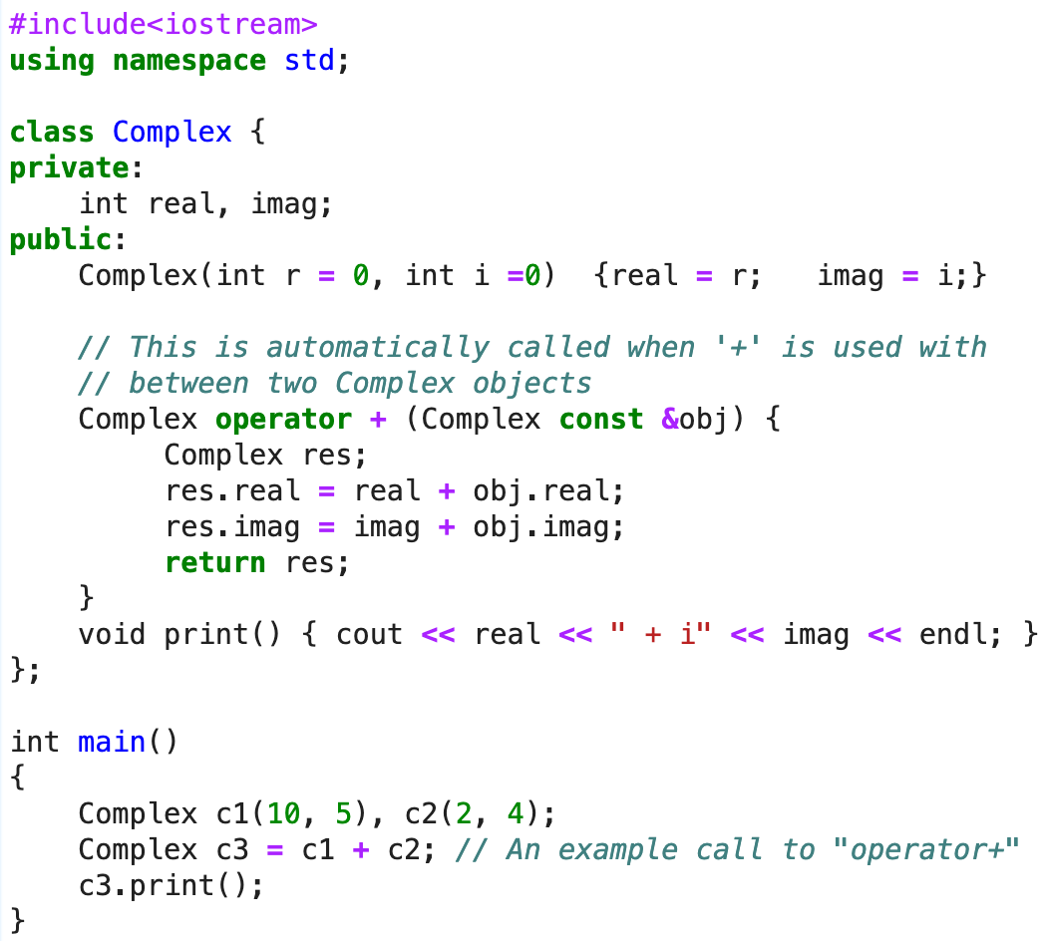
Polymorphism: Operator Overloading
Operators: + - * / % , ++ -- << >> == != > < >= <= ! && || ? & | ^ ~

Slide 21
Object Lifecycle
Constructors and Destructors
  A constructor is a function that runs when an object is first instantiated.
  A constructor has the same name as its class and has no return type.
  A destructor runs when an object is destroyed, usually when going out of scope.
  All destructor names begin with a ‘~’.
Setup
Functions
Clean-up

Slide 22
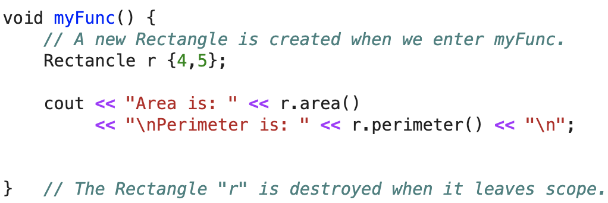
Object Lifecycle
Constructors and Destructors
Setup
Functions
Clean-up

Slide 23
Templates
Image credit: https://www.fluentcpp.com/2017/06/02/write-template-metaprogramming-expressively/

Slide 24
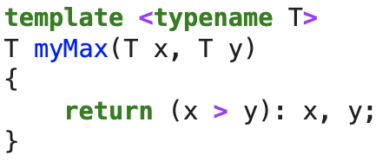
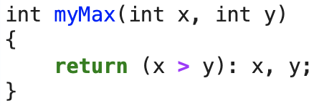
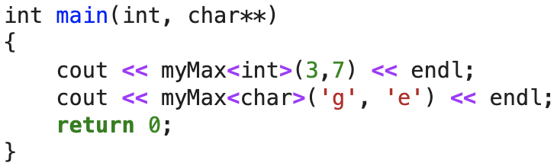
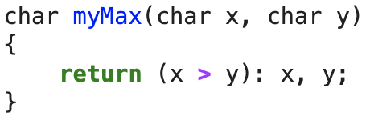
C++ Templates
A template is a simple and yet very powerful tool in C++. The simple idea is to pass a data type as a parameter so that we don’t need to write the same code for different data types.

Slide 25
Some Template Details
You can make templates out of functions, classes, and variables.
  template<typename T> constexpr T pi = T(3.141592653589793238462643383L);
  template < typename T> class myClass{ T data; };
  template < typename T> void myFunc(T);
You can have more than one template parameter.
  template < typename T, typename U > U myFunc(T);
You can nest templates inside of templates.
pi<float>
pi<double>, pi<int>
myClass<int>, myClass<float>
myFunc<int,double>(7)

Slide 26
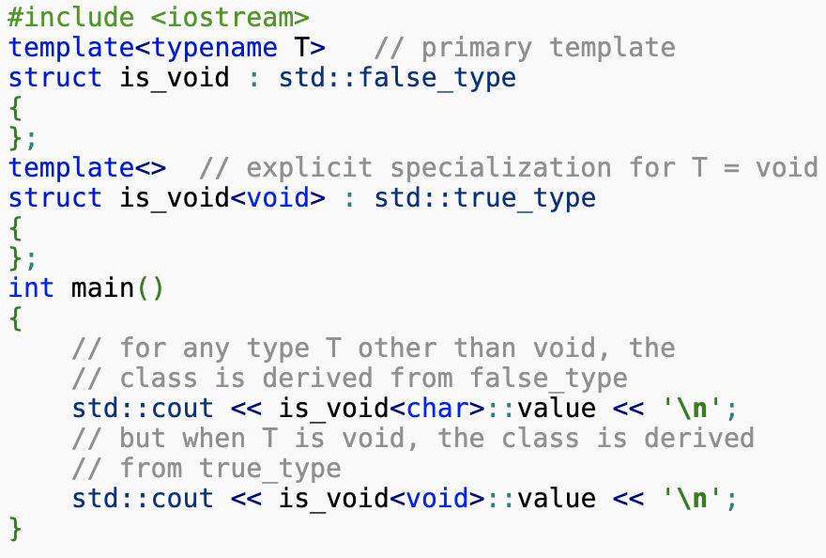
Some Template Details
You can specialize templates.
For more details: https://en.cppreference.com/w/cpp/language/template_specialization

Slide 27
The C++ Standard Template Library (STL)
Beyond just providing the core language, C++ compilers also provide a standard library for common tasks. All functions are in namespace std.
The C++ STL provides:
Containers (#include <set>, #include <vector>, #include <map>, …)
Fast algorithms for data searches and manipulation (#include <algorithm>)
File and console I/O (#include <iostream>, #include <sstream>)
Math functions (random numbers, complex numbers, …)
(#include <cmath>, #include <complex>, #include <random>)
Memory management (#include <memory>)
Strings (#include <string>)
https://www.cplusplus.com/
https://cppreference.com/

Slide 28
Back to Hello, World!
STL header file
Namespaces
Operator overloading and a STL stream
Templates

Slide 29
Best Practices

Slide 30
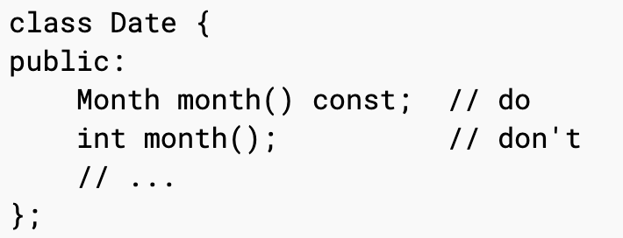
Express Ideas Directly in Code

Slide 31
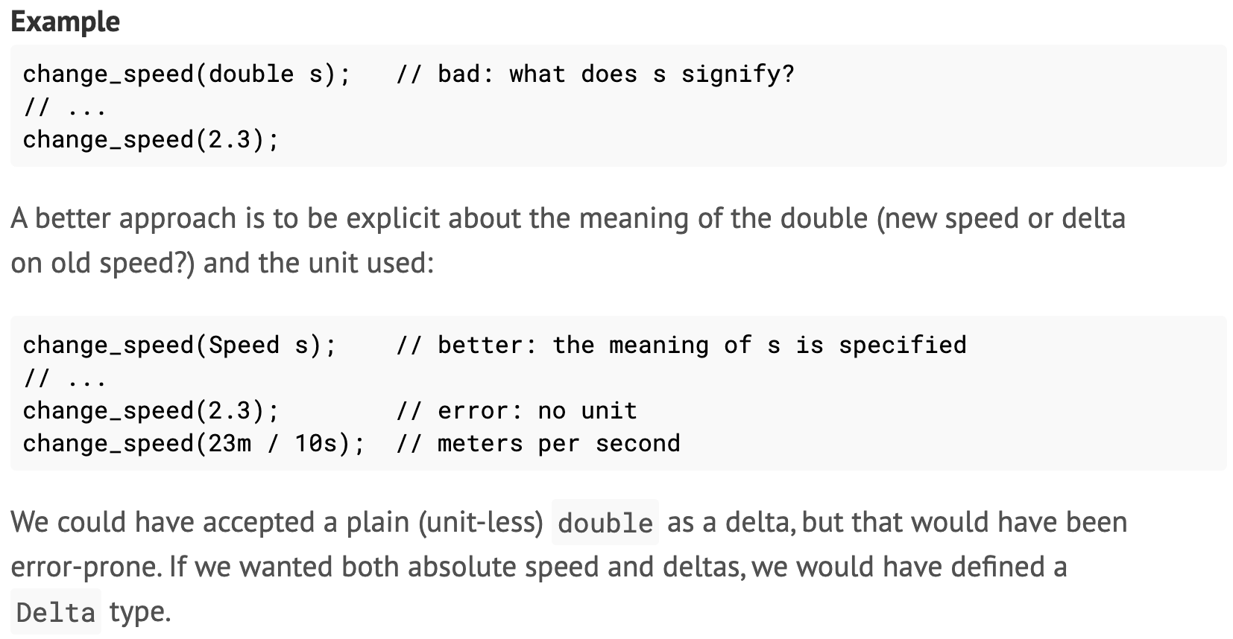
Express Ideas Directly in Code

Slide 32
Corollaries
Keep functions simple
  Do not have dozens or hundreds of variables. Break up large functions into small, easily testable components.
Break up large pull requests into smaller, manageable fragments
  It’s more Agile
Use comments and DOCUMENT your functions and classes!
  It helps everyone to understand what you wrote

Slide 33
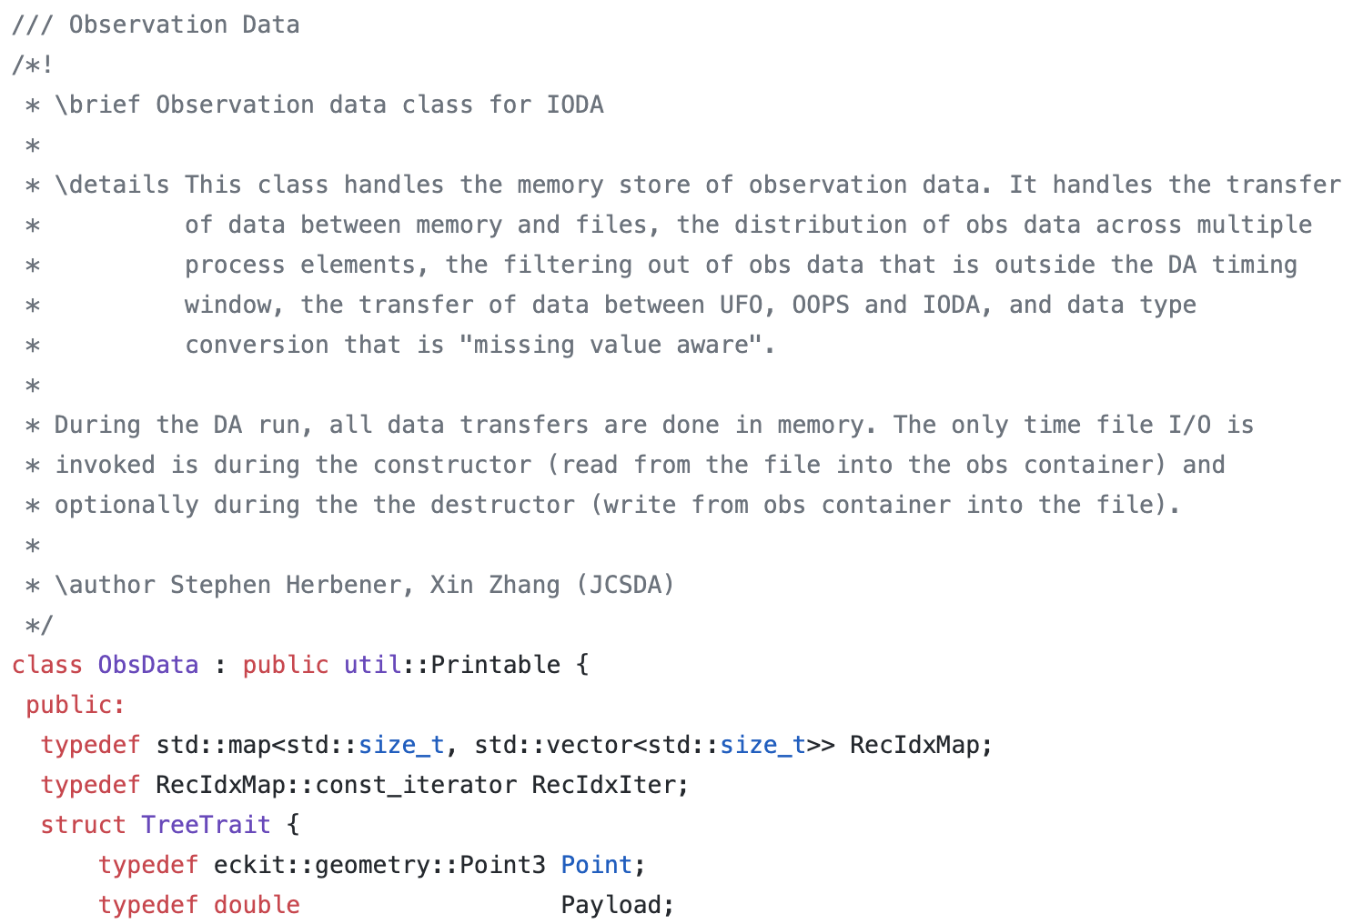
Corollaries
http://www.doxygen.nl/

Slide 34
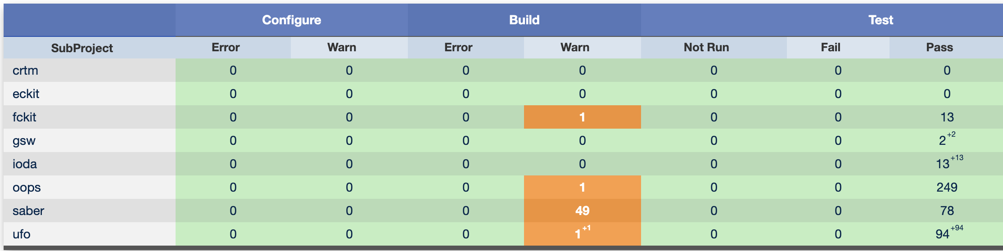
Build With All Compiler Warning Turned On
The compiler knows better C++ than you do. It warns about potential mistakes.
On gcc, this is the “-Wall” option.

Slide 35
Test Assumptions
Always assume that an operational system has bugs.
Try to add in runtime checks to make sure that your data are not bad.
JEDI has an Assert() macro to help with this.
Write unit tests to make sure your code works as expected.
  Today’s practical!

Slide 36
Thanks!
Questions?

