Slide 1
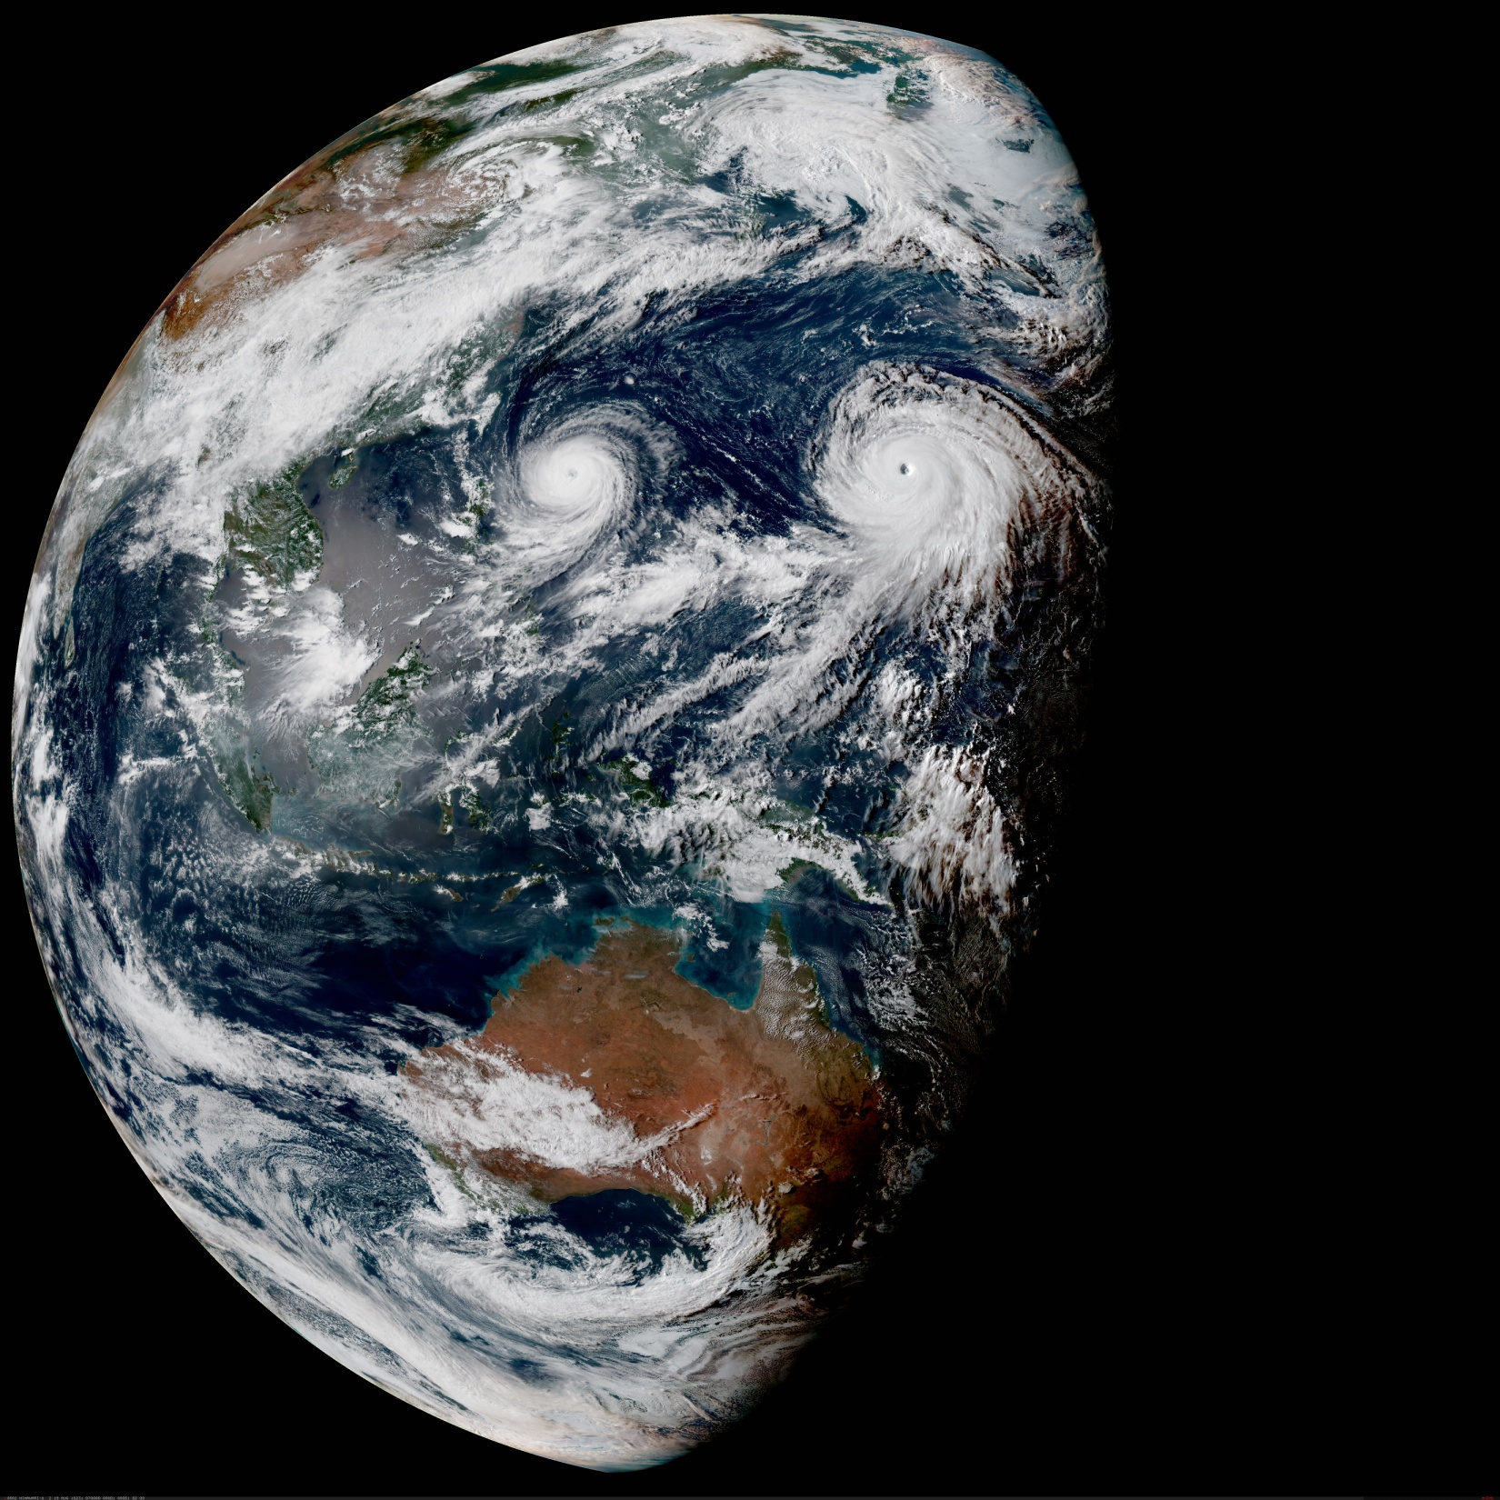
The Joint Effort for Data assimilation Integration (JEDI)
Data Assimilation Algorithms
Joint Center for Satellite Data Assimilation (JCSDA)
JEDI Academy - 21-25 June 2021

Slide 2
JEDI
Data Assimilation Reminders

Slide 3
Cycling Data Assimilation
NWP is a cycling process, repeated for every new forecast, typically:
Every 6 hours for global forecasts
More frequently for local forecasts
The period over which observations are used is the assimilation window, the repetitive process is the data assimilation cycling.
The cycling algorithm is coded in scripts and workflows (100s or 1000s of tasks per cycle).
The data assimilation itself is happening in one (a few) executable(s).
Cycling for JEDI is in development, the initial release (and this academy) only cover the data assimilation executables.

Slide 4
4D Assimilation Window
Observations
Analysis
Previous
forecast
Assimilation window
time

Slide 5
3D Assimilation Window
Observations
Analysis
Previous
forecast
Assimilation window
time
Not used any more in operational systems

Slide 6
3D-FGAT (First Guess at Appropriate Time)
Observations
Analysis
Previous
forecast
Assimilation window
time

Slide 7
OOPS Analysis and Design
Data assimilation aims at estimating the state of a system given all available information:
Previous forecast (background)
Observations
Possibly other constraints (theoretical information)
Example: variational data assimilation

Slide 8
JEDI
Data Assimilation in JEDI

Slide 9
Cost Function Design
Naive approach:
One object for each term of the cost function.
Compute each term (or gradient) and add them together.
Problem: The model is run several times (Jo, Jc, Jq)
Another naive approach:
Run the model once and store the full 4D state.
Compute each term (or gradient) and add them together.
Problem: The full 4D state is too big (for operational use).
A feasible approach:
Run the model once.
Compute each term (gradient) as the model is running.
Add all the terms together.

Slide 10
Cost Function Implementation
One class for each term (more flexible).
Call a method on each object on the fly while the model is running:
Uses the PostProcessor structure.
Finalize each term and add the terms together at the end.
Saving the model linearization trajectory is also handled by a PostProcessor.
Each formulation derives from an abstract CostFunction base class:
Code duplication: it was decided to keep 3D-Var and 4D-Var for readability.
The terms can be re-used (or not), 4D-En-Var was added in a few hours:
OO is not magic and will not solve scientific questions by itself.
Scientific questions (localization) remain but scientific work can start.
Months of work would have been necessary in traditional systems.

Slide 11
Post Processors
PostProcessors are called regularly during model integration
The presence or not of post processing does not affect the forecast
PostProcessors isolate the model code from many other unrelated aspects (separation of concerns)
Examples:
Output of forecast fields
Generation of products for users
Computation of filtered state (for DFI)
Generation of trajectory for linearized models
Generation of simulated observations
Diagnostics
…

Slide 12
4D-Var yaml
cost function:
cost type: 4D-Var
window begin: '{{window_begin}}’
window length: PT6H
geometry:
$(GEOMETRY)
model:
$(MODEL)
analysis variables: $(an_variables)
background:
$(BACKGROUND)
background error:
$(BACKGROUND_ERROR)
observations:
$(OBSERVATIONS)
variational:
minimizer:
algorithm: DRPCG
iterations:
- ninner: 30
gradient norm reduction: 0.01
geometry:
$(GEOMETRY)
linear model:
$(LINEAR_MODEL)
output:
$(AN_OUTPUT)
cost function:
cost type: 3D-Var
window begin: '{{window_begin}}’
window length: PT6H
geometry:
$(GEOMETRY)
analysis variables: $(an_variables)
background:
$(BACKGROUND)
background error:
$(BACKGROUND_ERROR)
observations:
$(OBSERVATIONS)
variational:
minimizer:
algorithm: DRPCG
iterations:
- ninner: 30
gradient norm reduction: 0.01
geometry:
$(GEOMETRY)
output:
$(AN_OUTPUT)
3D-Var

Slide 13
3D-FGAT yaml
cost function:
cost type: 4D-Var
window begin: '{{window_begin}}’
window length: PT6H
geometry:
$(GEOMETRY)
model:
$(MODEL)
analysis variables: $(an_variables)
background:
$(BACKGROUND)
background error:
$(BACKGROUND_ERROR)
observations:
$(OBSERVATIONS)
variational:
minimizer:
algorithm: DRPCG
iterations:
- ninner: 30
gradient norm reduction: 0.01
geometry:
$(GEOMETRY)
linear model:
$(LINEAR_MODEL)
output:
$(AN_OUTPUT)
cost function:
cost type: 4D-Var
window begin: '{{window_begin}}’
window length: PT6H
geometry:
$(GEOMETRY)
model:
$(MODEL)
analysis variables: $(an_variables)
background:
$(BACKGROUND)
background error:
$(BACKGROUND_ERROR)
observations:
$(OBSERVATIONS)
variational:
minimizer:
algorithm: DRPCG
iterations:
- ninner: 30
gradient norm reduction: 0.01
geometry:
$(GEOMETRY)
linear model:
name: identity
variable change: Identity
tstep: PT6H

Slide 14
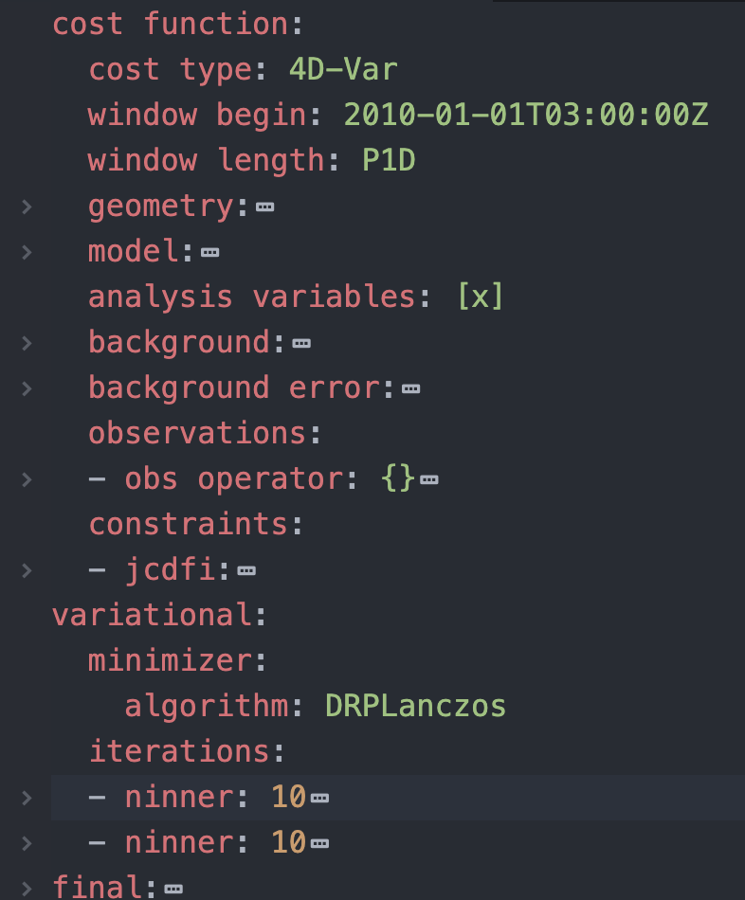
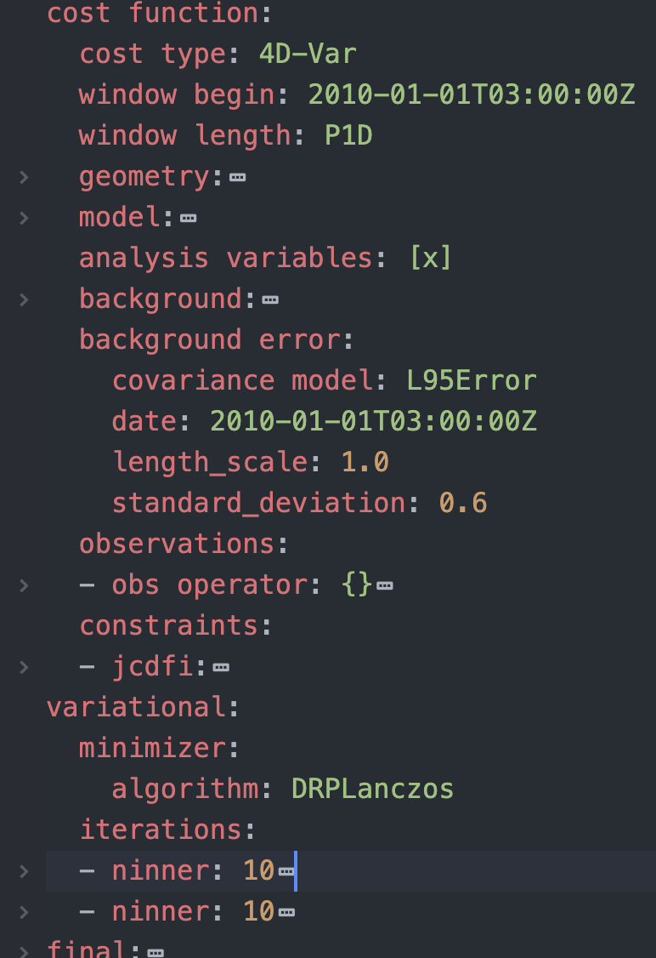
Editing yaml
Some editor let you fold/unfold yaml sections (here atom)

Slide 15
JEDI Applications

Slide 16
JEDI: Applications
OOPS-JEDI Applications can be found in src/oops/runs, for example:
Variational.h
Forecast.h
HofX.h
Applications are the normal mode of execution
Unit tests are specific applications that run tests for a given class
The main program manages tests and adds test reporting
This is hidden for most users and developers

Slide 17
JEDI: Variational Application
Several cost functions are available:
4D-Var
3D-Var
4D-En-Var
Weak constraint 4D-Var
The last two are parallel in time.
Minimizers are available:
In primal (model) space
In dual (observation) space
In double-primal space (GSI, Derber-Rosati, no B⁻¹)
As saddle point (weak constraint)
In each space, several algorithms:
PCG
Lanczos
GMRES
…

Slide 18
JEDI: EnsembleApplication
src/oops/runs also contains EnsembleApplication.h for… ensemble applications!
The EnsembleApplication class is templated on an Application and runs an ensemble of that application. It provides a generic way of running an ensemble of Applications in the same executable.
It’s yaml file is very simple, for an ensemble of variational DA (EDA):
EDA is coded with 77 lines of C++ (including comments) and some yaml.
It also work for ensemble forecasts, ensembles of H(x)… The only constraint is that all members run the same application.
files:
- "testinput/eda.3dvar.1.yaml”
- "testinput/eda.3dvar.2.yaml”
- "testinput/eda.3dvar.3.yaml”
- "testinput/eda.3dvar.4.yaml"

Slide 19
JEDI: Applications
Many more Applications can be found in src/oops/runs:
AddIncrement.h
ConvertState.h
DiffStates.h
Dirac.h
EnsRecenter.h
EnsVariance.h
ExternalDFI.h
Many are still in development and not fully documented or supported, feel free to explore.
Forecast.h
GenEnsPertB.h
HofX.h
HofXNoModel.h
LocalEnsembleDA.h
RTPP.h
StaticBInit.h
Variational.h

Slide 20
Working with JEDI Applications
All JEDI Applications are generic:
Given the appropriate yaml file and input data they work with any model
Debug and validate with simple toy models, apply to operational models
No recoding
Even in an operational center it will save time
The Lorenz 95 and QG models are provided with OOPS
(also a good place to understand interfaces)
Running the code in an interactive debugger can be a good way to learn

