Slide 1
The Joint Effort for Data assimilation Integration (JEDI)
Model Space
Joint Center for Satellite Data Assimilation (JCSDA)
JEDI Academy - 10-13 June 2019

Slide 2
Introduction
OOPS consists of a number of generic classes, each designed to handle a specific task or set of tasks without knowing the kind of model for which data assimilation is being performed.
Some of these classes require a specific implementation in order to perform their task. Consider the state or observation operator for example. There’s a class to handle these in oops but they’re fairly meaningless without a specific state or observation operator.
Other classes can have meaning without a specific implementation, e.g. the CostFunction class. However these classes often make use of other classes with a specific implementation, a cost function uses a state for example.
In JEDI we use the term “Model Space” to refer to the parts of the data assimilation system (classes) that require implementation for the specific model and the classes that fall under that category as interface classes.

Slide 3
Interface class
All model or observation specific classes are wrapped into an interface class
Using the C++ templates this is not strictly necessary but provides a convenient place to group all interfaces and make them visible
Each interface class contains a (smart) pointer to the actual implementation defined by the “model trait” (more on traits later) and passes the calls down
The interface layer is also used to instrument the code
Timing statistics
Trace execution
Interface classes are all in oops/src/oops/interface

Slide 4
Interface class
Abstract Layer
Generic
applications
Forecast
4DVar
EnKF
PF
H(x)
…
Uses
Interface layer
State
Model
Covariance
Observations
…
Implementation
Specific models
Lorenz
FV3GFS
GEOS
MOM6
…
In this simple example FV3GFS would need to implement State, Model, Covariance and Observations and pass those traits in order to create a 4DVar application.
Notes:
Q: How do we achieve a system that supports all models and provides data assimilation algorithms without imposing a particular approach?
A: Use modern abstract object oriented software. For JEDI we chose C++ because of its powerful templating capability.
How does abstract code work? We construct small task specific programming elements that can be combined and interfaced.
Someone can add a new application or data assimilation algorithm that everyone benefits from.
Someone can add a new observation operator that everyone benefits from.
Developers need very little understanding of other components. Users need even less.

Slide 5
Interface class
Class of specific
implementation
(from trait)
template <typename MODEL>
class State {
typedef typename MODEL::State State_;
public:
/// Most methods have been removed for readability
/// Interfacing
State_ & state() {return *state_;}
const State_ & state() const {return *state_;}
/// Get state values at observation locations
void getValues(const Locations_ &, const Variables &,
GeoVaLs_ &) const;
private:
boost::scoped_ptr<State_> state_;
};
Access specific object
(only for use in interface
classes)
Name of method is name
of class in lowercase
Smart pointer to
actual object

Slide 6
Interface class
Example of a method in an interface class
template<typename MODEL>
void State<MODEL>::getValues(const Locations_ & locs,
const Variables & vars,
GeoVaLs_ & gvals) const {
Log::trace() << "State<MODEL>::getValues starting" << std::endl;
util::Timer timer(classname(), "getValues");
state_->getValues(locs.locations(), vars, gvals.geovals());
Log::trace() << "State<MODEL>::getValues done" << std::endl;
}
Timer will be destructed
when going out of scope
Constructor and
destructor do the work
Trace method on
entry and exit
Method of specific implementation is called, with actual arguments

Slide 7
Model design: x_{t}=M(x₀)
grid.create(…)
model.create(…)
Setup
(lots of stuff)
model.initialize(…)
model.initialize(…)
Time Loop
Timestep
model.step(…)
Clean-up
(sometimes)
model.finalize(…)

Slide 8
Model space interface classes
Model space-related classes required by OOPS-JEDI
Geometry
State
Increment
InterpolatorTraj
Model
LinearModel
ErrorCovariance
Localization
ModelAuxControl
ModelAuxCovariance
ModelAuxIncrement
VariableChange
LinearVariableChange
Geometry, State, Increment, interpolation
Models
Background error covariance
Model bias correction or parameter estimation
(empty for now)
Nonlinear and linear change of variables

Slide 9
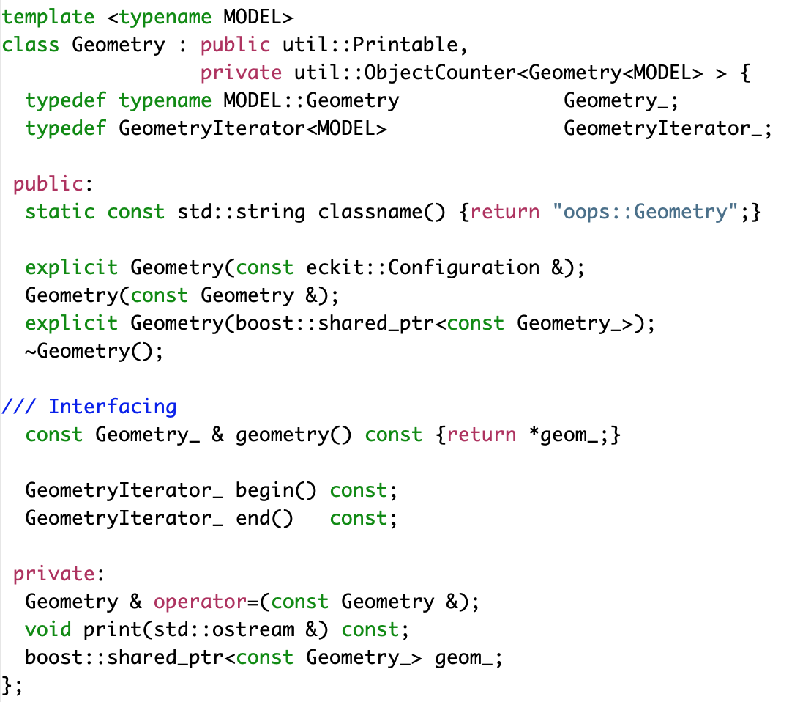
Geometry class

Slide 10
State class
template <typename MODEL>
class State : public util::Printable, private util::ObjectCounter<State<MODEL> > {
public:
static const std::string classname() {return "oops::State";}
/// Constructor, destructor
State(const Geometry_ &, const eckit::Configuration &);
State(const Geometry_ &, const State &);
State(const State &);
~State();
State & operator=(const State &);
/// Interfacing
State_ & state() {return *state_;}
const State_ & state() const {return *state_;}
/// Get state values at observation locations
void getValues(const Locations_ &, const Variables &, GeoVaLs_ &) const;
void getValues(const Locations_ &, const Variables &, GeoVaLs_ &, InterpolatorTraj_ &) const;
/// Time
const util::DateTime validTime() const {return state_->validTime();}
/// I/O and diagnostics
void read(const eckit::Configuration &);
void write(const eckit::Configuration &) const;
double norm() const;
Geometry_ geometry() const;
private:
void print(std::ostream &) const;
boost::scoped_ptr<State_> state_;
};

Slide 11
Increment class
template <typename MODEL> class Increment {
public:
static const std::string classname() {return "oops::Increment";}
/// Constructor, destructor
Increment(const Geometry_ &, const Variables &, const util::DateTime &);
Increment(const Geometry_ &, const Increment &);
Increment(const Increment &, const bool copy = true);
virtual ~Increment();
/// Interfacing
Increment_ & increment() {return *increment_;}
const Increment_ & increment() const {return *increment_;}
/// Get increment values at observation locations
void getValuesTL(const Locations_ &, const Variables &, GeoVaLs_ &, const InterpolatorTraj_ &) const;
void getValuesAD(const Locations_ &, const Variables &, const GeoVaLs_ &, const InterpolatorTraj_ &);
/// Interactions with State
void diff(const State_ &, const State_ &);
/// Time
const util::DateTime validTime() const {return increment_->validTime();}
void updateTime(const util::Duration & dt) {increment_->updateTime(dt);}
/// Linear algebra operators
void zero();
void zero(const util::DateTime &);
Increment & operator =(const Increment &);
Increment & operator+=(const Increment &);
Increment & operator-=(const Increment &);
Increment & operator*=(const double &);
void axpy(const double &, const Increment &, const bool check = true);
double dot_product_with(const Increment &) const;
void schur_product_with(const Increment &);
void random();
void accumul(const double &, const State_ &);
/// I/O and diagnostics
void read(const eckit::Configuration &);
void write(const eckit::Configuration &) const;
private:
void print(std::ostream &) const;
boost::scoped_ptr<Increment_> increment_;
};

Slide 12
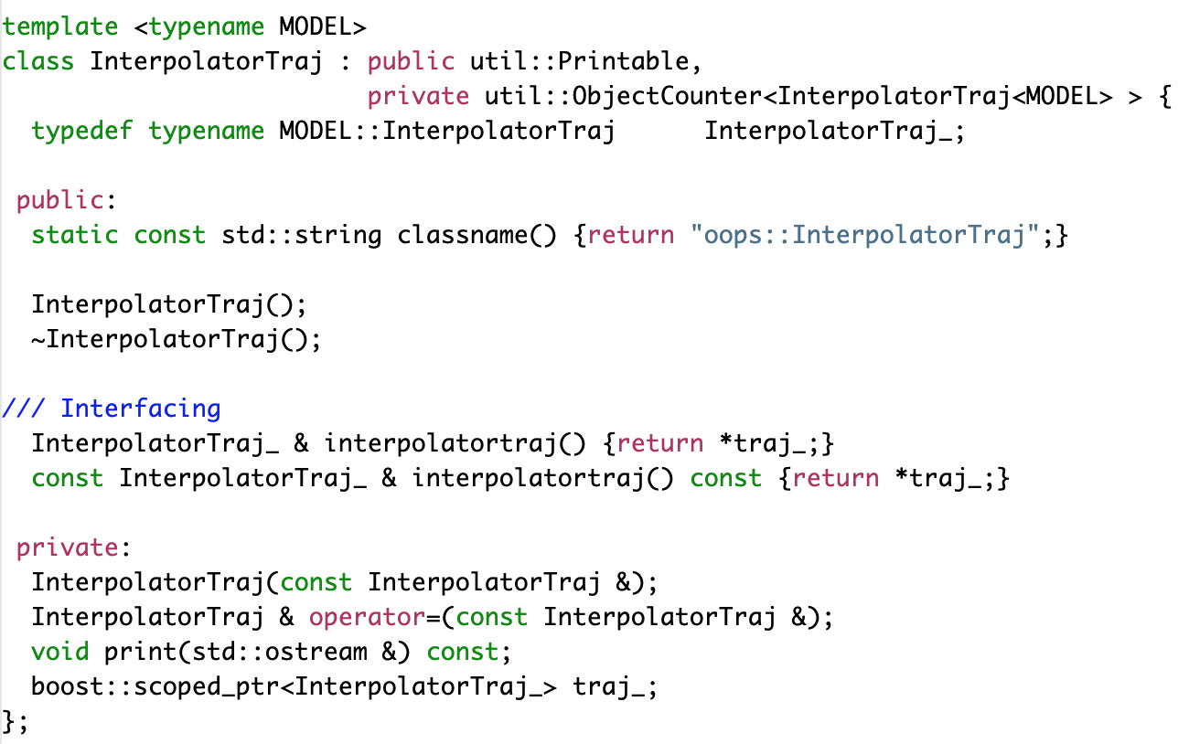
InterpolatorTraj

Slide 13
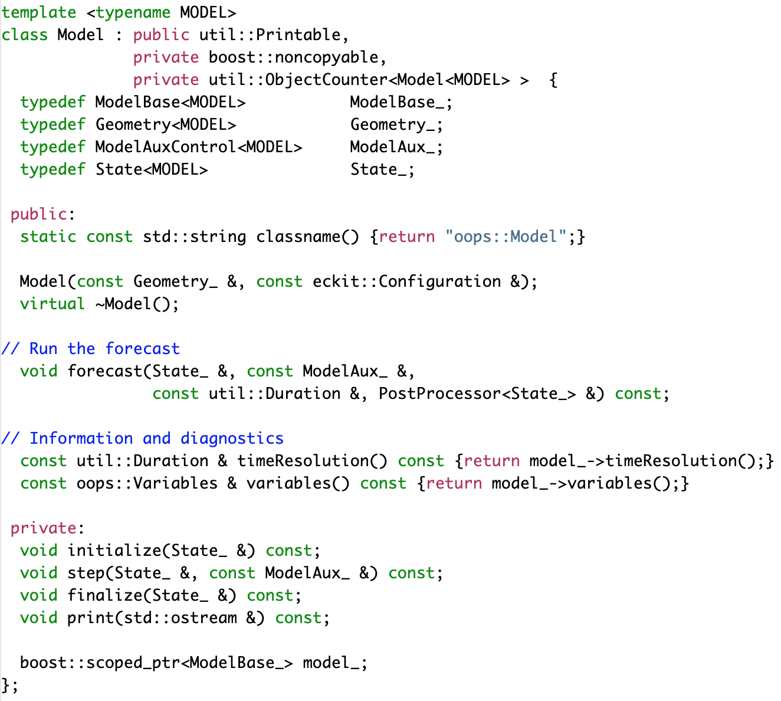
Model class

Slide 14
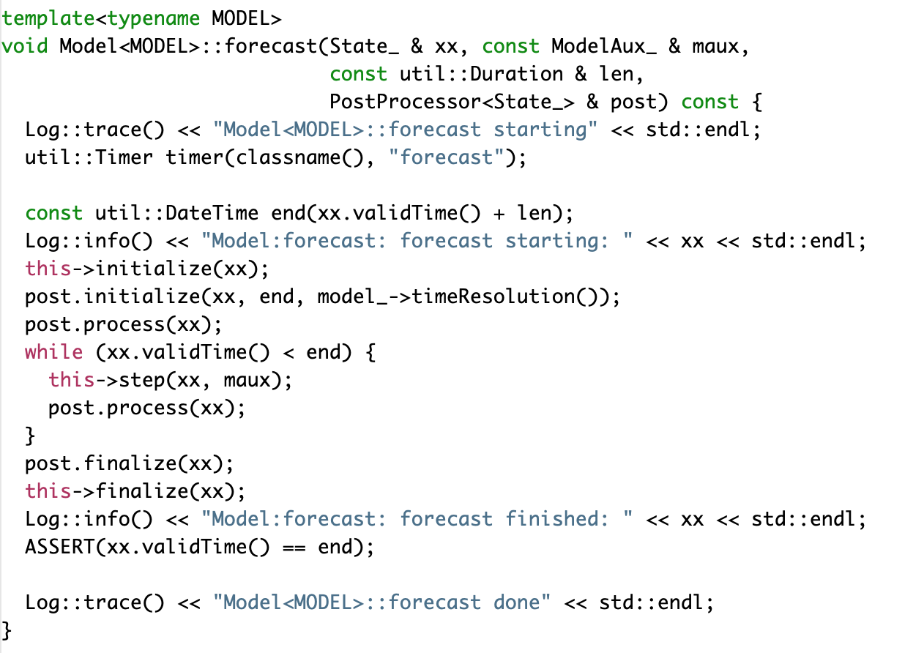
Model class | forecast

Slide 15
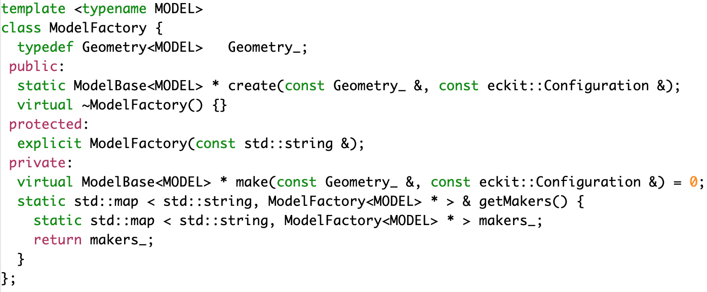
ModelBase Factory
Some of the constructors in JEDI use factories. This is a powerful way of constructing objects in JEDI that allows for run time choice of constructor without lots of messy if statements.
The Model class in JEDI is an example of using a factory.

Slide 16
Pseudo model
Four dimensional data assimilation algorithms require forecasts through the data assimilation window.
Typically this is done by connecting JEDI to the forecast model and stepping the model in time while calling the post processors.
Alternatively the forecast can be achieved using IO. In OOPS there is a generic pseudo model class.
Instead of the step method containing a call to the forecast model is call the state.read method and reads a model state from a previously run forecast.

Slide 17
LinearModel class
template <typename MODEL>
class LinearModel : public util::Printable,
private boost::noncopyable,
private util::ObjectCounter<LinearModel<MODEL> > {
public:
static const std::string classname() {return "oops::LinearModel";}
LinearModel(const Geometry_ &, const eckit::Configuration &);
~LinearModel();
/// Run the tangent linear forecast
void forecastTL(Increment_ &, const ModelAuxIncr_ &, const util::Duration &,
PostProcessor<Increment_> post = PostProcessor<Increment_>(),
PostProcessorTLAD<MODEL> cost = PostProcessorTLAD<MODEL>(),
const bool idmodel = false) const;
/// Run the adjoint forecast
void forecastAD(Increment_ &, ModelAuxIncr_ &, const util::Duration &,
PostProcessor<Increment_> post = PostProcessor<Increment_>(),
PostProcessorTLAD<MODEL> cost = PostProcessorTLAD<MODEL>(),
const bool idmodel = false) const;
// Set the linearization trajectory
void setTrajectory(const State_ &, State_ &, const ModelAux_ &);
// Information and diagnostics
const util::Duration & timeResolution() const {return tlm_->timeResolution();}
protected:
// Run the TL forecast
void initializeTL(Increment_ &) const;
void stepTL(Increment_ &, const ModelAuxIncr_ &) const;
void finalizeTL(Increment_ &) const;
// Run the AD forecast
void initializeAD(Increment_ &) const;
void stepAD(Increment_ &, ModelAuxIncr_ &) const;
void finalizeAD(Increment_ &) const;
private:
// diagnostics
void print(std::ostream &) const;
boost::scoped_ptr<LinearModelBase_> tlm_;
};

Slide 18
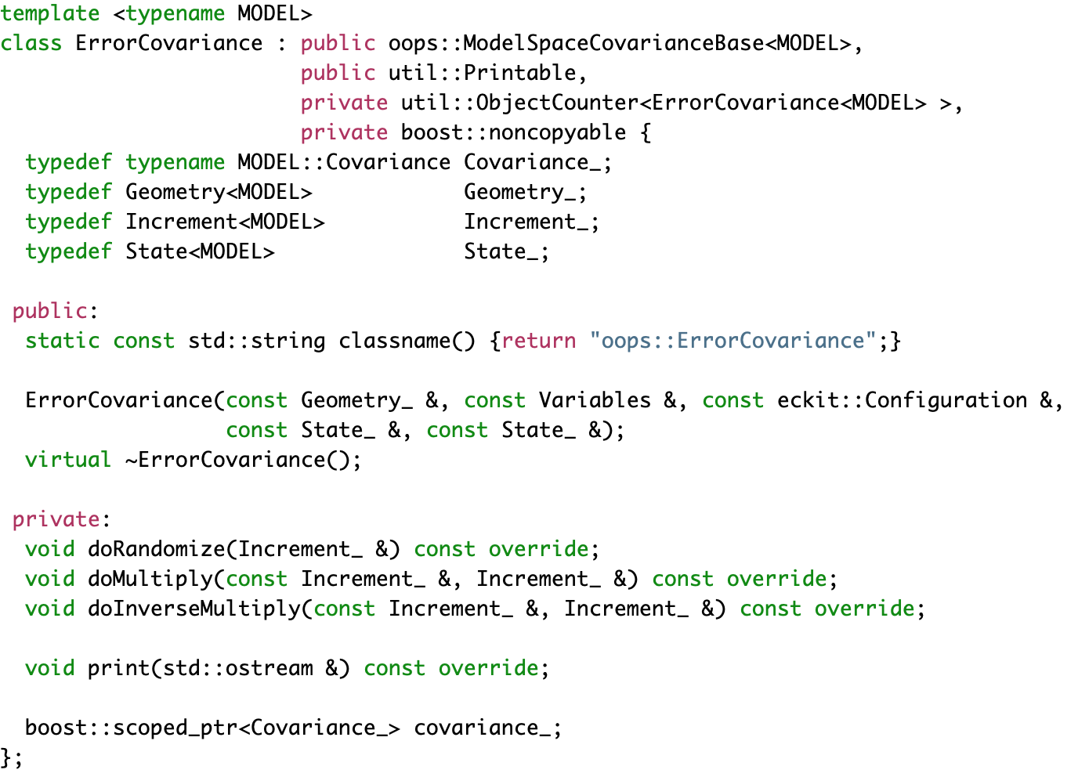
ErrorCovariance Class

Slide 19
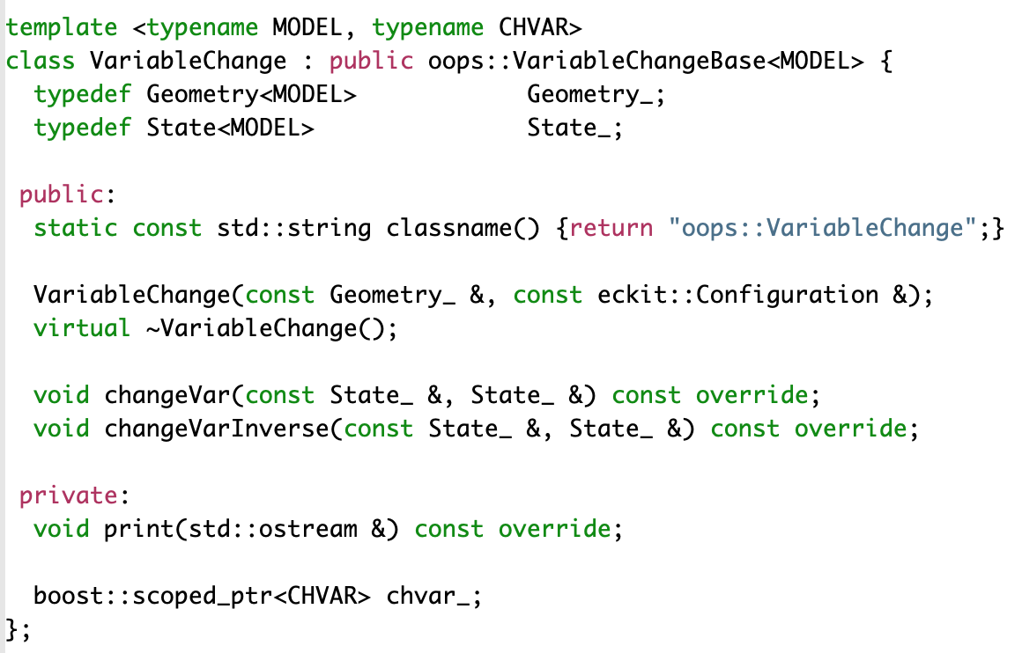
VariableChange class

Slide 20
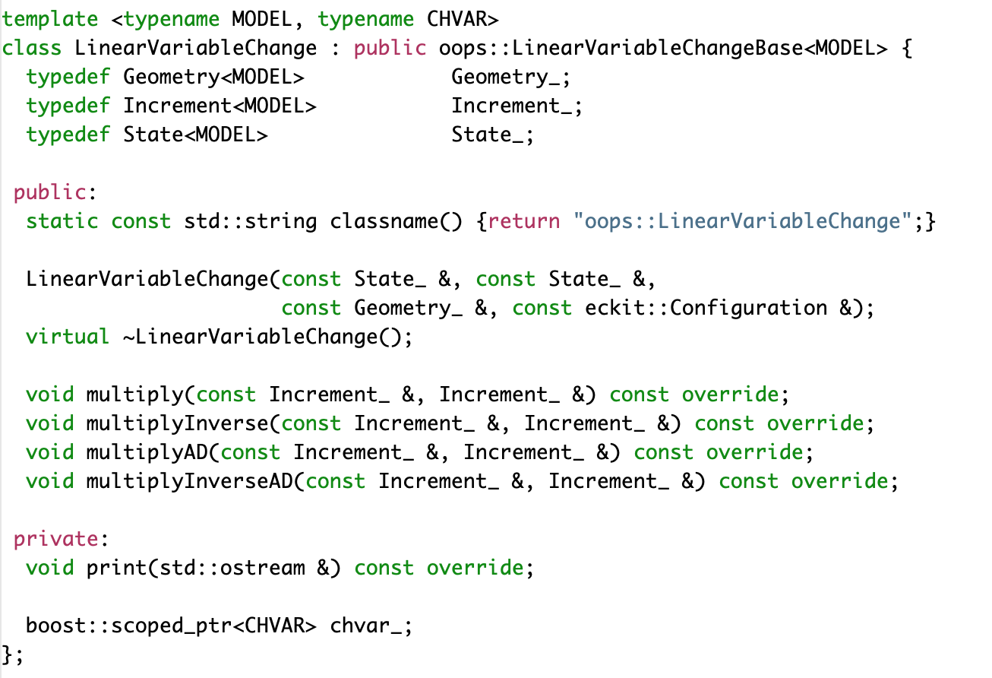
LinearVariableChange

