Slide 1

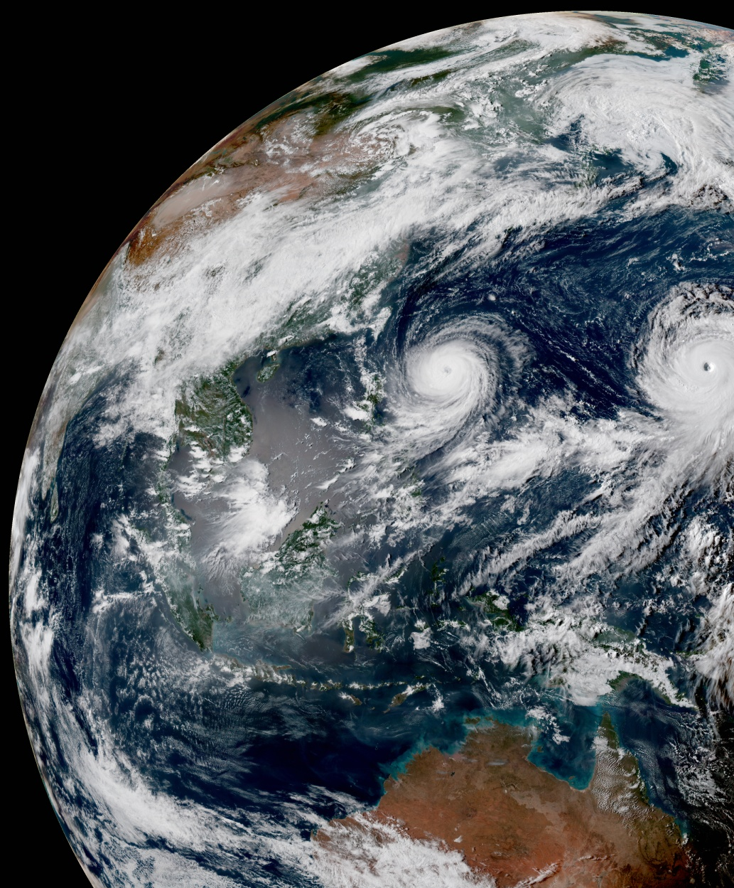
Introduction of JEDI Unified Forward Operator (UFO)
Hui Shao, JCSDA
JEDI Academy, June 21-25, 2021 (Virtual)

Slide 2
OBS Team
OBS team focus on the observation aspects in the context of data assimilation and assessment:
JEDI UFO development, including QC and BC, based on generic JEDI framework
UFO generic framework
Data ingestion, (e.g., data conversion, naming convention, etc) relevant to IODA
Data validation and scientific assessment
Diagnostics and FSOI tools development
OBS Core Team:
Benjamin Johnson, Hui Shao, Greg Thompson, Wei Han, Fabio Diniz, Hailing Zhang, Ryan Honeyager, Francois Vandenberghe, Rachel Schweiker
In-Kind Contributors (2020):
E. H. Liu, R. Knuteson, H. Revercomb, J. Jin, M. Cooke, C. Harlow, S. Newman, D. Rundle, Y. Wu, H. Liu, L. Kouvaris, M. Pagowski, B. Karpowicz, B. Ruston, N. Bowler, O. Lewis, K. Bathmann, I. Genkova , D. Merkova, L. Hawkness-Smith, C. Thomas, G. Kelly, J. Cotton, D. Simonin, P. Pauley, M. Hu, C. Alexander, S. Benjamin, L. Wicker, D. Kleist, N. Baker, J. Guerrette, Z. (Jake) Liu, C. Snyder, C. Schwarz, B.J. Jung, J. Ban, E. Platt, M. McAtee
With support from JCSDA core teams, partners, and collaborators

Slide 3
Outline for OBS Sessions
Intro to UFO operators:
  What are available, development and validation processes, introduction to common operators
CRTM:
  one of the radiative transfer model UFO is interfaced with
Observation Operators and QC: general
Observation Operators and QC: development
QC, ObsFunctions
How to config, run, and add new UFO/QC/BC

Slide 4
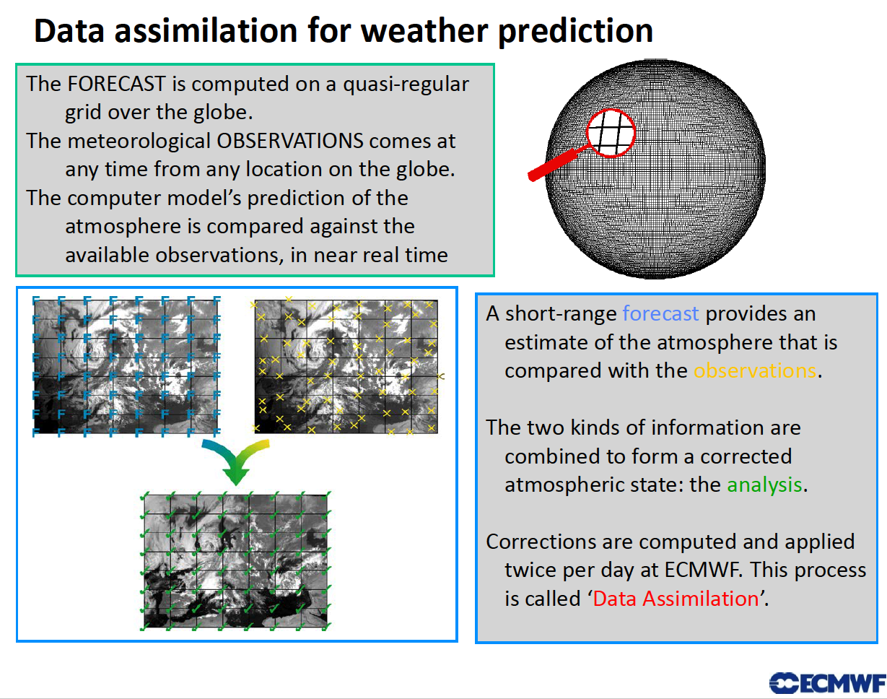
(Lars Isaksen)

Slide 5
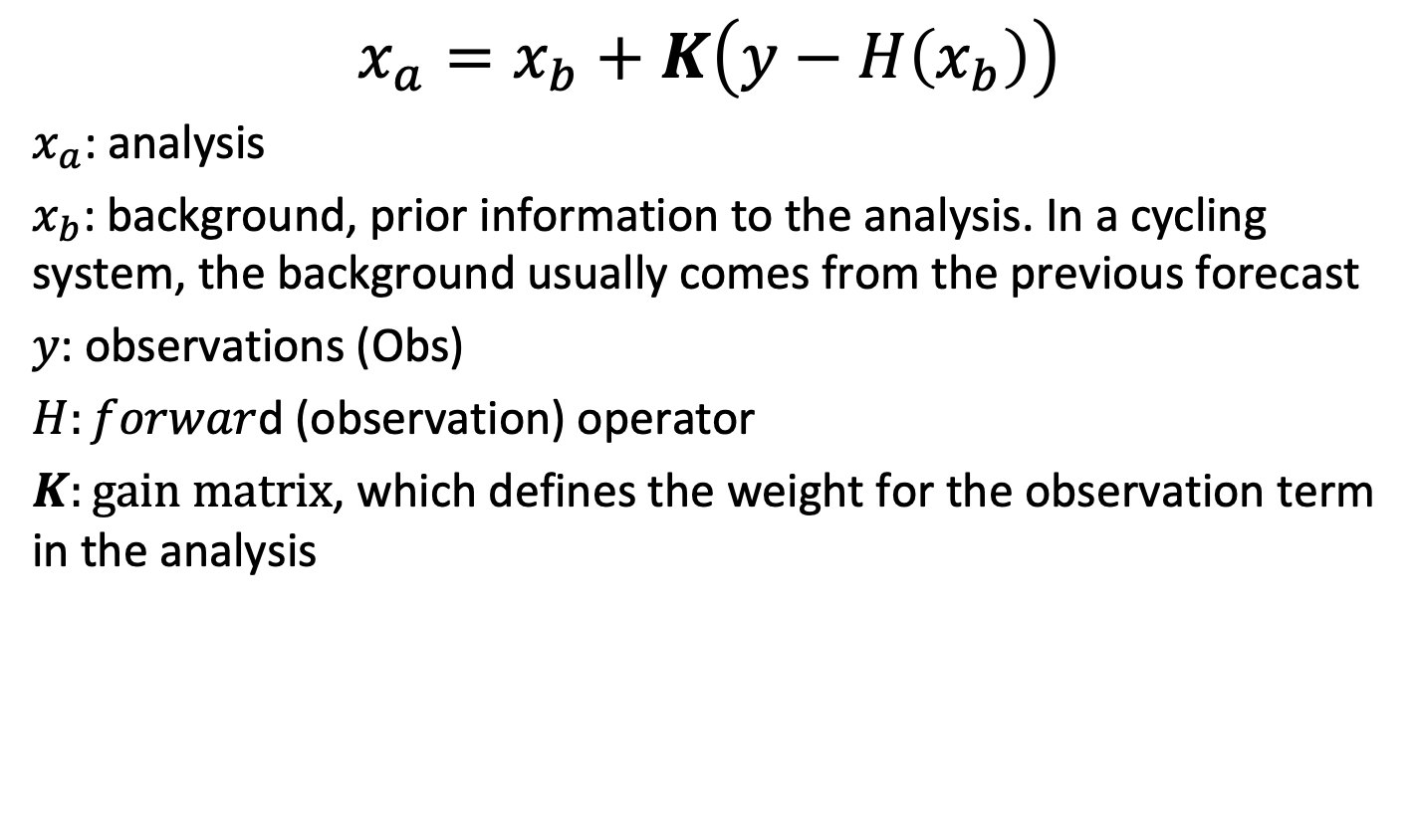
Analysis: based on background and observations
$$x_{a}=x_{b}+K\left(y−H\left(x_{b}\right)\right)$$
$x_{a}$: analysis
$x_{b}$: background, prior information to the analysis. In a cycling system, the background usually comes from the previous forecast
$y$: observations (Obs)
$H:forwar$d (observation) operator
$K:gain matrix$, which defines the weight for the observation term in the analysis

Slide 6
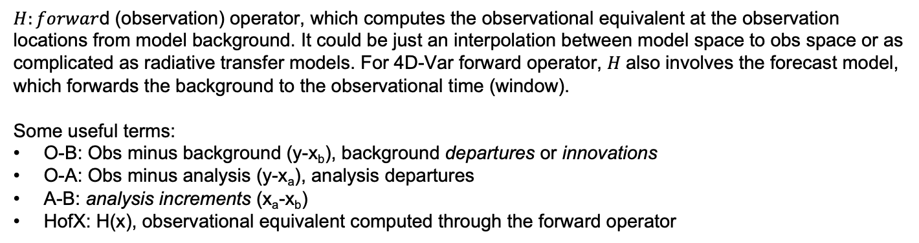
Forward Operator
x_{b}
x_{b}
x_{b}
x_{b}
x_{b}
H(x_{b})
y
x_{b}
x_{b}
x_{b}
x_{b}
x_{b}
x_{b}
x_{b}
x_{b}
x_{b}
x_{b}
x_{b}
x_{b}
x_{b}
x_{b}
x_{b}
Model space
Obs space
Obs space
$H:forwar$d (observation) operator, which computes the observational equivalent at the observation locations from model background. It could be just an interpolation between model space to obs space or as complicated as radiative transfer models. For 4D-Var forward operator, $H$also involves the forecast model, which forwards the background to the observational time (window).
Some useful terms:
O-B: Obs minus background (y-x_{b}), background departures or innovations
O-A: Obs minus analysis (y-x_{a}), analysis departures
A-B: analysis increments (x_{a}-x_{b})
HofX: H(x), observational equivalent computed through the forward operator

Slide 7
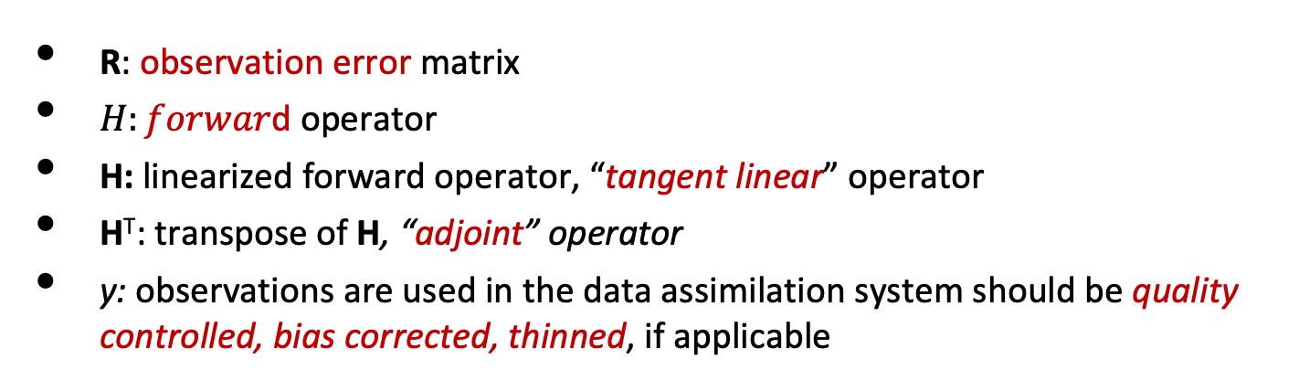

Forward Operator Components
K can be estimated through ensemble, or using optimal interpolation or variational method.
For example, for an variational system, K is implicitly solved by minimizing the cost function like
$J\left(x\right)={\frac{1}{2}(x−x_{b})}^{T}B^{−1}(x−x_{b})$+ ${\frac{1}{2}\left(y−H\left(x\right)\right)}^{T}R^{−1}(y−H(x))$
$∇J\left(x\right)=B^{−1}(x−x_{b})$- $H^{T}R^{−1}(y−H(x))$
R: observation error matrix
$H:forwar$d operator
H: linearized forward operator, “tangent linear” operator
H^{T}: transpose of H, “adjoint” operator
y: observations are used in the data assimilation system should be quality controlled, bias corrected, thinned, if applicable
These components are what you need for developing a new forward operator for variational data assimilation (and UFO)
R: observation error matrix
$H:forwar$d operator
H: linearized forward operator, “tangent linear” operator
H^{T}: transpose of H, “adjoint” operator
y: observations are used in the data assimilation system should be quality controlled, bias corrected, thinned, if applicable

Slide 8
Unified Forward Operator (UFO)
Share observation operators between JCSDA partners and reduce duplication of work
  Taking the model agnostic approach one level down into the observation operators
Faster use of new observing platforms
  Regular satellite missions are expensive
  Cube-sat have short expected lifetime
  Include users and instruments science teams
Unified Forward Operator (UFO)
  Build a community app-store for observation operators

Slide 9
Separate Concerns
Same separation of concerns principles that lead to the design of OOPS
Obs. Locations
Variables
State
Obs. Operators
Observations
Field Values
at Locations
JEDI/UFO introduces standard interfaces between models and observations
Observation operators are independent of the model and can easily be shared, exchanged, compared

Slide 10
H(x) in UFO
geovals
H includes a few steps:
Forecast model (if 4DVar)
Horizontal interpolation, which provides geovals:
  These two steps are performed at the JEDI model level and provide values to the obs space through the model interface
Compute HofX at the observation locations: e.g., vertical interpolation, simulate observables using geovals, etc.
  This step is performed in the obs space under UFO
Model levels in Pressure
T, q
Bending angle (obs)
Projection of bending angle in lat-lon grids
Simplified plot for geovals
Blue line: T and q profiles (geovals) in pressure, interpolated to the lat and lon of the specific obs (red dot).
UFO will compute bending angle using T, q, and p geovals at the observation location

Slide 11
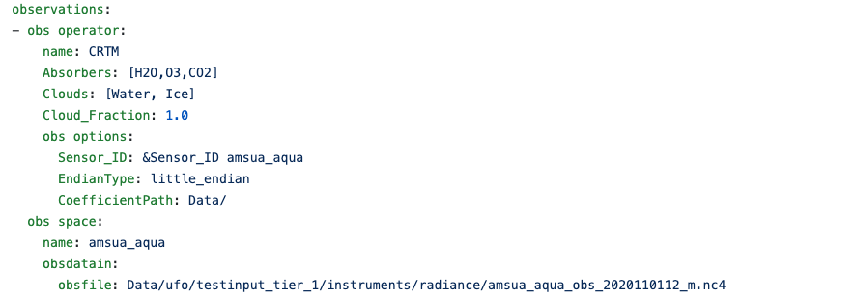
Current Components of UFO
Forward operators with non-linear and its tangent linear (TL)/adjoint (AD) code
  Operators: Interpolation (vertical, surface, layer), GNSSRO, SCATwind, precipitable water, ground GNSS, surface pressure, AOD, …
  Interfaces with other packages: CRTM, RTTOV, ROPP
Filters
  QC and thinning
  Actions
Bias correction (BC) (predictors)
Variable transforms
Configurations (Yaml)

Slide 12
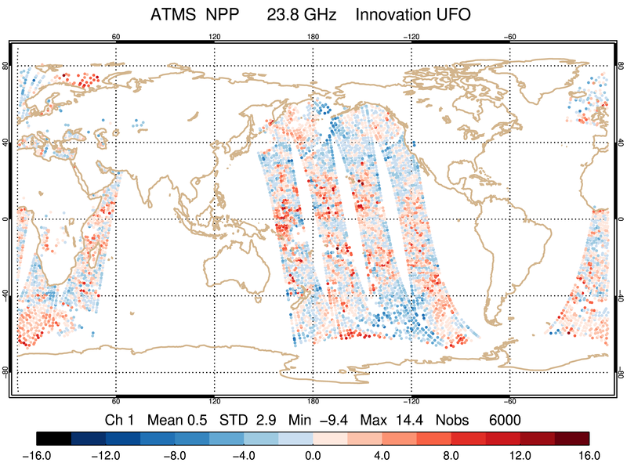
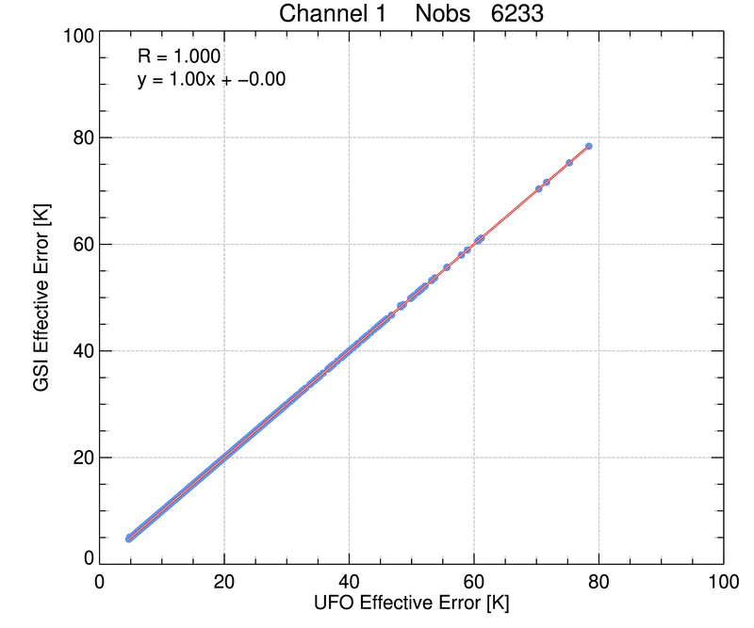
JEDI-FV3 Release 1.1
HDF5
ObsStore
BUFR
ODB
yaml
More…
IODA-Engines: Groups, Variables, Dimensions, Attributes, Type System
IODA V2.0.0
Leverages HDF5 data model for improved organization, management, extensibility, metadata
Enhanced support for multi-dimensional data sets
C++/python interoperability
ObsSpace
Bias
Converters
Diagnostics
Containers
User-facing classes
IODA v2 Release
After Release
Planned / Potential
JEDI UFO for ATMS
UFO V1.1.0
H(x), Bias correction, and QC for NCEP operational instruments following NCEP GDAS implementations
Good agreement with GDAS in most cases; validation work continues
UFO

Slide 13
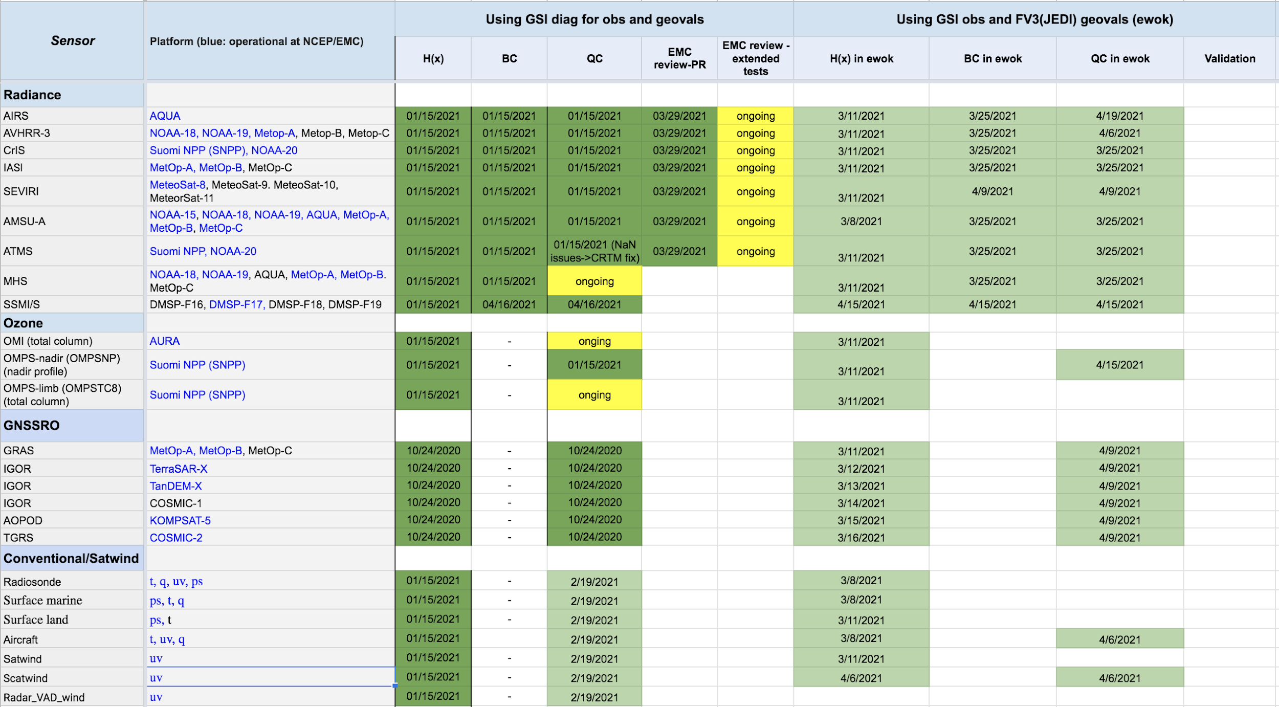
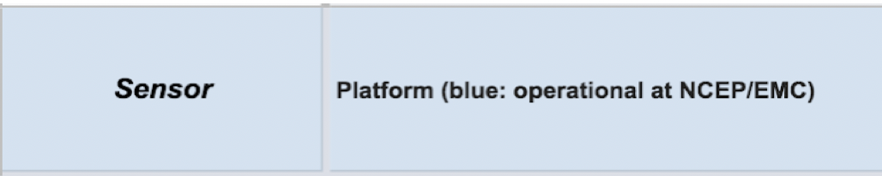
UFO for JEDI GDAS Sensors/Instruments
Close partnership with NOAA
You may build your own QC/BC configurations based on the existing UFO configurations validated for JEDI_GDAS

Slide 14
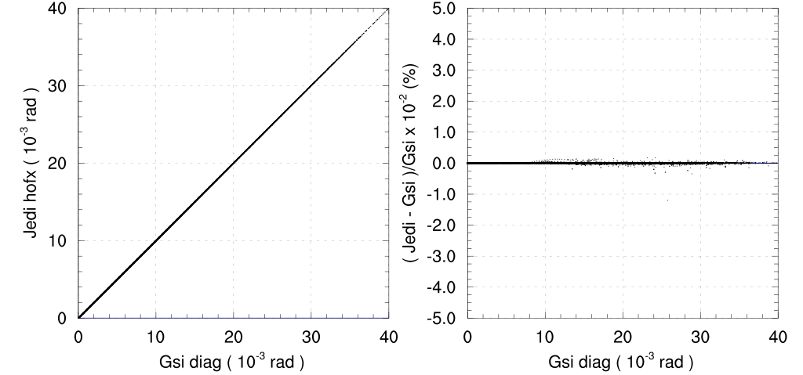
UFO Validation against NCEP GDAS (GSI)
All instruments for JEDI_GDAS have been validated against GSI: H(x) only, with BC, with BC & QC
Using the same input (geovals and obs), UFO can fully replicate GSI forward operators (NCEP GDAS) results for most radiance and GNSSRO instruments.
Other instruments have reasonable matching results with known reasons.
Validations continues using JEDI_GDAS testbed
Ongoing efforts for diagnostic tools

Slide 15
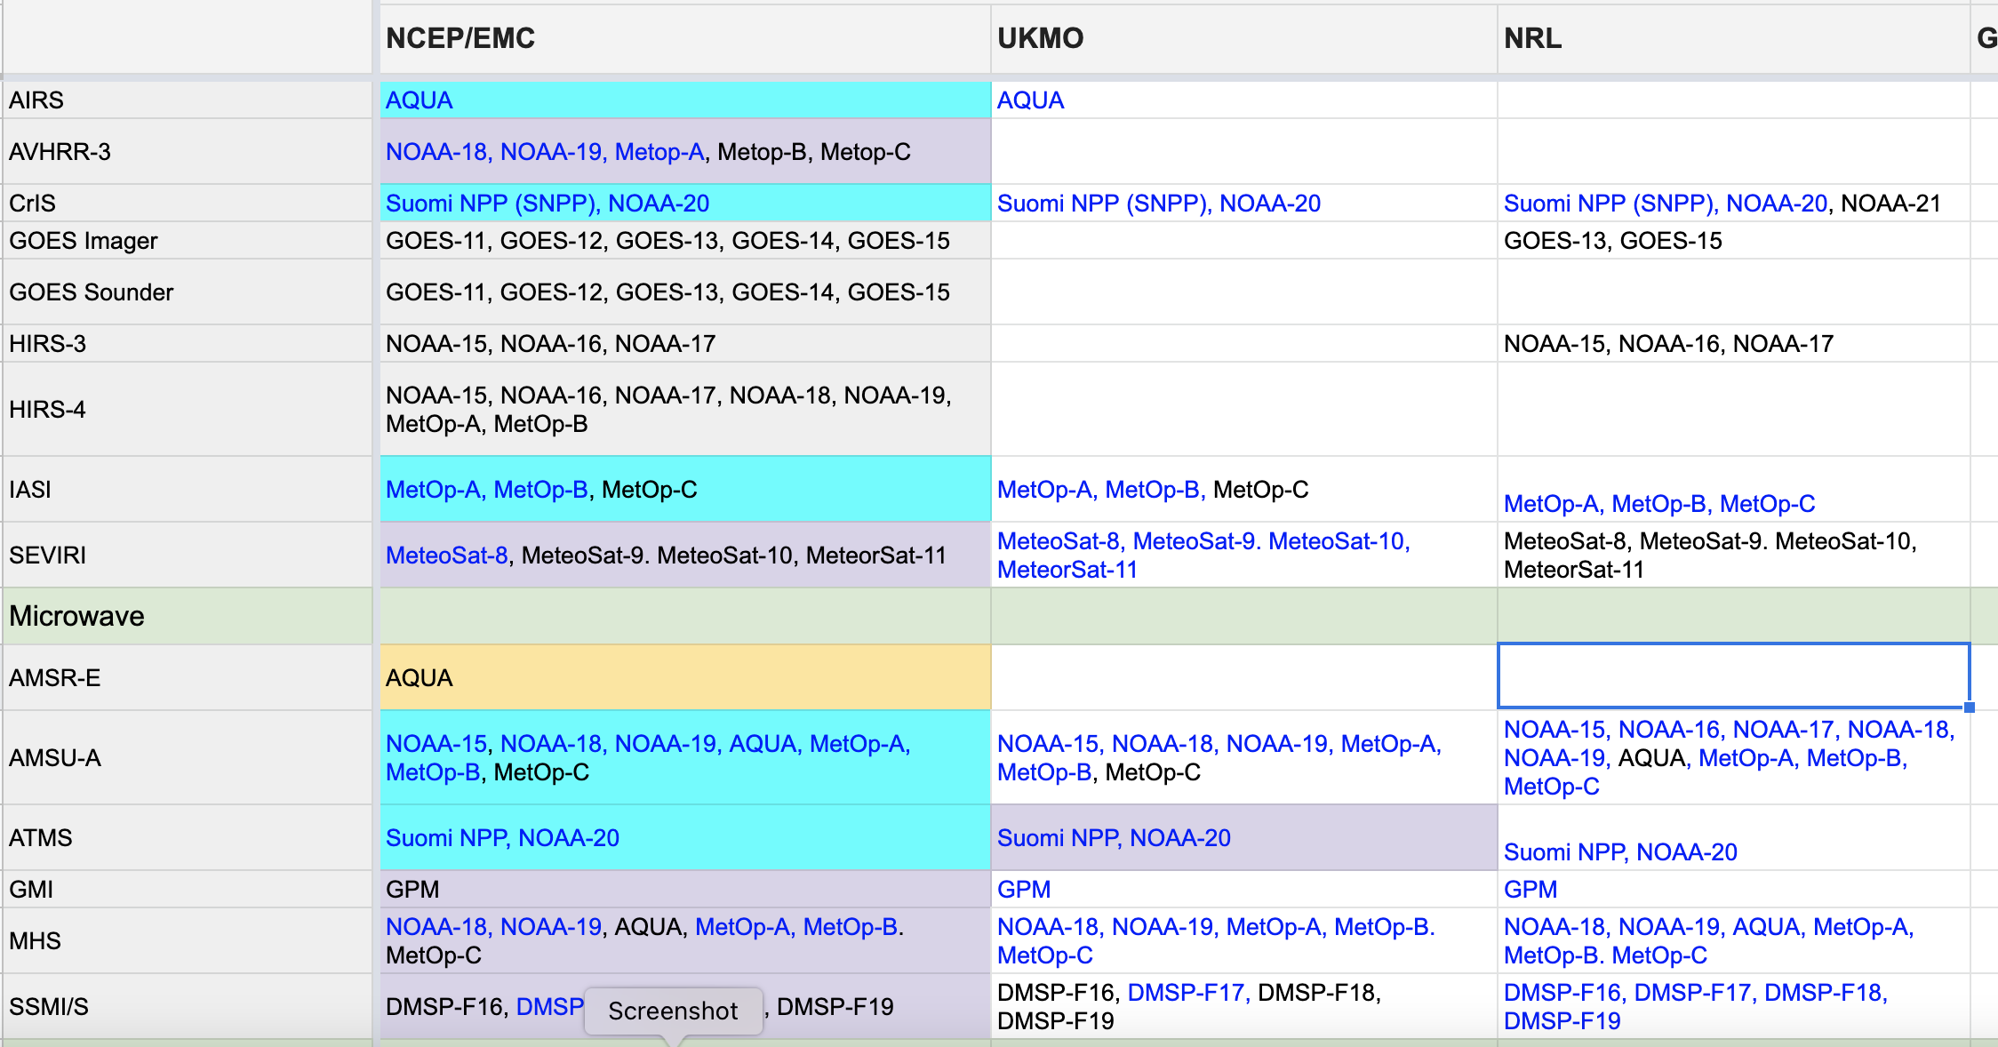
Joint efforts
Active development from all partners, including NOAA, UKMO, GMAO, NRL …
New operators and filters are being developed for different observation types
UFO is being validated for the NOAA global applications (JEDI_GDAS)
Transition table contributed from JCSDA partners

Slide 16
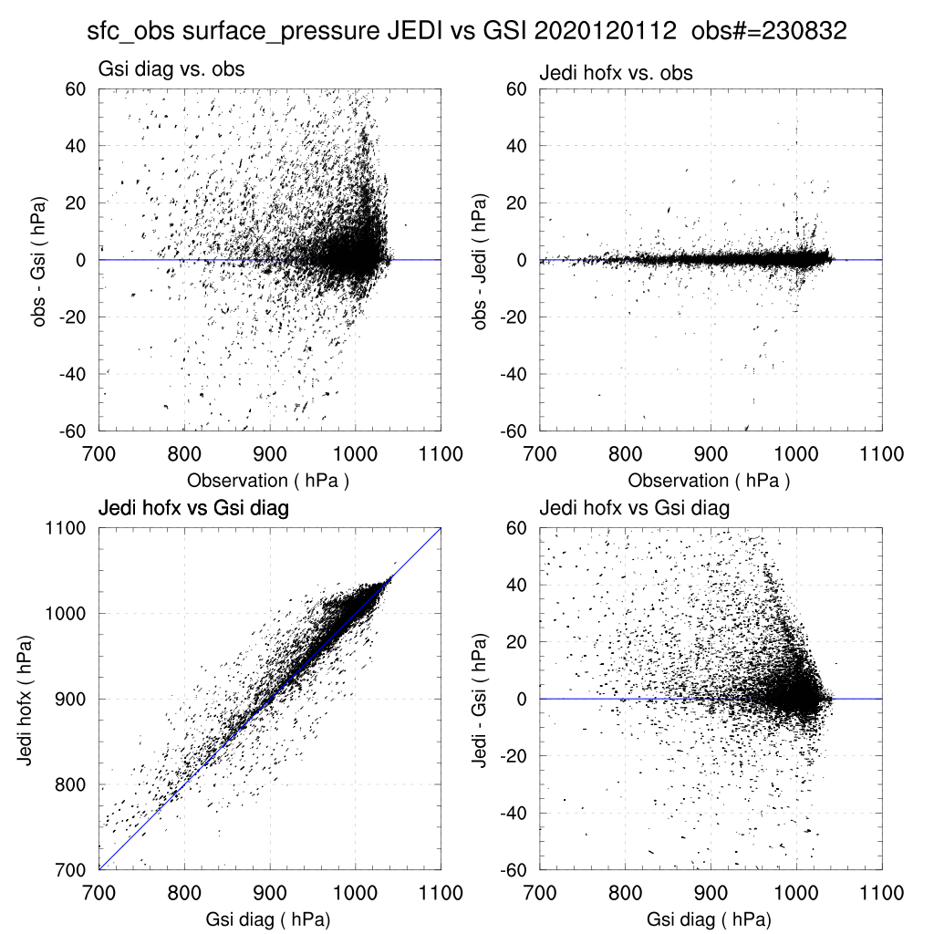
Configured UFO
Generic implementations allows flexibility to switch between operators/QC procedures through configuration files and, therefore, optimize the performance of UFO
You will touch some of the forward operators as well as QC and bias correction filters during the practical sessions
Original scheme from reference
Available UKMO scheme from UFO
O-B (hPa)
Surface pressure simulation vs Obs

Slide 17
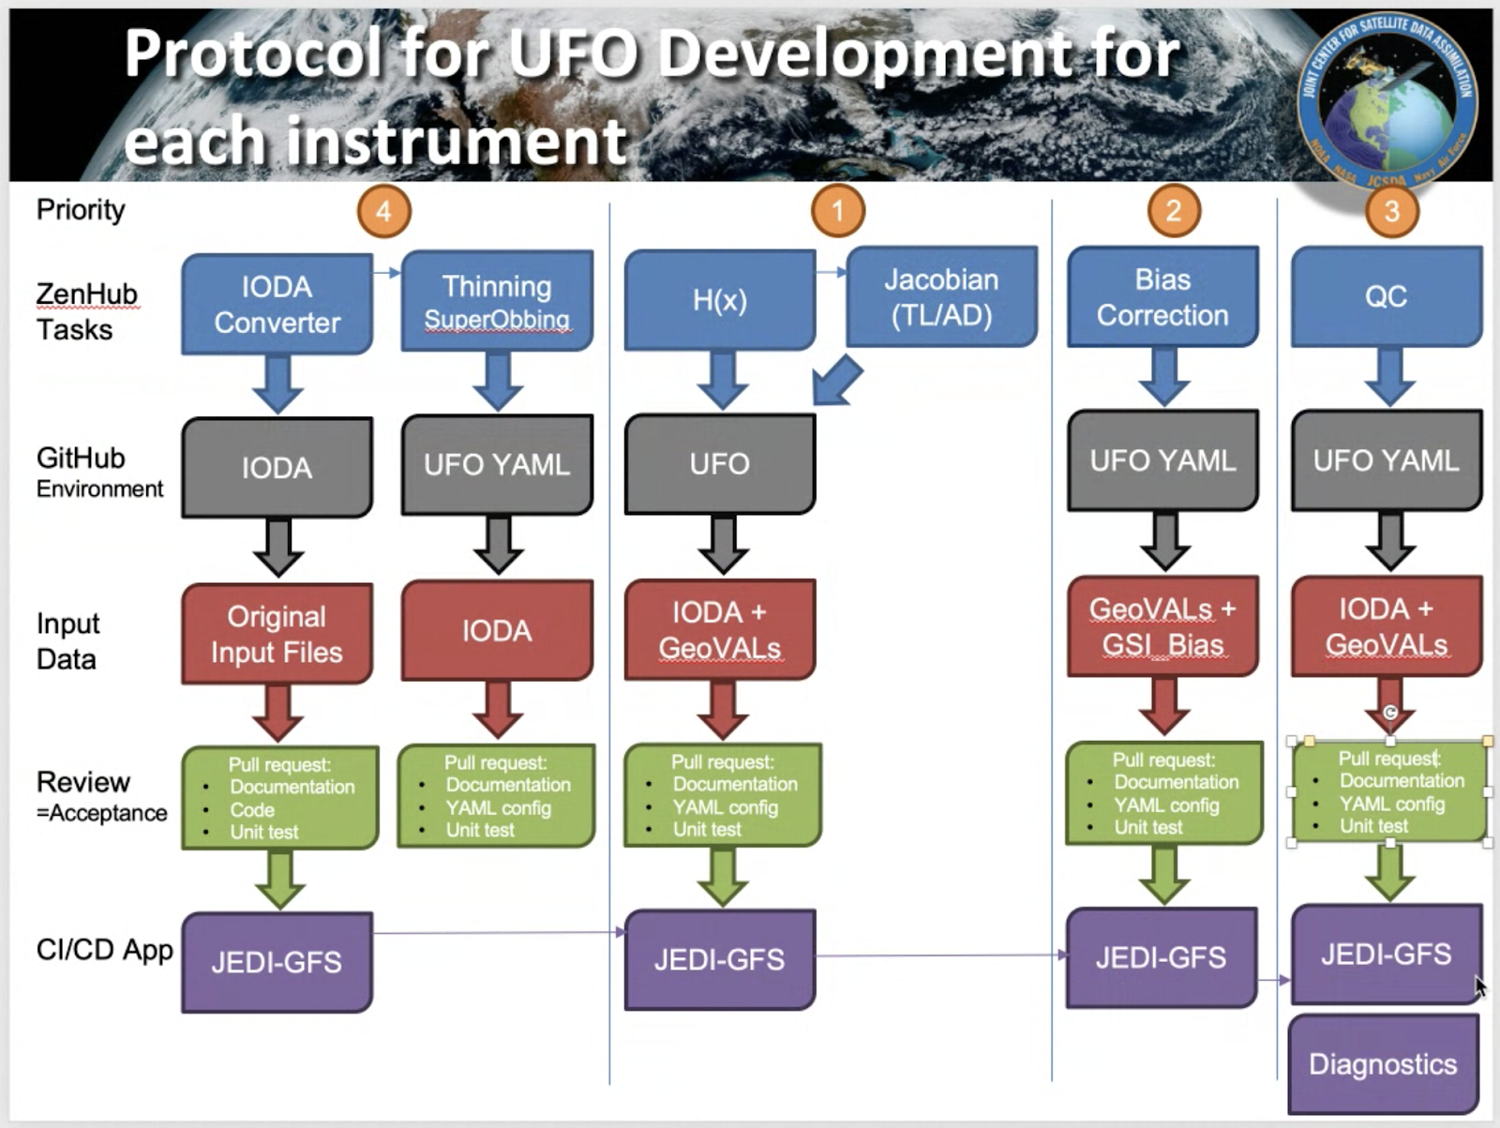

Slide 18
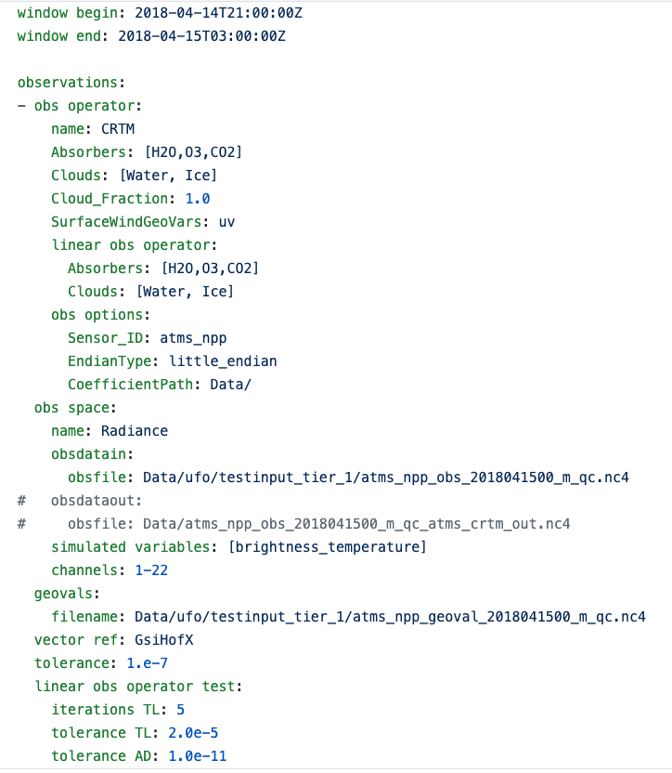

Slide 21
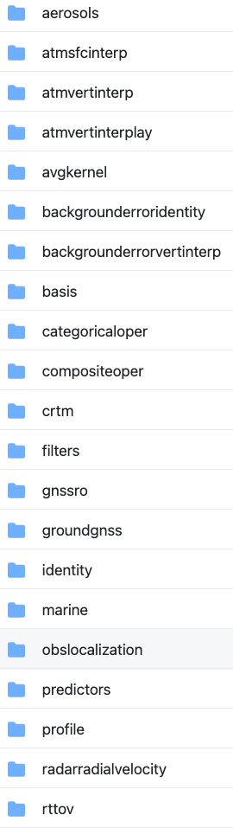
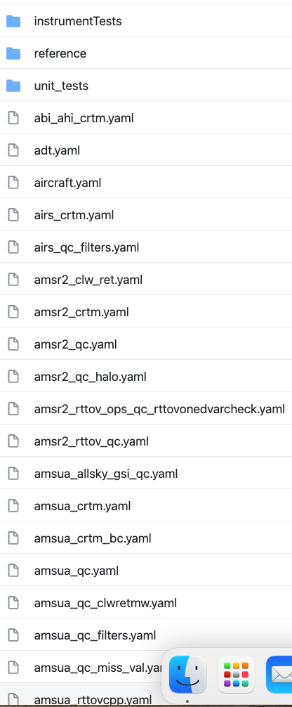
JCSDA/ufo
Validated (yaml) configurations using JEDI_FV3
UFO components
ufo/src/ufo
Interface to CRTM
ufo/test/testinput
Filters for QC, thinning etc
Ctest yaml
Predictors for bias correction

Slide 22
UFO Operators: conventional/retrievals
Generic operators, which could be applied to various observation types (usually doesn’t need to have a variable transform)
VertInterp (ufl/src/ufo/atmvertinterp):
  Atmosphere linear vertical Interpolation (e.g., sonde_gfs_HofX.yaml)
AtmVertInterpLay (ufl/src/ufo/atmvertinterplay) :
  Atmosphere Vertical Layer Interpolation using top and bottom pressure values from obs (ompsnp_npp.yaml (ozone))
GSISfcModel (ufo/src/ufo/atmsfcinterp):
  Atmosphere near surface variable interpolation (right now it follows NOAA GSI implementations. It might be updated in the future to make it more generic with a generic name) (scatwinds_gfs_HofX.yaml)
SfcPCorrected (ufo/src/ufo/sfcpcorrected):
  Apply terrain height correction for surface pressure simulation. Two options: WRFDA scheme and UKMet scheme (sonde_gfs_HofX.yaml)

Slide 23
UFO Operators: radiance
(Lars Isaksen)
CRTM (next talk) and RTTOV
    RTTOV is only available for registered users

Slide 24
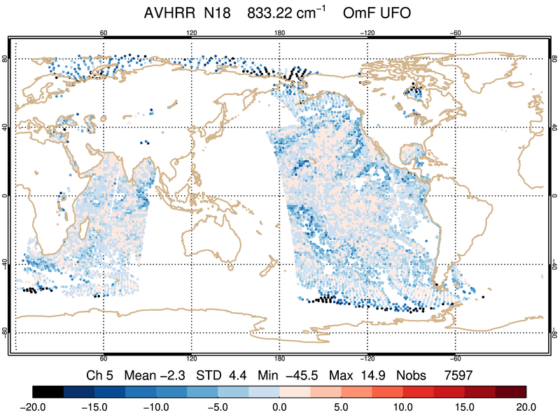
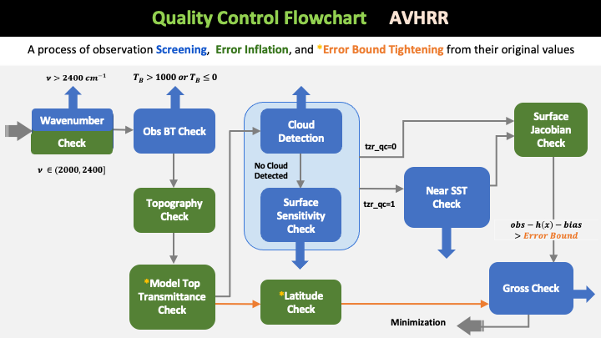
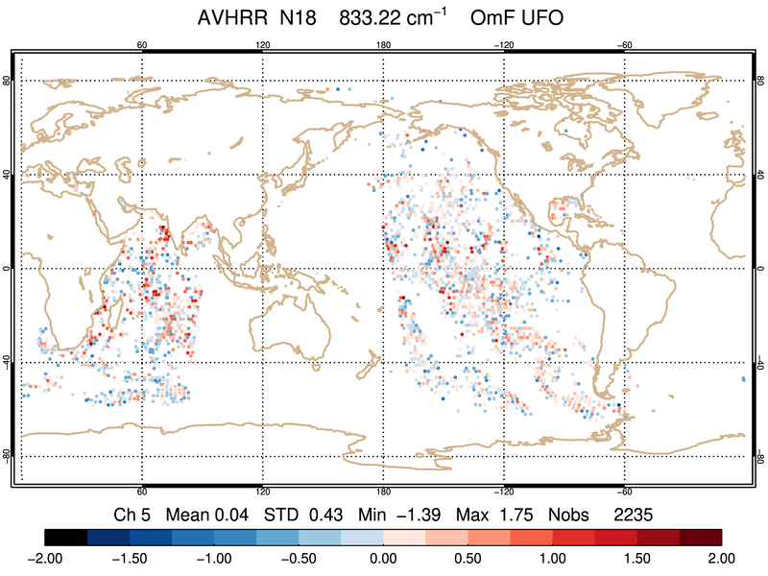

UFO development for AVHRR
Unfiltered
UFO
Filtered
Data filtering using combination of generic filters and obs functions
Parameters defined in GSI resource file (satinfo) for radiances are implemented in YAML
Each QC action implemented has an associated test in UFO
100% replication of GSI result in terms of error inflation, error bound adjustment, and number of observation passed QC filters
GSI
Filtered
Reference

Slide 25
UFO Operators: GNSSRO
Multiple operators are available for GNSSRO in UFO. The following was tested for FV3 background:
  GnssroRef (ufo/src/ufo/gnssro/Ref):
      operator for refractivity
      gnssroref.yaml
  GnssroBndNBAM (ufo/src/ufo/gnssro/BndNBAM):
  1D bending angle operator
  GnssroBnd_gfs.yaml
  GnssroBndROPP1D (uf/src/ufo/gnssro/BndROPP1D):
  1D bending angle operator following ROPP package managed by ROMSAF. Only available to ROPP registered users.
  GnssroBnd_nrt.yaml
  GnssroBndROPP2D (uf/src/ufo/gnssro/BndROPP2D):
  2D ray-tracing operator for bending angle from ROPP. Only available to ROPP registered users.
  GnssroBnd_nrt.yaml

Slide 26
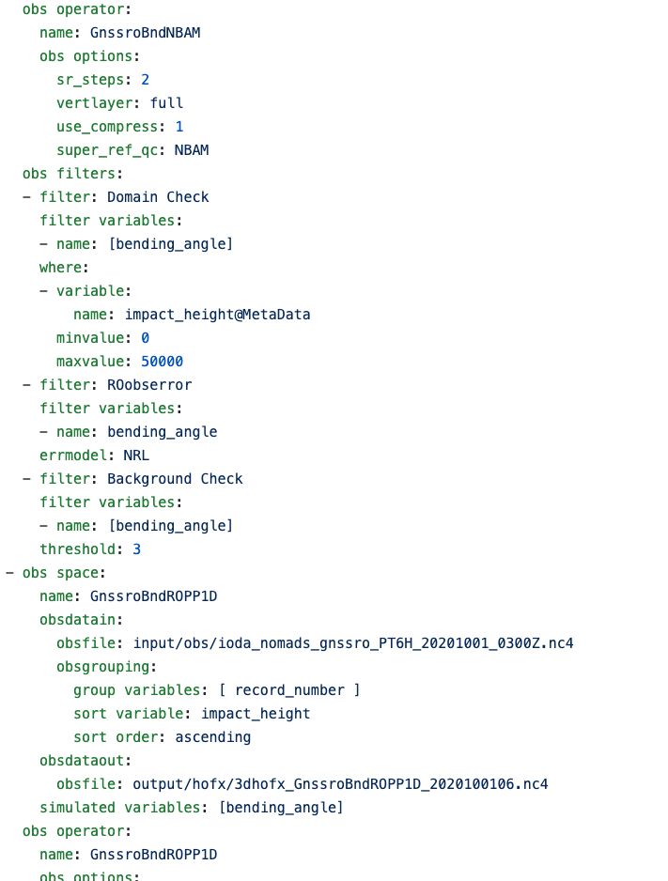
Obs Monitoringc

Slide 27
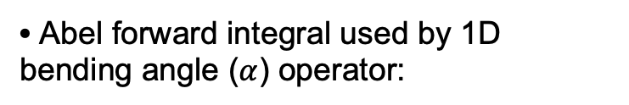

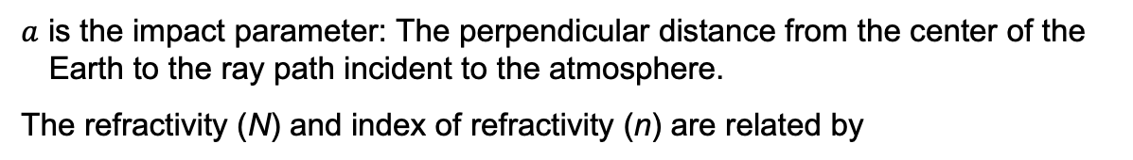
GNSSRO 1D Operators
GPS
Occultation plane
Refractivity (N)
$N=k1\frac{P_{d}}{T}+k2\frac{P_{w}}{T}$+ $k3\frac{P_{w}}{T^{2}}$
K₁,k₂,k₃ are constants.
LEO
Abel forward integral used by 1D bending angle ($α$) operator:
$a$ is the impact parameter: The perpendicular distance from the center of the Earth to the ray path incident to the atmosphere.
The refractivity (N) and index of refractivity (n) are related by
Notes:
The ABel inversion integral mentioned earlier derives the refractivity index as a function of the radius from the bending angle observaiton as a function of impact parameter.
As a completeness, Abel forward integral is also introduced here, which, on the contrary, derives the bending angle from the refractivity ‘index. The relationship between the refractivity and index of refractivity is shown here.

Slide 28

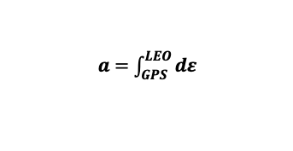



Ray tracing method
n_{ij+1k+1}
n_{i+1j+1k+1}
1) Refractivity
$$n=f(P,T,Q)$$
n_{ij+1k}
n_{i+1j+1k}
2) Ray Equation
$$dε$$
$$\frac{d^{2}\vec{r}}{{dτ}^{2}}=n\vec{∇}n$$
$$n\vec{∇}n$$
n_{i+1jk+1}
n_{i+1j+1k}
3) Bending angle
$a=\int_{GPS}^{LEO}{dε}$
n_{ijk}
The bending angle is computed from the initial and final ray direction.
n_{i+1jk}

Slide 29
Summary
UFO is actively being developed, incorporating research and operational capabilities
Some of the UFO operators have been validated by the OBS core team
All available capabilities, including unit test/validated yaml files, can be found in the UFO github repository
Upstream data conversion/ingest development and scientific validation are in progress

Slide 30
Reference
Aspects of using observations in Data Assimilation (Lars Isaksen, ECWMF training courses)
JEDI doc for UFO: https://jointcenterforsatellitedataassimilation-jedi-docs.readthedocs-hosted.com/en/latest/inside/jedi-components/ufo/index.html

