Slide 1

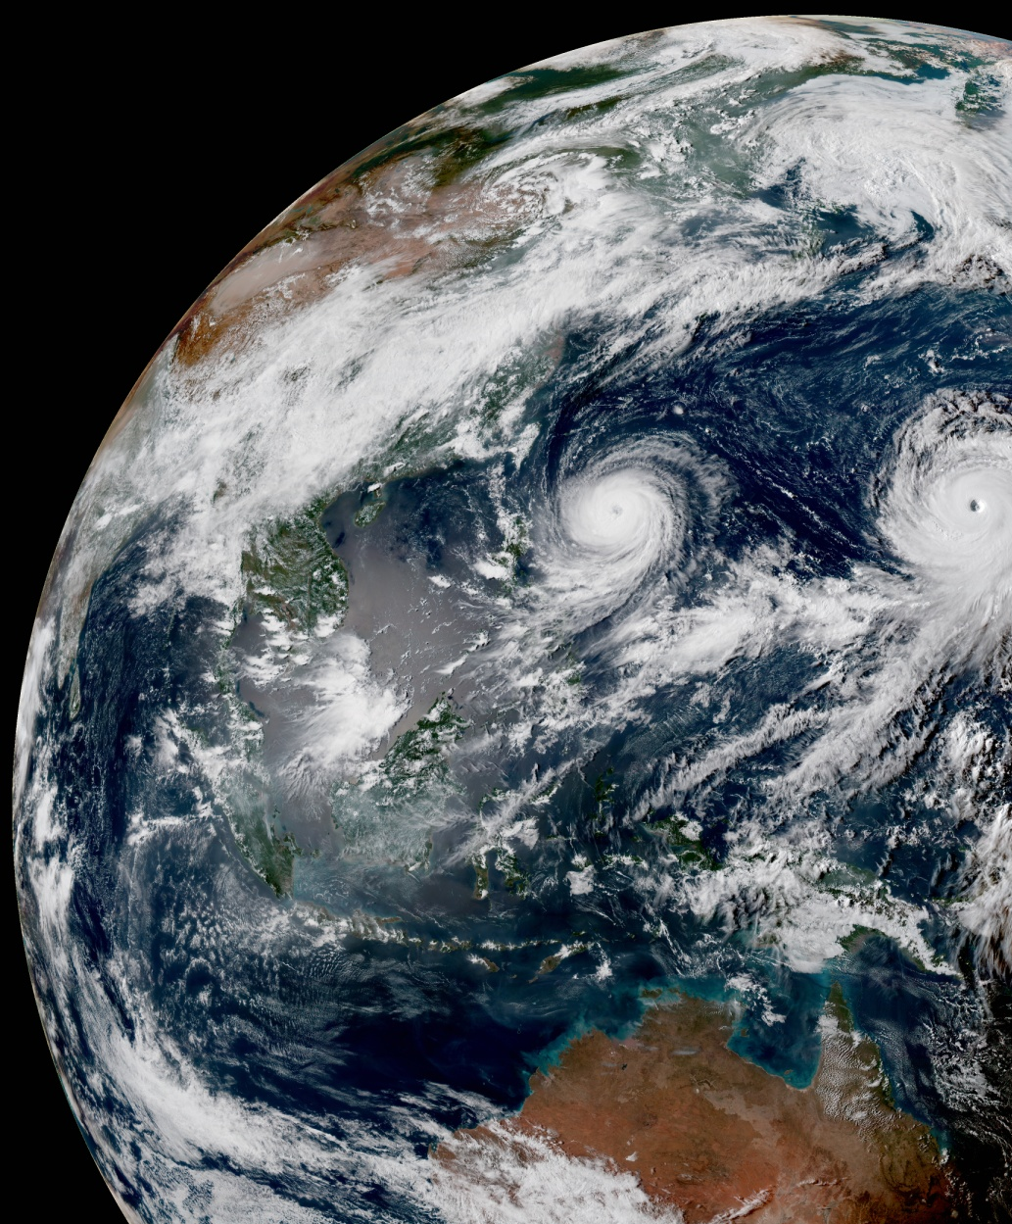
Testing Framework in JEDI
Maryam Abdi-Oskouei
maryamao@ucar.edu
JEDI Academy, Feb 2020

Slide 2
Testing is one of the key components of Agile methodology
Agile testing:
Continuous process and receive feedback in each iteration
Easier to review
Issues are fixed within the same iteration
Types of tests:
Unit tests (test each component) : is input correct? is the answer close to a known answer?, …
Application tests (test the whole system)
In JEDI we use Ctest (Cmake test driver program) to run sets of tests.

Slide 3
Testing Workflow
Reviewers
Master or develop branch
Release
Code development
Merge Code
Pull Request
Version Control System (VCS)

Slide 4
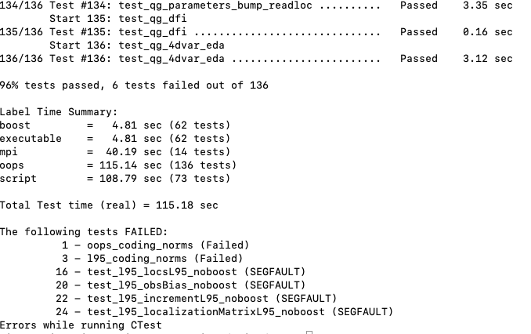
Running tests after building and compiling the bundle
ctest
ctest –R test_name
ctest –VV –R test_name
ctest --rerun-failed
export OOPS_DEBUG=1
export OOPS_TRACE=1
https://jointcenterforsatellitedataassimilation-jedi-docs.readthedocs-hosted.com/en/latest/developer/building_and_testing/unit_testing.html#running-ctest

Slide 5
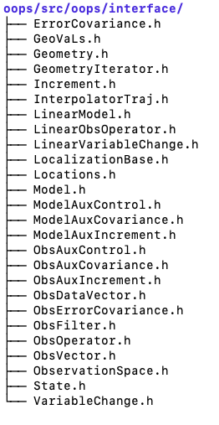
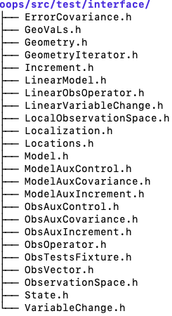
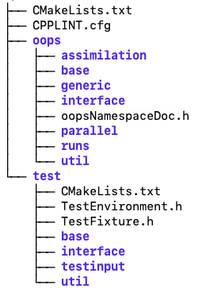
The governance of JEDI testing framework
The governance of the JEDI Testing Framework is to have the test directory mirror the source directory such that each of the main C++ classes defined in the source directory has a corresponding test.
OOPS repo:
src/
CMakeLists.txt is where the tests are added to the suite of tests (ecbuild_add_test()) that is executed by ctest
Configuration (yaml) files

Slide 6
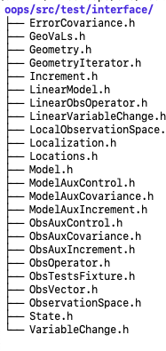
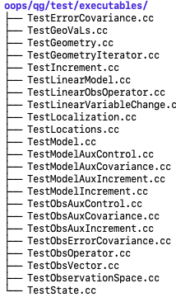
Testing Directory Governance

Slide 7
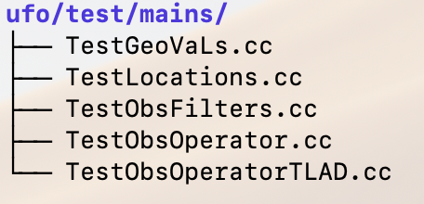
Testing Directory Governance
Ufo/test/mains/TestGeoVaLs.cc

Slide 8
To add a new test you need to register all files with Cmake
test/CMakeLists.txt
iasi_crtm.yaml
window_begin: 2018-04-14T21:00:00Z
window_end: 2018-04-15T03:00:00Z
LinearObsOpTest:
coefTL: 1.e-3
toleranceTL: 1.0e-5
toleranceAD: 1.0e-11
list( APPEND ufo_test_input
…
testinput/mhs_crtm.yaml
testinput/iasi_crtm.yaml
…)
…
ecbuild_add_test( TARGET test_ufo_iasi_opr_crtm
MPI 2
SOURCES mains/TestObsOperator.cc
ARGS "testinput/iasi_crtm.yaml"
LIBS ufo )
…
Tests are added to the suite of tests with “ecbuild_add_test” in CMakeLists.txt
More details on ecbuild_add_test: https://github.com/JCSDA/ecbuild/blob/develop/cmake/ecbuild_add_test.cmake

Slide 9
Important components in *.h file
oops/src/test/interface/GeoVaLs.h
#ifndef TEST_INTERFACE_GEOVALS_H_
#define TEST_INTERFACE_GEOVALS_H_
…
#define ECKIT_TESTING_SELF_REGISTER_CASES 0
…
#include "oops/interface/GeoVaLs.h"
…
#include "oops/runs/Test.h"
#include "test/TestEnvironment.h"
namespace test {
Test Fixtures are generally used to create objects based on relevant sections of configuration (yaml) file
// -----------------------------------------------------------------------------
template <typename MODEL>
class GeoVaLsFixture : private boost::noncopyable {
typedef oops::ObsSpaces<MODEL> ObsSpaces_;
public:
static const util::DateTime & tbgn() {return *getInstance().tbgn_;}
static const util::DateTime & tend() {return *getInstance().tend_;}
static ObsSpaces_ & obspace() {return *getInstance().ospaces_;}
private:
…
}
GeoVaLsFixture(): tbgn_(), tend_(), ospaces_() {
tbgn_.reset(new util::DateTime(TestEnvironment::config().getString("window_begin")));
tend_.reset(new util::DateTime(TestEnvironment::config().getString("window_end")));
const eckit::LocalConfiguration conf(TestEnvironment::config(), "Observations");
ospaces_.reset(new ObsSpaces_(conf, oops::mpi::comm(), *tbgn_, *tend_));
}
~GeoVaLsFixture() {}
..
};

Slide 10
Important components in *.h file
oops/src/test/interface/GeoVaLs.h
template <typename MODEL> void testConstructor() {
typedef GeoVaLsFixture<MODEL> Test_;
typedef oops::GeoVaLs<MODEL> GeoVaLs_;
typedef oops::Locations<MODEL> Locations_;
typedef oops::ObsOperator<MODEL> ObsOperator_;
const eckit::LocalConfiguration obsconf(TestEnvironment::config(), "Observations");
std::vector<eckit::LocalConfiguration> conf;
obsconf.get("ObsTypes", conf);
for (std::size_t jj = 0; jj < Test_::obspace().size(); ++jj) {
ObsOperator_ hop(Test_::obspace()[jj], conf[jj]);
Locations_ locs(hop.locations(Test_::tbgn(), Test_::tend()));
boost::scoped_ptr<GeoVaLs_> ov(new GeoVaLs_(locs, hop.variables()));
EXPECT(ov.get());
ov.reset();
EXPECT(!ov.get());
}
}
Example of a testConstructor in GeoVaLs.h, this test makes sure you construct correctly

Slide 11
Important components in *.h file
oops/src/test/interface/GeoVaLs.h
template <typename MODEL>
class GeoVaLs : public oops::Test {
public:
GeoVaLs() {}
virtual ~GeoVaLs() {}
private:
std::string testid() const {return "test::GeoVaLs<" + MODEL::name() + ">";}
void register_tests() const {
std::vector<eckit::testing::Test>& ts = eckit::testing::specification();
ts.emplace_back(CASE("interface/GeoVaLs/testConstructor")
{ testConstructor<MODEL>(); });
ts.emplace_back(CASE("interface/GeoVaLs/testRead")
{ testRead<MODEL>(); });
}
};
} // namespace test
#endif // TEST_INTERFACE_GEOVALS_H_
In order for eckit to run your tests, you have to register each individual test. This is achieved by means of the register_tests() method
Notes:
In order for eckit to run your tests, you have to register each individual test. This is achieved by means of the register_tests() method of test::MyClass

Slide 12
Examples for EXPECT command
EXPECT(TestContainer.get());
EXPECT(Nlocs == ExpectedNlocs);
EXPECT(is_close(Vnorm, ExpectedVnorm, Tolerance));
EXPECT(val < tolerance)

Slide 13
Create an executable
ufo/test/mains/TestGeoVaLs.cc
oops/qg/test/executables/TestGeoVals.cc
#include "model/QgTraits.h"
#include "oops/runs/Run.h"
#include "test/interface/GeoVaLs.h"
int main(int argc, char ** argv) {
oops::Run run(argc, argv);
test::GeoVaLs<qg::QgTraits> tests;
run.execute(tests);
return 0;
}
#include "ufo/UfoTrait.h"
#include "oops/runs/Run.h"
#include "test/interface/GeoVaLs.h"
int main(int argc, char ** argv) {
oops::Run run(argc, argv);
test::GeoVaLs<ufo::UfoTrait> tests;
run.execute(tests);
return 0;
};
execute() method is defined in oops/src/oops/runs/Test.h

Slide 14
class Test : public Application {
public:
Test() {}
virtual ~Test() {}
int execute(const eckit::Configuration & config) const;
private:
virtual void register_tests() const = 0;
virtual std::string testid() const = 0;
static bool init_unit_test() {return true;}
std::string appname() const {return "oops::Test running " + testid();}
};
// -----------------------------------------------------------------------------
oops/src/oops/runs/Test.h
int Test::execute(const eckit::Configuration & config) const {
// Setup configuration for tests
test::TestEnvironment::getInstance().setup(config);
// Generate the argc and argv arguments for unit_test_main(...)
int argc = 1;
char * argv[argc];
char dummy[] = "abcde";
argv[0] = dummy;
// Run the tests
Log::trace() << "Registering the unit tests" << std::endl;
register_tests();
Log::trace() << "Running the unit tests" << std::endl;
int result = eckit::testing::run_tests(argc, argv, false);
Log::trace() << "Finished running the unit tests" << std::endl;
Log::error() << "Finished running the unit tests, result = " << result << std::endl;
// Return test status
return result;
}
https://github.com/ecmwf/eckit/blob/develop/src/eckit/testing/Test.h

Slide 15
Adding a new test
! Make sure your test fails !
Step 1: Create a File for your Test Application
Step 2: Define A Test Fixture
Step 3: Define Your Unit Tests
Step 4: Register your Unit Tests with eckit
Step 6: Create an Executable
Step 7: Create a Configuration File
Step 8: Register all files with CMake and CTest
Useful examples in oops:
Useful examples in ufo:
/ufo/test/ufo/
├── GaussianThinning.h
├── GeoVaLs.h
├── Locations.h
├── ObsDiagnostics.h
├── ObsFilterData.h
├── ObsFilters.h
├── ObsFunction.h
├── Parameters.h
├── ProcessWhere.h
├── RecursiveSplitter.h
├── TemporalThinning.h
└── Variables.h
Most of the infrastructure is already in place. Most likely you will only need step 7 and step 8.
More information in the practical session!
Link to the documentation: https://jointcenterforsatellitedataassimilation-jedi-docs.readthedocs-hosted.com/en/latest/developer/building_and_testing/adding_a_test.html

Slide 16
Code development and automated testing workflow
Automated testing tools
Test outputs are posted to the PR discussion using Webhooks
Run multiple configurations in parallel using containers and cloud computing
Containers
Travis-CI is free for open source but has limits
AWS CodeBuild not free but cheap, different instances available
Travis-CI
+
DockerHub
AWS CodeBuild
AWS ECR
Reviewers
VCS
Code developer
Merge Code
GitHub
Pull Request

Slide 17


Container: A packaged user environment that can be “upacked” and used across different systems, from laptops to cloud to HPC
Standardized packaging for software and dependencies
Build and test across multiple platforms
Increase portability and reusability of the code
Docker
Singularity
Automated testing
Container 1
JEDI-stack
Container 2
HPC
Container 3
Workstations
Mark Miesch, JCSDA

Slide 18
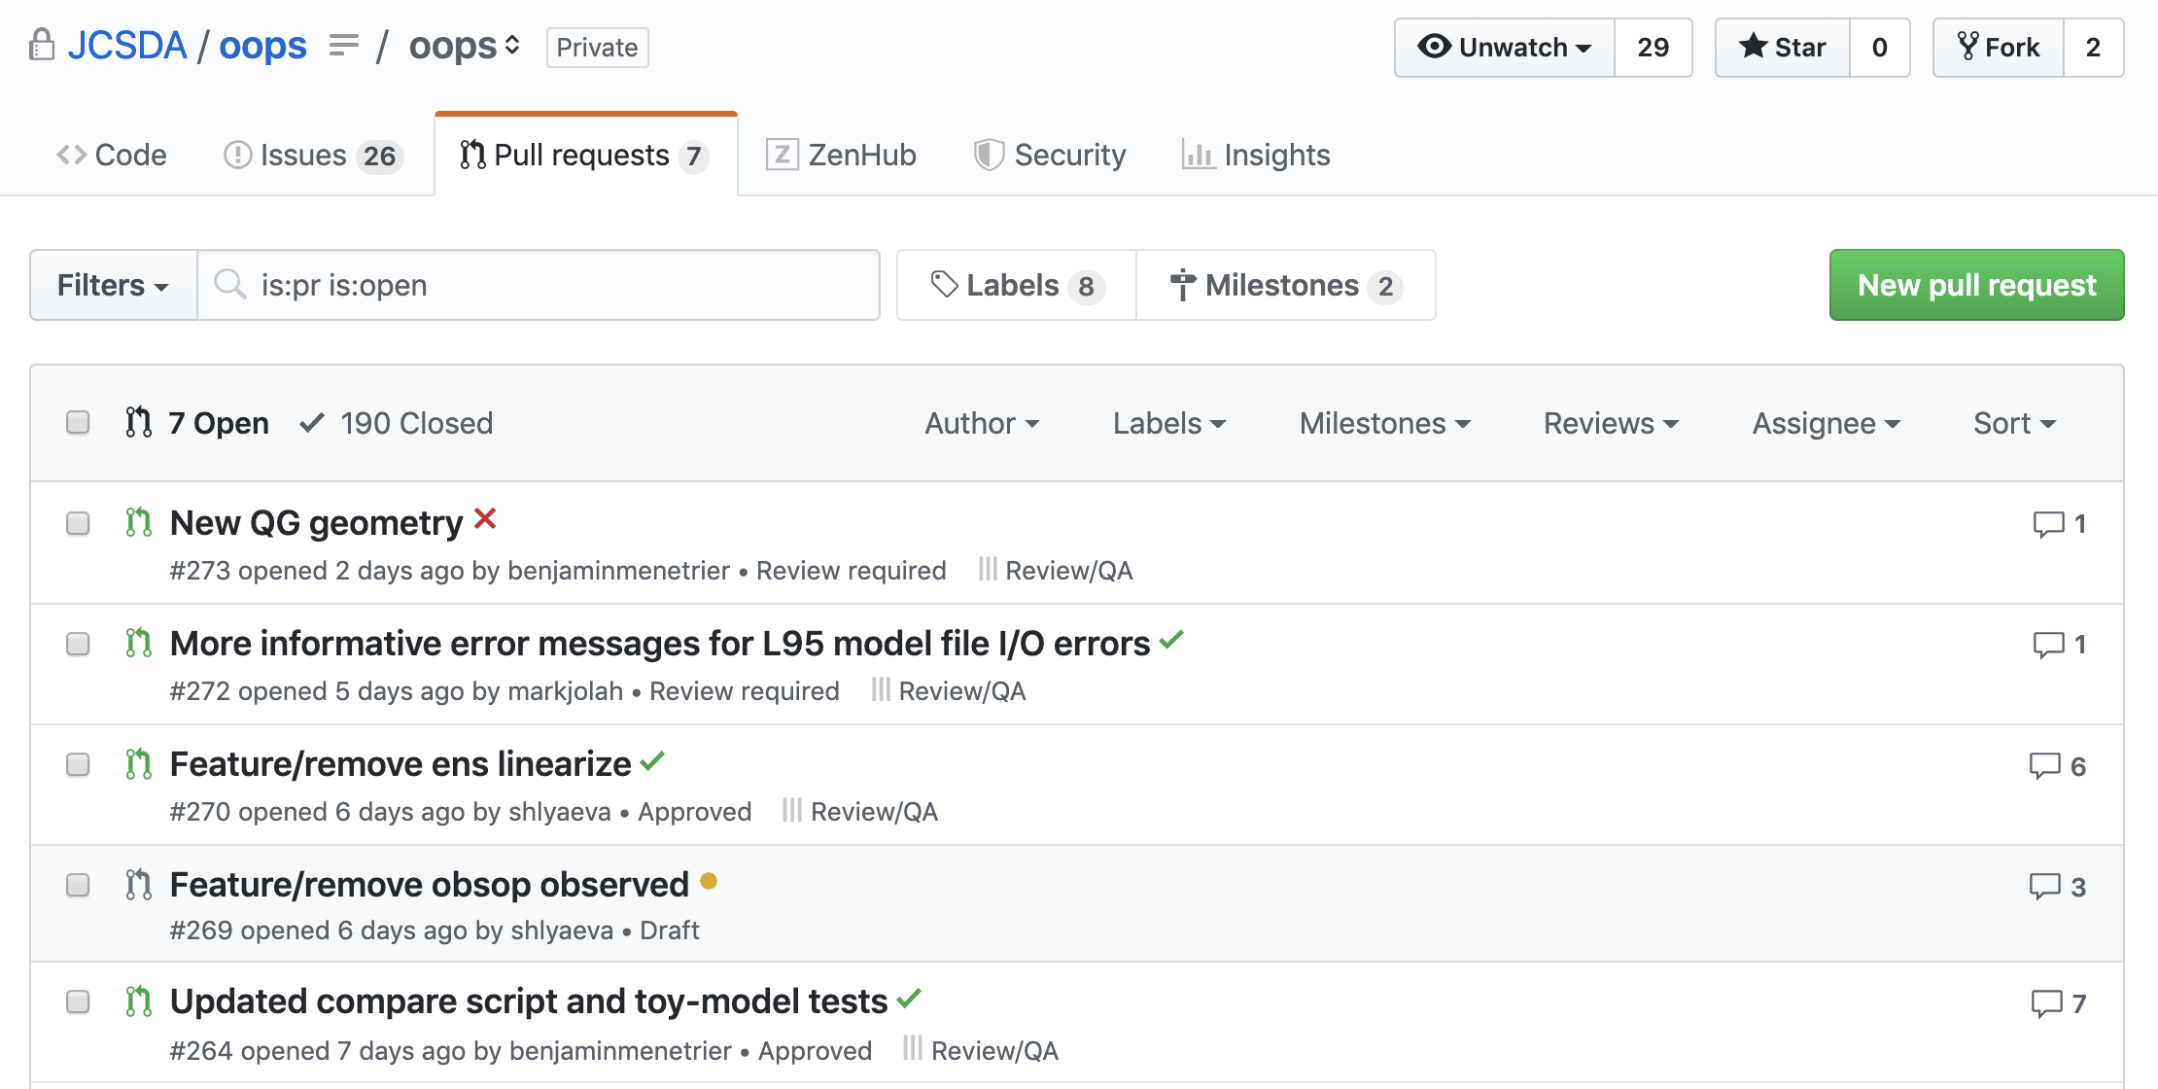
Example of automated testing interface in OOPS

Slide 19
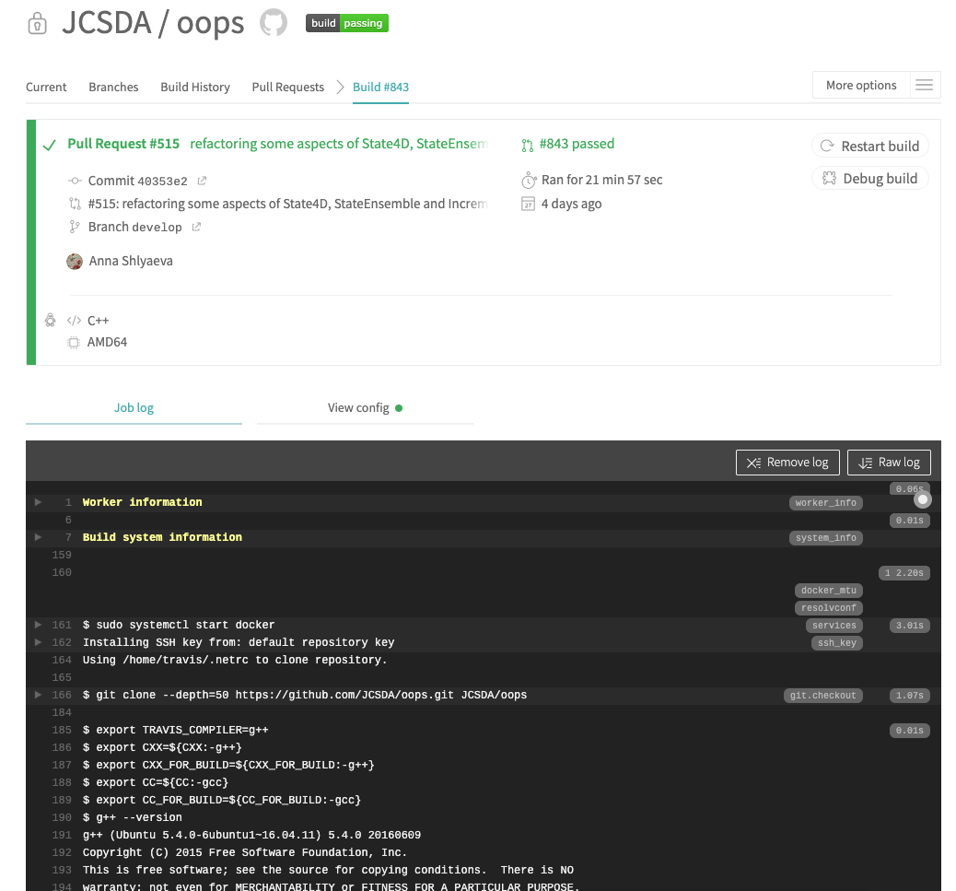
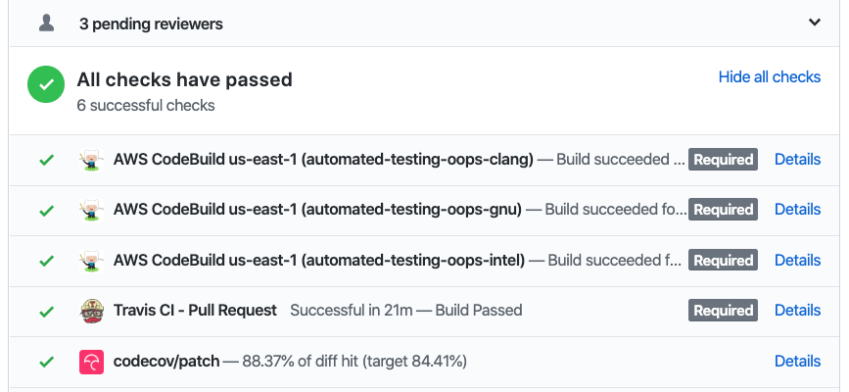

Slide 20
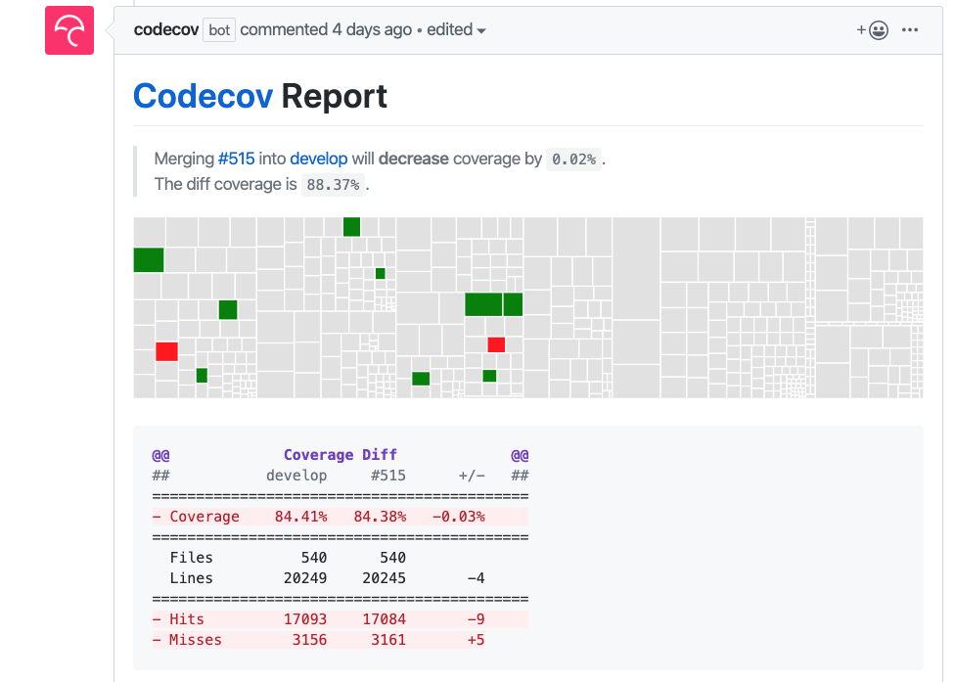
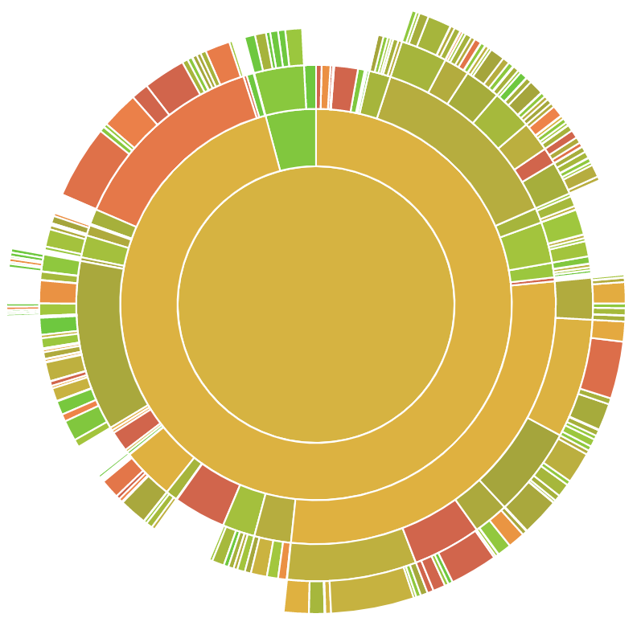
CodeCov report:
/src/ufo/marine
/
/src/ufo/filters
/src/ufo
Notes:
-DCMAKE_BUILD_TYPE=Debug -DENABLE_GPROF=ON

