Slide 1
JEDI and C++
Ryan Honeyager JEDI core team
honeyage@ucar.edu
February 27, 2020

Slide 2
Why Use C++?
We want JEDI to provide an abstract interface layer that separates the state, model, covariances, observation operators, et cetera from their specific implementations.
We want to take advantage of many new libraries and capabilities that are available in other languages.
We want to write fast code that can be implemented in an operational context.

Slide 3
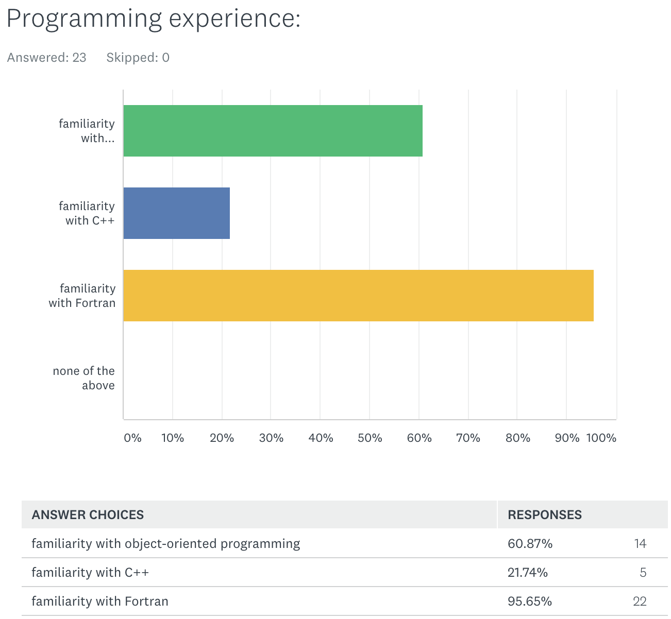
Survey Results

Slide 4
C++ Resources
Tutorials (easier):
http://www.cplusplus.com/doc/tutorial/
https://www.geeksforgeeks.org/
How to write good, modern C++ (moderate):
https://isocpp.github.io/CppCoreGuidelines/CppCoreGuidelines
http://www.stroustrup.com/resource-model.pdf
C++ reference (technical):
https://en.cppreference.com/
Libraries:
https://www.boost.org/
http://eigen.tuxfamily.org/

Slide 5
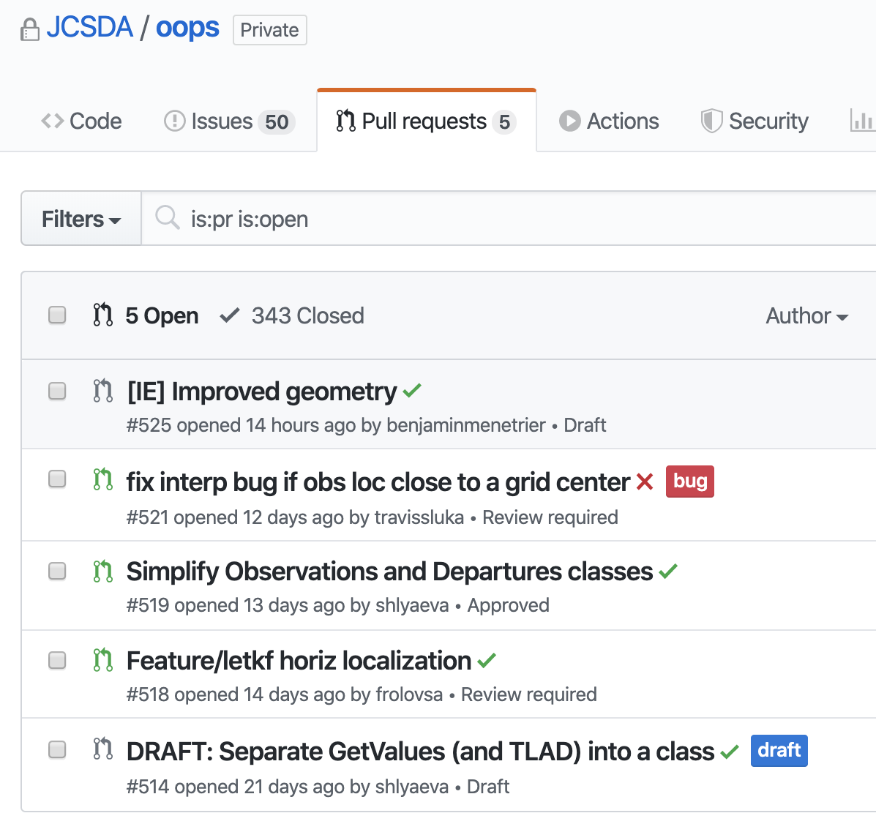
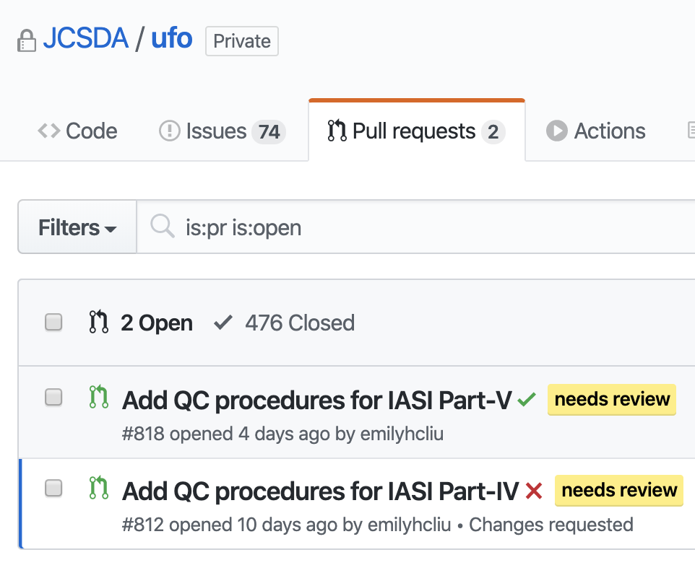
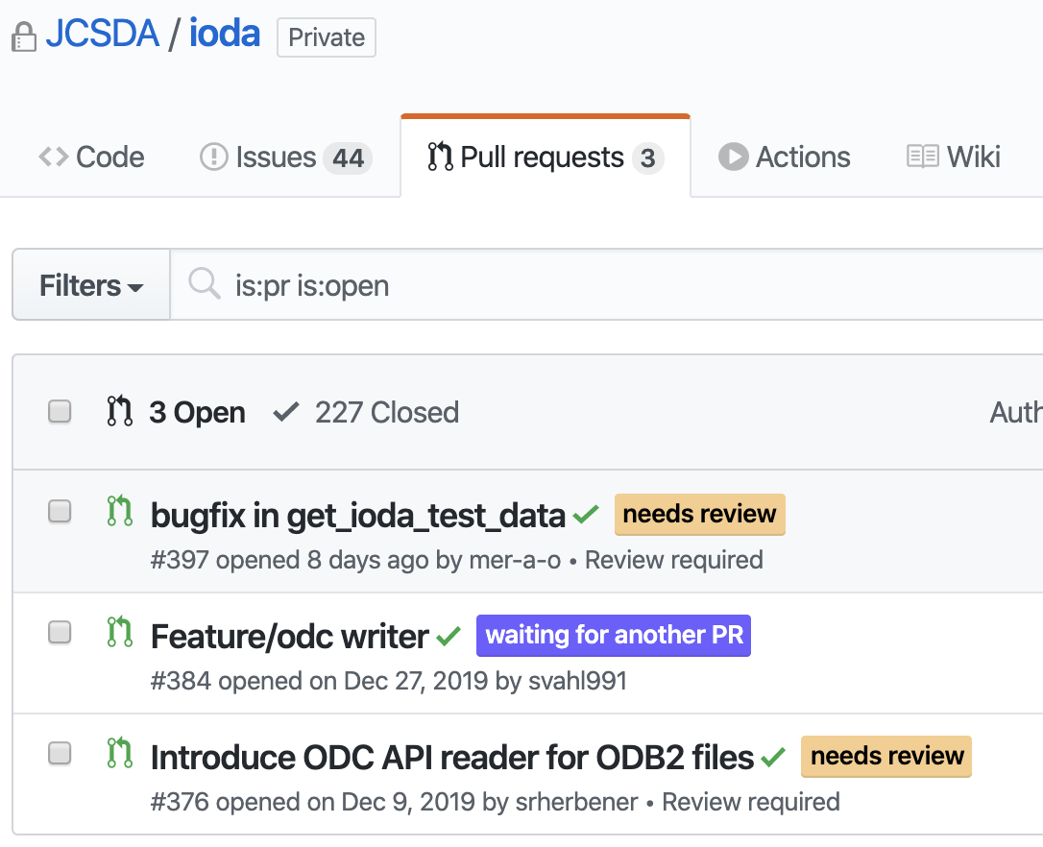
Code Reviews

Slide 6
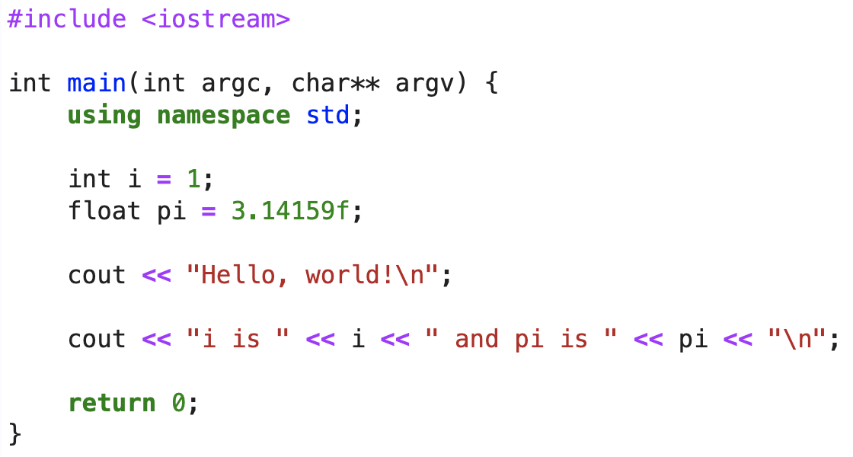
Hello, World!

Slide 7
A Really Terse Development of Programming
In the beginning, there were calculators. They had a few logic gates and maybe a register or two of memory.
1948 – First assembler. Used one-letter mnemonics in place of binary instructions.
1954 – First FORTRAN. 95% reduction in code length vs assembly languages.
Fortran 66 supported program units (SUBROUTINE, FUNCTION), several data types, library functions, flow control, comments, basic I/O, go-tos, and variable names up to 6 characters in length.

Slide 8
A Really Terse Development of Programming
1972 – First release of C, based on B and BCPL.
1979 – K&R C “standard”, and 1989/1990 – ANSI C standard
Convergent development with Fortran – many similar features.
Gotchas vis Fortran:
C extensively uses memory pointers.
C can pass data by value, reference or by pointer.
C frequently relies on a simple macro pre-processing language.
Different array indices.
C-Fortran data structure compatibility is still being standardized.

Slide 9
A Few C Limitations: Lack of Scope & Overloading
All functions have the same scope, so no two functions can have the same name. Causes problems with libraries.
You need to write separate functions to do similar tasks with different data types.
fabs(double) vs fabsf(float) vs fabsl(long double) vs labs(long int) vs llabs(long long int).
Macro-magic can help to get around this, but then the result is really hard to debug.

Slide 10
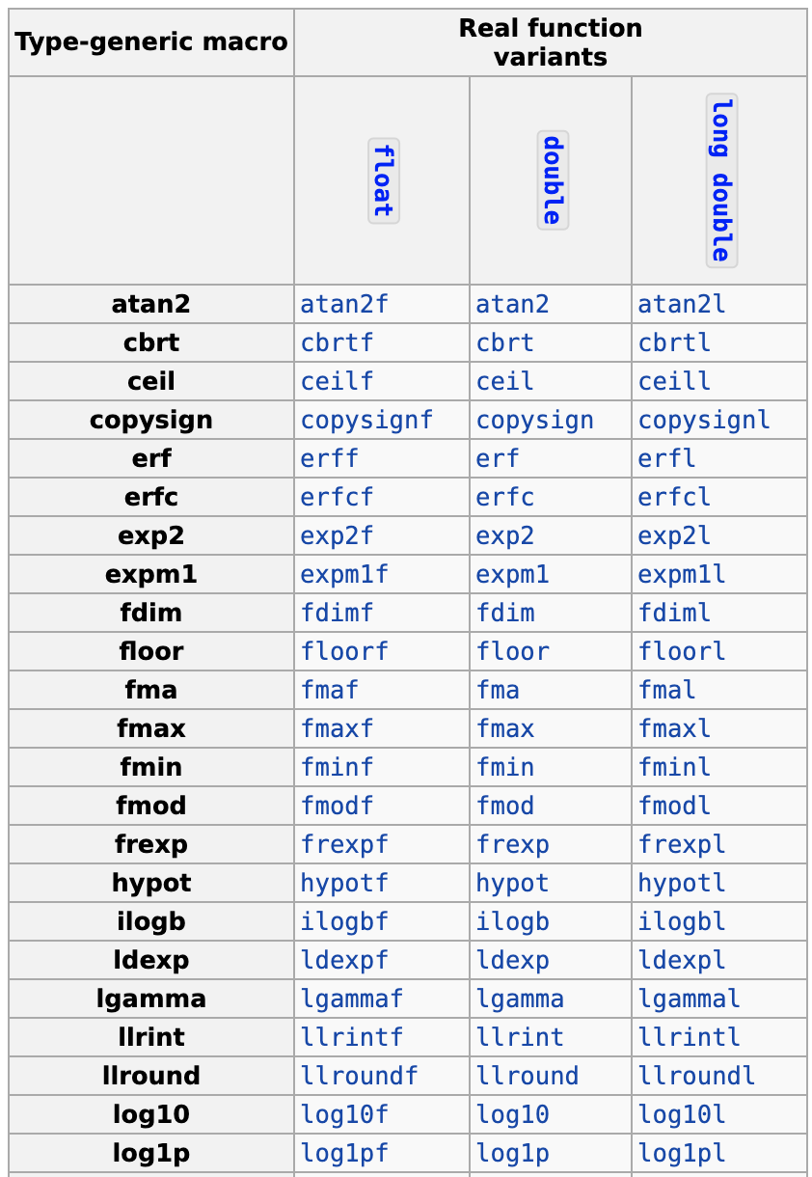
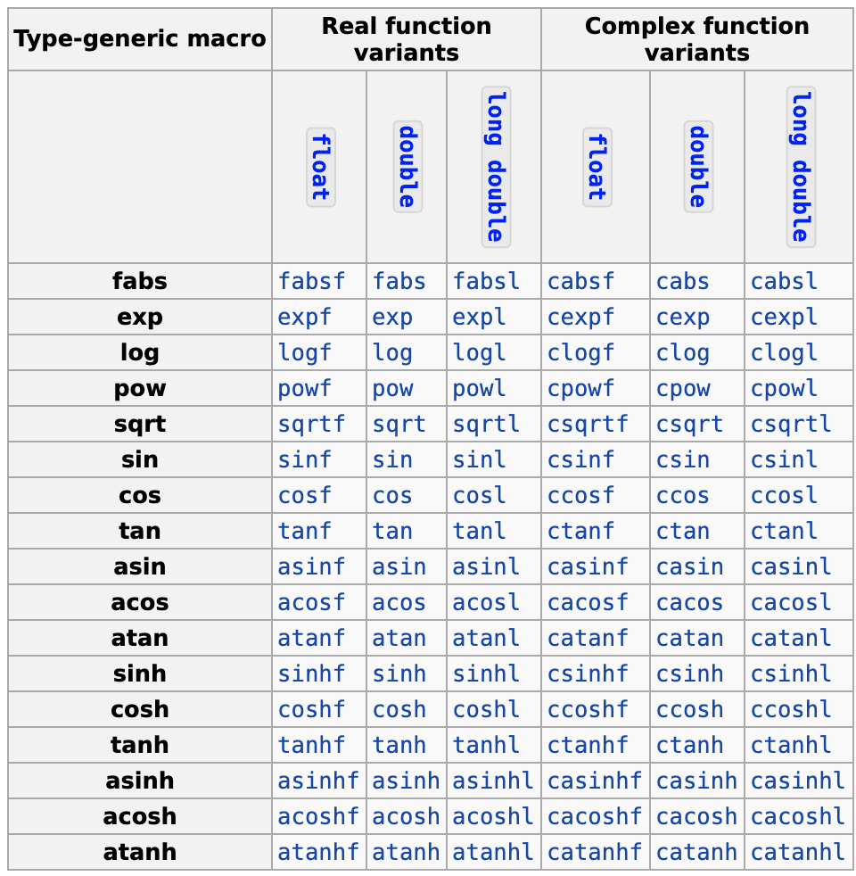
A Few C Limitations

Slide 11
A Few C Limitations: No Objects
There are no true “objects” and the language is best-suited for plain-old data types. Have to allocate, initialize and deallocate structures manually, which is error-prone.
Also, you have to manually check the result of every function call for errors, and most people forget to do this.

Slide 12
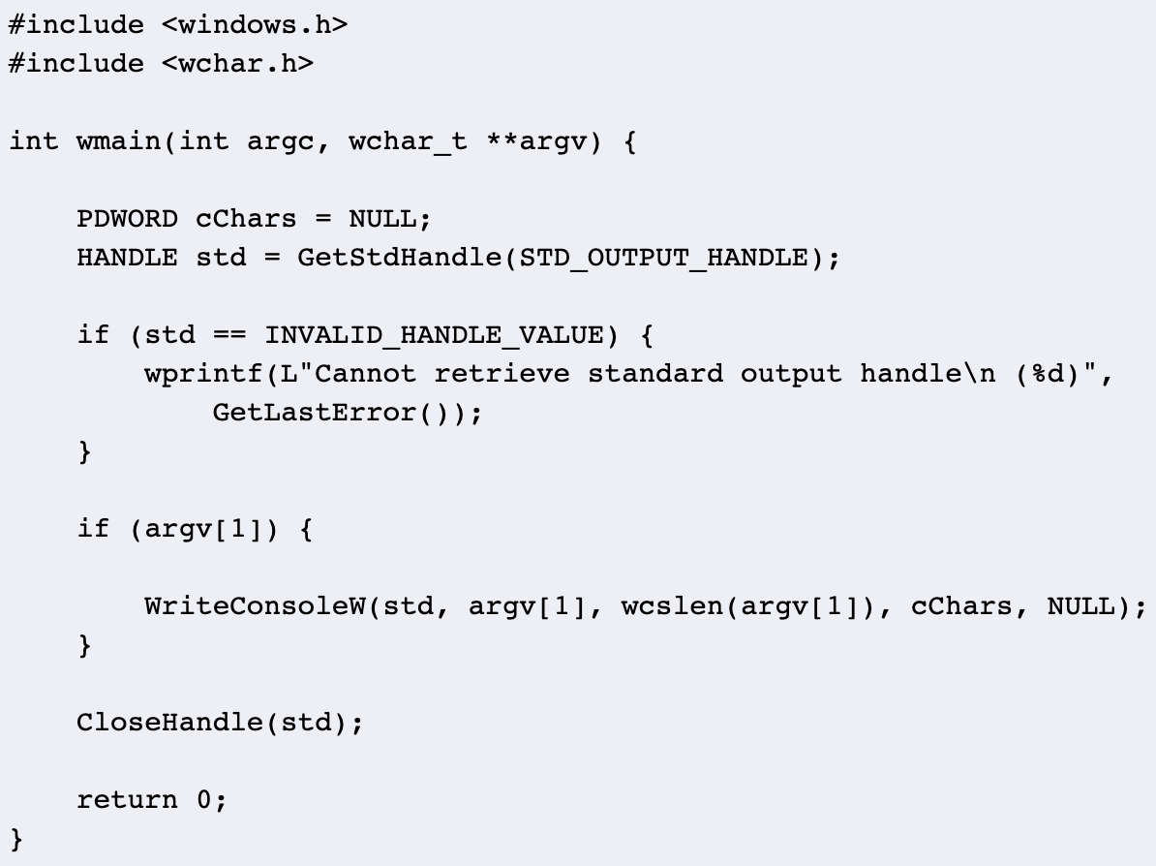
A Few C Limitations
There are no true “objects” and the language is best-suited for plain-old data types. Have to allocate, initialize and deallocate structures manually, which is error-prone.
Also, you have to manually check the result of every function call for errors, and most people forget to do this.

Slide 13
A Few C Limitations: Library Support
The standard C library provides facilities for interacting with the underlying OS (via FILEs), some math, and some string manipulation functions.
It entirely lacks support for data storage containers.

Slide 14
Objects and Classes
Image credit: http://www.trytoprogram.com/cplusplus-programming/class-object/

Slide 15
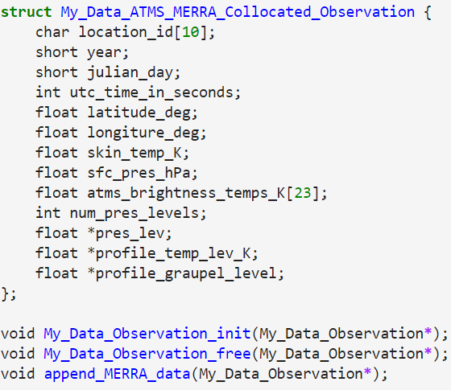
An Evolution of C-style Structs into Objects
Structs are a way to encapsulate groups of data together.
Structs can contain fundamental types, pointers, and other structs.
As structs become more complex, then you start to have to add in support functions to construct, deallocate and otherwise manipulate objects.

Slide 16
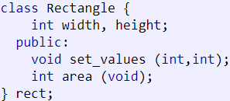
C++ Objects and Classes
What is an object?
It’s an instance of a class / the working entity of a class.
What is a class?
It is a template or blueprint about the capabilities of what an object can do.
This declares a class (i.e. a type) called Rectangle and an object (i.e. a variable) of this class, called rect.
The class has four members: width, height, set_values, and area.
The class name (Rectangle) and the object name (rect) are different.
Similar to: int a;

Slide 17
C++ Objects and Classes
Why use objects?
Encapsulation
Keep resources (records) together. Tie functions with the data that they work with.
Abstraction
Hide unnecessary implementation details from the end-user of the object.
Inheritance
Derive characteristics and functionality from another object.
Polymorphism
Use the same interface to operate on different types of objects.

Slide 18
Encapsulation and Abstraction
width, height are private. A consumer of the Rectangle class won’t be able to modify them directly. Instead, they must go through the set_values function.
The area and perimeter functions are bound to the class.

Slide 19
Object Lifecycle
Constructors and Destructors
A constructor is a function that runs when an object is first instantiated.
A destructor runs when an object is destroyed, usually when going out of scope.
Setup
Functions
Clean-up

Slide 20
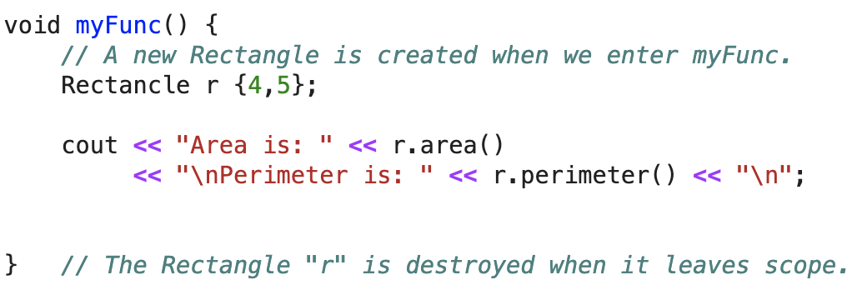
Object Lifecycle
Constructors and Destructors
Setup
Functions
Clean-up

Slide 21
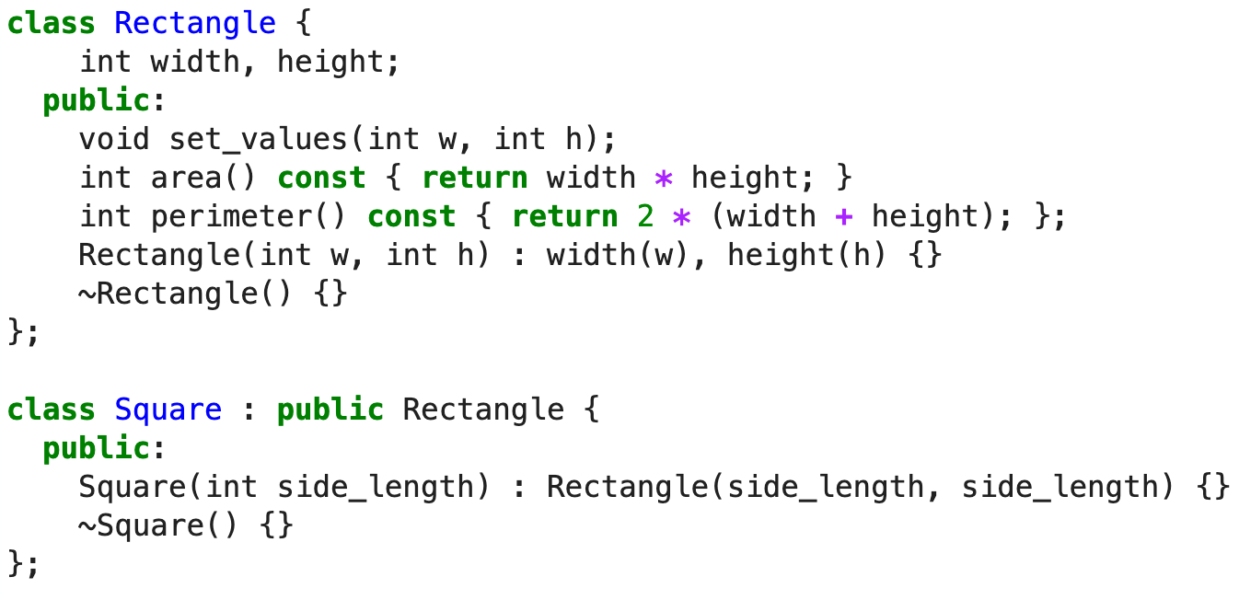
Inheritance

Slide 22
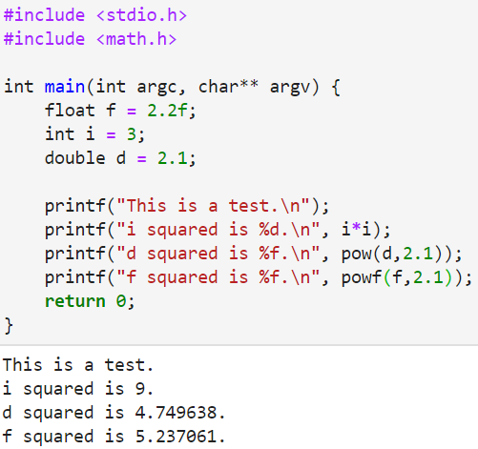
Polymorphism: Function Overloading
In C:
We want to take a power of a number. We must use differently-named functions to do the same thing for different types.

Slide 23
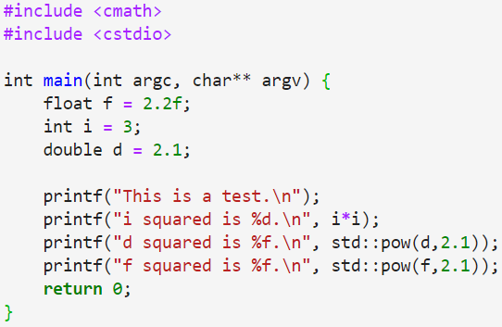
Polymorphism: Function Overloading
In C++:

Slide 24
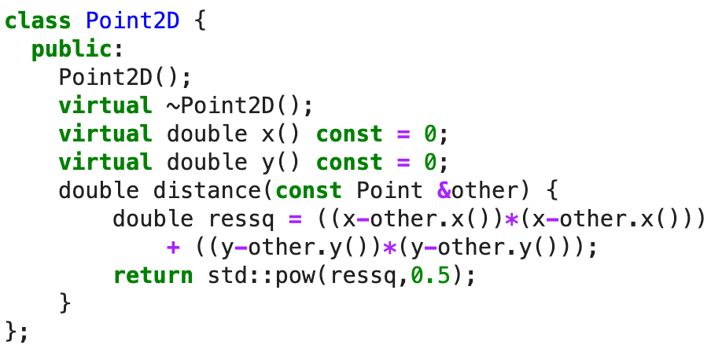
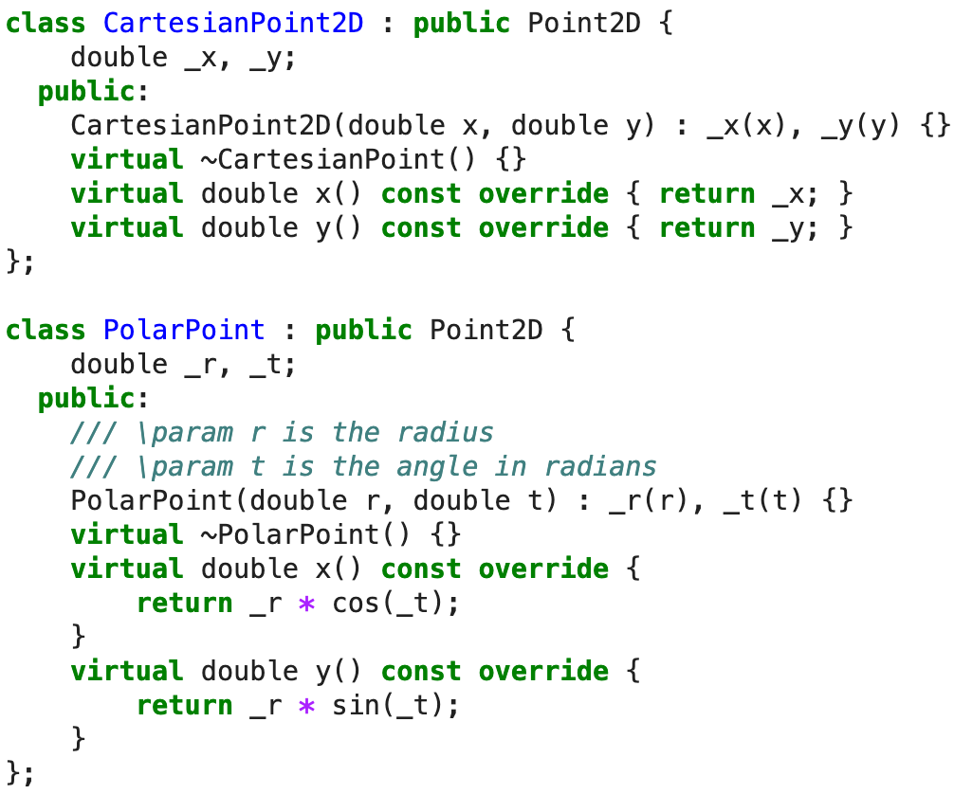
Polymorphism: Class Overloading

Slide 25
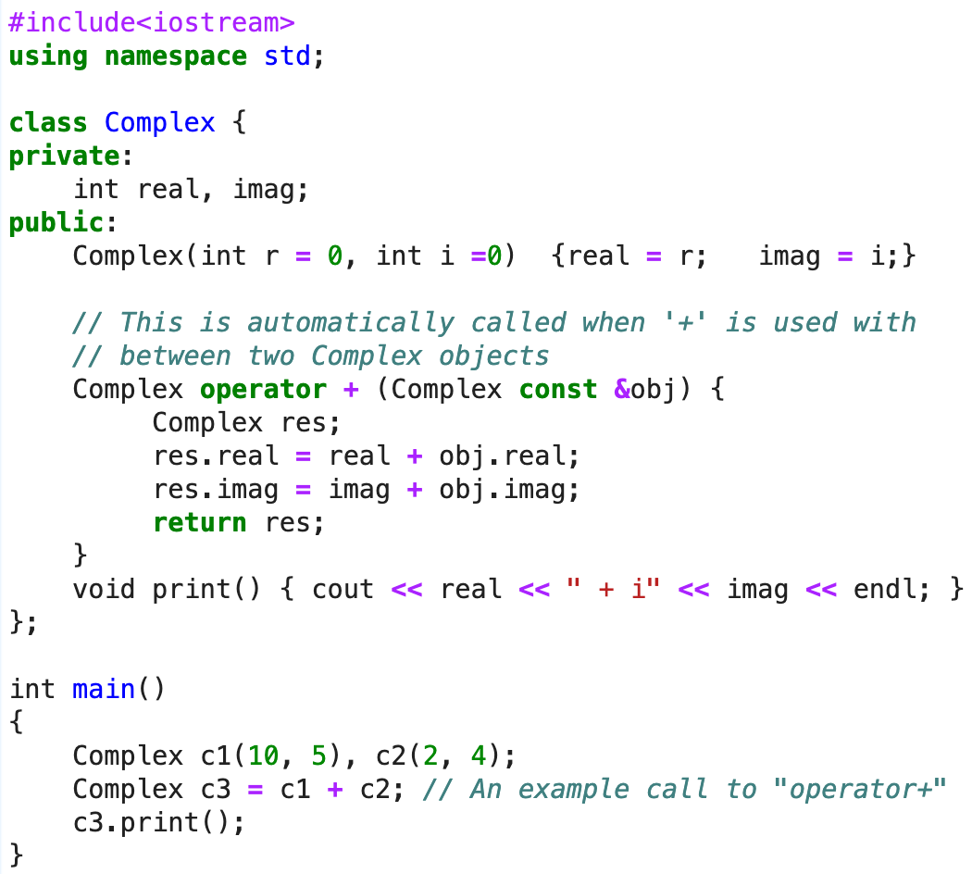
Polymorphism: Operator Overloading
Operators: + - * / % , ++ -- << >> == != > < >= <= ! && || ? & | ^ ~

Slide 26
Templates
Image credit: https://www.fluentcpp.com/2017/06/02/write-template-metaprogramming-expressively/

Slide 27
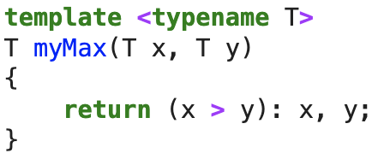
C++ Templates
A template is a simple and yet very powerful tool in C++. The simple idea is to pass a data type as a parameter so that we don’t need to write the same code for different data types.

Slide 28
Some Template Details
You can make templates out of functions, classes, and variables.
template<typename T> constexpr T pi = T(3.141592653589793238462643383L);
template < typename T> class myClass{ T data; };
template < typename T> void myFunc(T);
You can have more than one template parameter.
template < typename T, typename U > U myFunc(T);
You can nest templates inside of templates.
pi<float>
pi<double>, pi<int>
myClass<int>, myClass<float>
myFunc<int,double>(7)

Slide 29
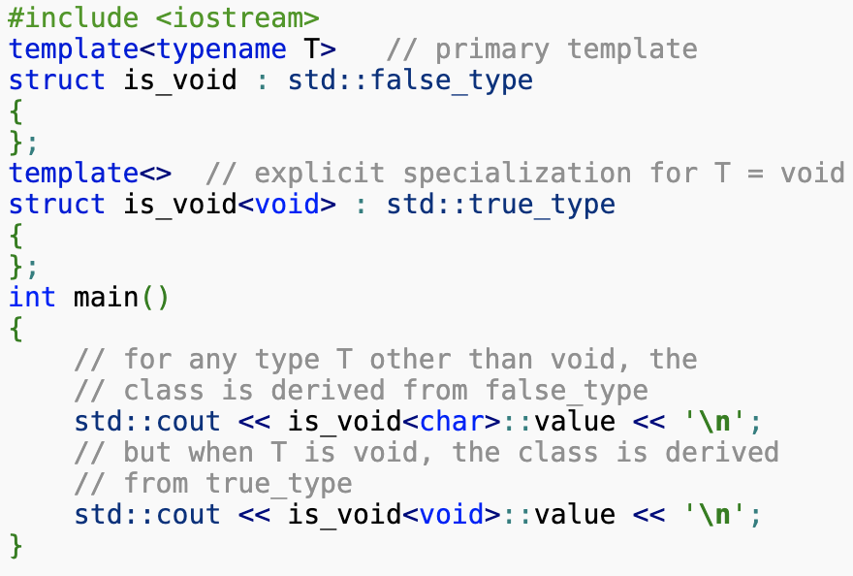
Some Template Details
You can specialize templates.
For more details: https://en.cppreference.com/w/cpp/language/template_specialization

Slide 30
Libraries That Use Templates

Slide 31
The C++ Standard Template Library
Beyond just providing the core language, C++ compilers also provide a standard library for common tasks.
The C++ STL provides:
Containers
Fast algorithms for data searches and manipulation
File and console I/O
Math functions (random numbers, complex numbers, …)
Memory management
Strings

Slide 32
Containers: maps, sets, vectors
When you have to store data, consider using a standard container.
std::vector<T> - An unsorted, dynamic, indexable, resizable array of data.
std::map<T, U> - A sorted key-value store.
std::set<T> - A sorted set of unique objects of type T.

Slide 33
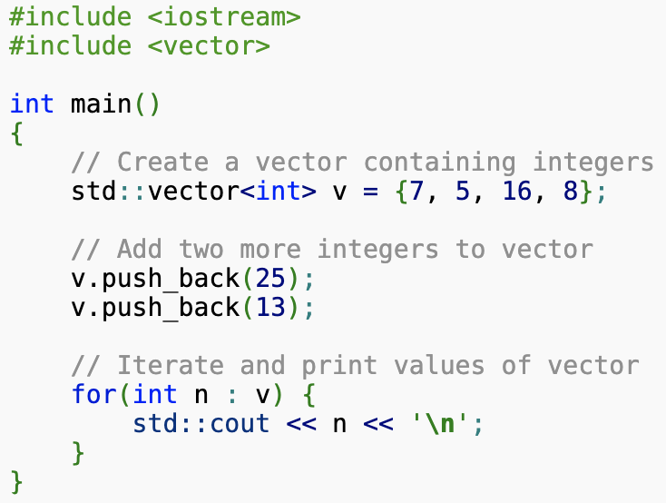
std::vector<T>
A vector is a container that stores elements contiguously, which means that elements can be accessed not only through iterators, but also using offsets to regular pointers to elements.
The storage of the vector is handled automatically, being expanded and contracted as needed. Vectors usually occupy more space than static arrays, because more memory is allocated to handle future growth. This way a vector does not need to reallocate each time an element is inserted, but only when the additional memory is exhausted.
Think of vectors as smart, resizable arrays.

Slide 34
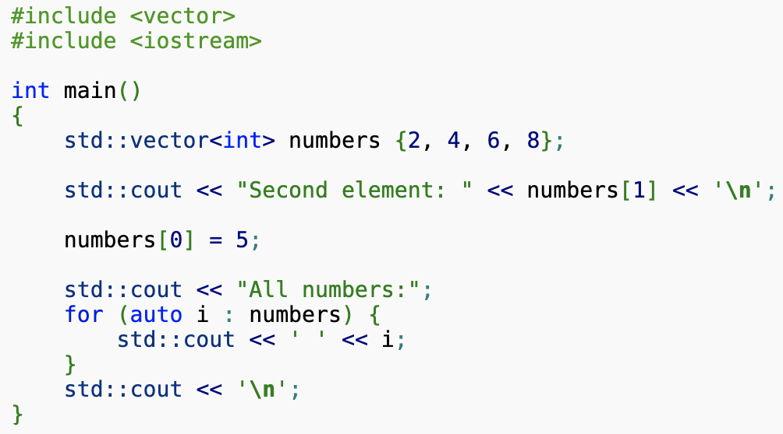
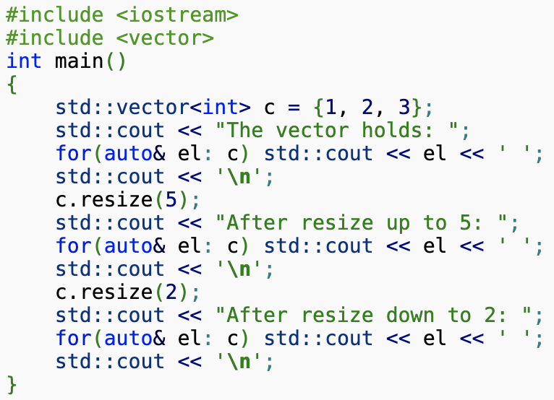
Things You Can Do With std::vector<T>
Access individual elements:
Resize them:

Slide 35
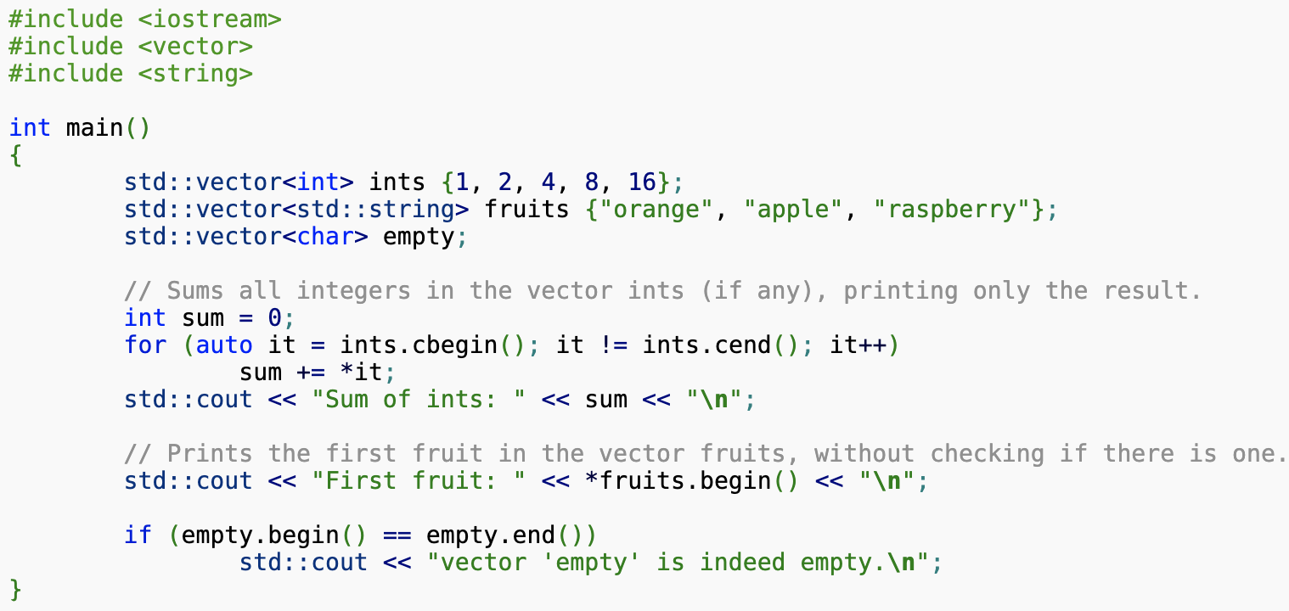
Things You Can Do With std::vector<T>
Iterate over all elements:

Slide 36
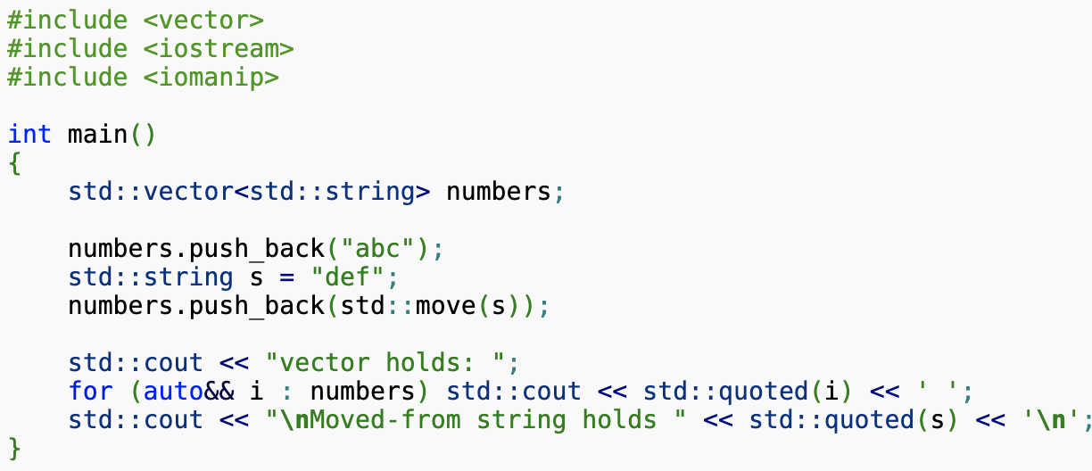
Things You Can Do With std::vector<T>
Append elements:
Erase the vector:
std::vector<int> v{1,2,3,4};
v.erase();
… and so on…
https://en.cppreference.com/w/cpp/container/vector

Slide 37
Other Containers: std::map<T,U> and std::set<T>
std::map is a sorted associative container that contains key-value pairs with unique keys. Keys are sorted by using a comparison function. Search, removal, and insertion operations have logarithmic complexity.
std::set is an associative container that contains a sorted set of unique objects of the same type. Sorting is done using the key comparison function. Search, removal, and insertion operations have logarithmic complexity.

Slide 38
Strings
std::string is a typedef (alias) to std::basic_string<char>.
std::basic_string generalizes how sequences of characters are manipulated and stored. String creation, manipulation, and destruction are all handled by a convenient set of class methods and related functions.
We get much of the same functionality as a vector<char>, but with a few added methods (c_str(), substr(), replace(), find_first_of(), stoi()).

Slide 39
Algorithms: std::find, …
The STL provides common algorithms, like std::find, std::copy, move, sort, min, max, count_if, inplace_merge, generate, …
http://www.cplusplus.com/reference/algorithm/
Key ideas:
Express intent in your code, without getting bogged down in algorithm details.
Don’t reinvent the wheel.

Slide 40
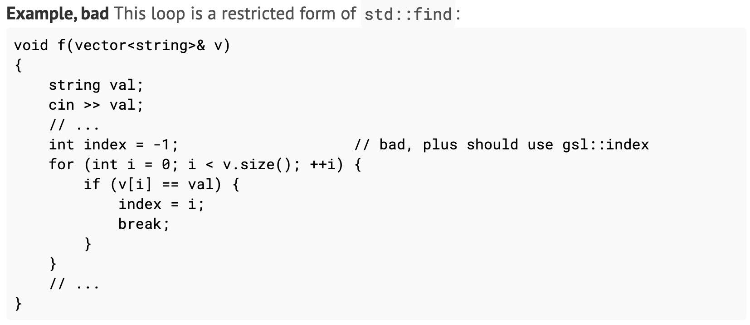
Algorithms: std::find, …
Express intent in your code, without getting bogged down in algorithm details.
This is verbose and potentially buggy.

Slide 41
Algorithms: std::find, …
Express intent in your code, without getting bogged down in algorithm details.

Slide 42
Smart Pointers
What are pointers?
A pointer is a programming language object that stores a memory address.
A pointer references a location in memory, and obtaining the value stored at that location is known as dereferencing the pointer.
Raw pointers are troublesome.
They can refer to a single object,
But, they can also act as indices to access an array of objects int *a; a[5] = 1;

Slide 43
Smart Pointers
The STL provides three types of smart pointers (i.e. containers that automatically free the enclosed pointers when they are no longer used).
std::unique_ptr, std::shared_ptr, std::weak_ptr
Do you really need to use a pointer?
To avoid slicing… yes
Returning objects from a factory… yes
Otherwise, not really?

Slide 44
Other Libraries (That We Use in JEDI)
Atlas – Parallel data structures for unstructured grids and functions.
Boost – Many new types of containers, random numbers, and much more.
Eckit – Configuration / YAML parsing, file I/O, and much more.
Eigen – Array storage container and very fast math.
Fckit – Fortran toolkit for interoperating Fortran with C++.

Slide 45
What is Eigen?
http://eigen.tuxfamily.org/
Eigen is a high-level C++ library of template headers for linear algebra, matrix and vector operations, geometrical transformations, numerical solvers and related algorithms.
We already Eigen in JEDI, but it would be nice to use it more…
Eigen has very good, well-documented tutorials.

Slide 46
Why Do We Want It?
Eigen provides classes for manipulating data that are efficient and easy to use.
C++ arrays are uni-dimensional. We want our data objects to retain their native dimensionality.
We would rather not have people constructing custom indexing functions or using vector<vector<float>>.
We do not want to reinvent the wheel. Eigen-generated code is generally faster that what you can write by hand. It can take advantage of advanced processor instructions and vectorization.
We would like to extend the IODA ObsSpace / ObsData / ObsDataVector interfaces to natively store and manipulate Eigen objects.
We want to avoid situations where we have to split up data (e.g. Tb_ch1, Tb_ch2, …).

Slide 47
A Very Simple Program
#include <iostream>
#include <Eigen/Dense>
using Eigen::ArrayXXd;
int main(int, char**)
{
ArrayXXd a(2,2);
a(0,0) = 3;
a(1,0) = 2.5;
a(0,1) = -1;
a(1,1) = a(1,0) + a(0,1);
std::cout << a << std::endl;
}
CMakeLists.txt
cmake_minimum_required(VERSION 3.2)
project(ex VERSION 0.0.1 LANGUAGES C CXX)
find_package(Eigen3 REQUIRED)
add_executable(ex1 ex1.cpp)
set_property(TARGET ex1
PROPERTY CXX_STANDARD 14)
target_include_directories(ex1
SYSTEM PUBLIC
${EIGEN3_INCLUDE_DIR})
Create a 2x2 array.
Set the array coefficients.
Print the array.
3 -1
2.5 1.5

Slide 48
What is an Eigen::Array?
Other types:
char
float
int…
Dynamic allocation allows objects to be resized. If you have something reasonably small, you can try to allocate on the stack instead.
Eigen Arrays are templates.
Eigen::ArrayXXd →
Eigen::Array< double, Eigen::Dynamic, Eigen::Dynamic, Eigen::ColMajor>
Storage Type
Rows and columns at compile time.
Generally should be Eigen::Dynamic.
$$\left[\begin{matrix}1 & 2 & 3 \\ 4 & 5 & 6 \\ 7 & 8 & 9\end{matrix}\right]$$
Store in Column-Major Form
Row-major: 1, 2, 3, 4, 5, 6, 7, 8, 9
Column-major: 1, 4, 7, 2, 5, 8, 3, 6, 9

Slide 49
Math with Eigen
Eigen::Arrays can perform coefficientwise math.
So, you can add, subtract, multiply, divide without using indices!
ArrayXXd a(2,2), b(2,2);
a << 1, 2, 3, 4;
b << 2, 3, 4, 5;
auto c = a + b;
auto d = ((a*2) – b) + 4;
Eigen::Matrix is another Eigen class that stores data like an array, but implements matrix math (matrix multiplication, outer products, determinants, etc.).
$$a=\left[\begin{matrix}1 & 2 \\ 3 & 4\end{matrix}\right] \\ b=\left[\begin{matrix}2 & 3 \\ 4 & 5\end{matrix}\right] \\ c=\left[\begin{matrix}3 & 5 \\ 7 & 9\end{matrix}\right] \\ d=\left[\begin{matrix}4 & 5 \\ 6 & 7\end{matrix}\right]$$

Slide 50
Manipulating Array Objects
ArrayXXd a(2,2);
a << 1, 2, 3, 4;
Resizing
a.resize(6,8);
Converting data types
auto b = a.cast<float>();
A thorough tutorial is provided in the Eigen documentation: http://eigen.tuxfamily.org/dox/group__TutorialMatrixClass.html
Block Operations
a.block(2,0,4,8);
Setting to a constant value
a.setConstant(0);
a.block(2,0,4,8).setConstant(3);
Resize a to a 6x8 array.
Start row, start col, # rows, # cols
Convert an array of doubles to an array of floats.
Sets all of a to a constant zero.
Sets the block to 3.

Slide 51
Best Practices

Slide 52
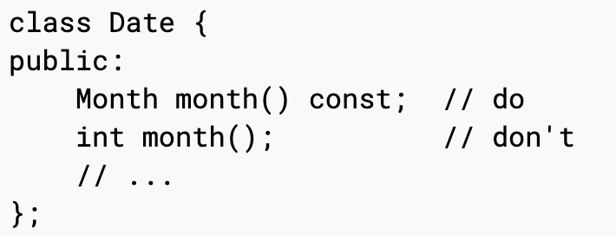
Express Ideas Directly in Code

Slide 53
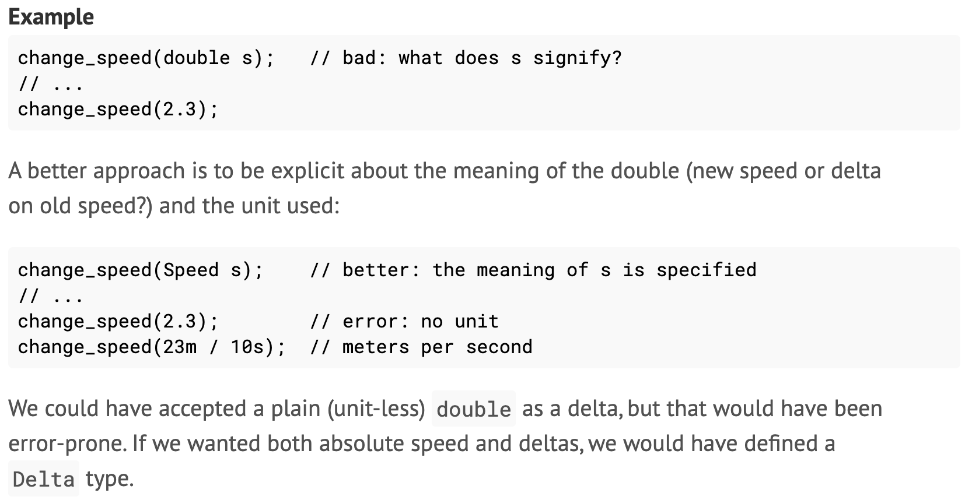
Express Ideas Directly in Code

Slide 54
Corollaries
Use comments and DOCUMENT your functions and classes!
It helps everyone to understand what you wrote
Keep functions simple
Do not have dozens or hundreds of variables. Break up large functions into small, easily testable components.
Break up large pull requests into smaller, manageable fragments
It’s more Agile

Slide 55
Corollaries
http://www.doxygen.nl/

Slide 56
Corollaries
Use comments and DOCUMENT your functions and classes!
It helps everyone to understand what you wrote
Keep functions simple
Do not have dozens or hundreds of variables. Break up large functions into small, easily testable components.
Break up large pull requests into smaller, manageable fragments
It’s more Agile

Slide 57
Build With All Compiler Warning Turned On
The compiler knows better C++ than you do. It warns about potential mistakes.
On gcc, this is the “-Wall” option.

Slide 58
Test Assumptions
Always assume that an operational system has bugs.
Try to add in runtime checks to make sure that your data are not bad.
JEDI has an Assert() macro to help with this.
Write unit tests to make sure your code works as expected.
Today’s practical!

Slide 59
Thanks!

