Slide 1
Observation Operators and QC
Ryan Honeyager JEDI Core Team + Many Others
honeyage@ucar.edu
February 25, 2020

Slide 2
Unified Forward Operator (UFO)
Share observation operators between JCSDA partners and reduce duplication of work
Taking the model agnostic approach one level down into the observation operators
Faster use of new observing platforms
Regular satellite missions are expensive
Cube-sat have short expected life time
Include users and instruments science teams
Unified Forward Operator (UFO)
Build a community app-store for observation operators

Slide 3
OOPS interfaces implemented in UFO
GeoVaLs
Locations
ObsOperator
LinearObsOperator
ObsFilter
ObsAuxControl
ObsAuxIncrement
ObsAuxCovariance
ObsOperator related classes, implemented once for all
ObsOperators
QC related classes
Bias correction related classes

Slide 4
UFO example: satellite radiance calculations
The observation operator for satellite radiance data consists of four parts:
4D (spatial/temporal) linear interpolation of model field to observation location and time - GeoVaLs
Apply CRTM to the interpolated field obtain simulated measurement: $h_{crtm}\left(x_{obs}\right)$ - ObsOperator
Add bias correction to simulated measurement: $h\left(x_{obs}\right)=h_{crtm}\left(x_{obs}\right)−\sum_{i=1}^{n_{p}}{x_{n+1}P_{i}}$ - Bias Correction
Also, set QC flags at each of these stages (input, interpolation, et cetera)
x₀₁
x₁₁
$$w_{00}=\left(1−δx\right)\left(1−δy\right) \\ w_{10}=δx\left(1−δy\right) \\ w_{01}=\left(1−δx\right)δy \\ w_{11}=δxδy \\ x_{obs,t}=x_{00}w_{00}+x_{10}w_{10}+x_{01}w_{01}+x_{11}w_{11}$$
Spatial Interpolation
w₀₁
w₁₁
for each model level k at
1
−
𝛿y
time t
x_{obs,t}
*performed with grid unit
𝛿y
(
lat
/
lon
index)
w₀₀
w₀₁
x₀₀
𝛿x
1
−
𝛿x
x₁₀
Weight given to spatially interpolated $x_{obs}$ at $t_{obs}$ is:
$w_{i}=\frac{t_{i+1}−t_{obs}}{t_{i+1}−t_{i}}$ and $w_{i+1}=1−w_{i}$
$$x_{obs}=w_{i}x_{obs,i}+w_{i+1}x_{obs,i+1}$$
Time Interpolation
w_{i}
w_{i+1}
Obs
x_{obs,i}
x_{obs,i+1}
-
3
-
2
-
1
0
1
x_{obs}
2
3
Credit: Emily Liu, JCSDA

Slide 5
Interpolated model state (GeoVaLs)
getValues
ObsOperator
State $x$
GeoVaLs
ObsVector $H(x)$
(model-aware part)
(model-agnostic part)
MODEL
Model (or grid)-aware part: horizontal interpolation of state variables that ObsOperator needs to compute $H(x)$.
Model-agnostic part: everything that ObsOperator needs to do after getting model fields interpolated to observation location.
UFO

Slide 6
Interpolated model state (GeoVaLs)
GeoVaLs are vertical profiles of requested model variables at observation x-y-t location. Forward operator defines which variables it needs from the model to compute H(x)).
Examples:
radiances: vertical profiles of t, q, ozone, pressure; surface variables: wind, SST, land properties, etc.
radiosondes/aircrafts: vertical profiles of pressure (to do vertical interpolation), t, u, v, q
sea ice concentration retrieval: sea ice concentrations for different ice thickness categories
SST retrieval: SST (observation operator becomes an identity in this case)
Notes:
\

Slide 7
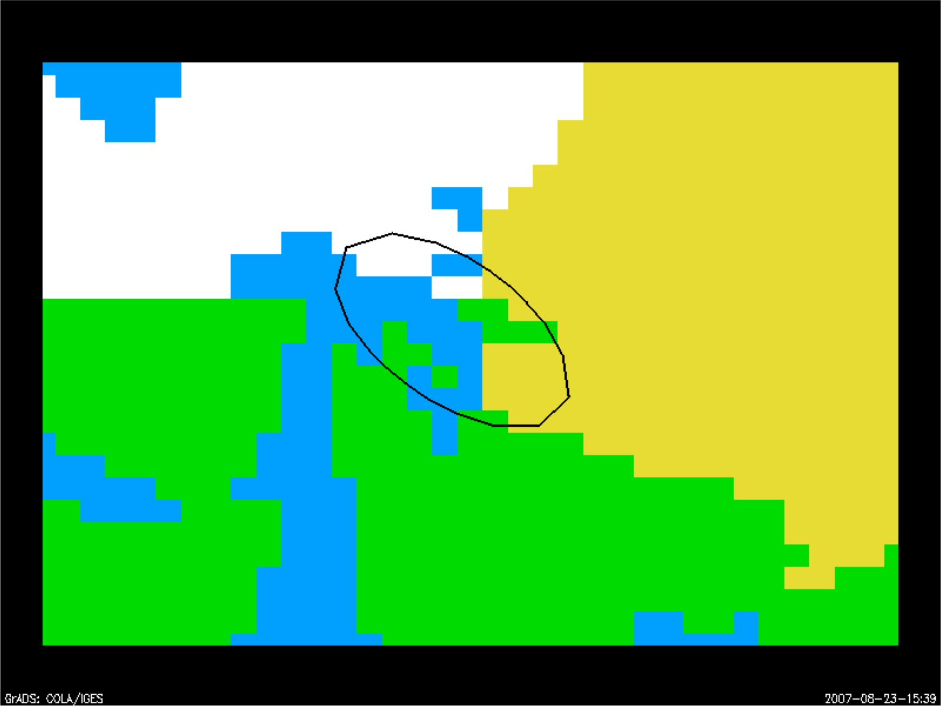
GeoVaLs and field of view
Snow
Sea Ice
As model resolution becomes higher, instrument sensor footprints may cover several grid points
Interpolation using a single nearest grid point is not suitable. Antenna pattern kernels are also a part of GeoVaLs.
Water
Snow
–
free Land
Credit: Emily Liu, JCSDA

Slide 8
Some implemented ObsOperators
Short description | Where in ufo | Name in the factory
Interface to CRTM | ufo/src/ufo/crtm | CRTM
Interface to CRTM AOD | ufo/src/ufo/crtm | Aod
Interface to RTTOV | ufo/src/ufo/rttov | RTTOV
Vertical interpolation in log-pressure (can be used for radiosondes, aircrafts, satwinds) | ufo/src/ufo/atmvertinterp | Radiosonde Aircraft Satwind
GNSSRO bending angle following GSI | ufo/src/ufo/gnssro/BndGSI | GnssroBndGSI
GNSSRO refractivity following GSI | ufo/src/ufo/gnssro/RefGSI | GnssroRef
GNSSRO bending angle ROPP1D | ufo/src/ufo/gnssro/BndROPP1D | GnssroBndROPP1D
GNSSRO bending angle ROPP2D | ufo/src/ufo/gnssro/BndROPP2D | GnssroBndROPP2D
“Identity” ObsOperator (horizontal interpolation) | ufo/src/ufo/identity | Surface SeaSurfaceTemp

Slide 9
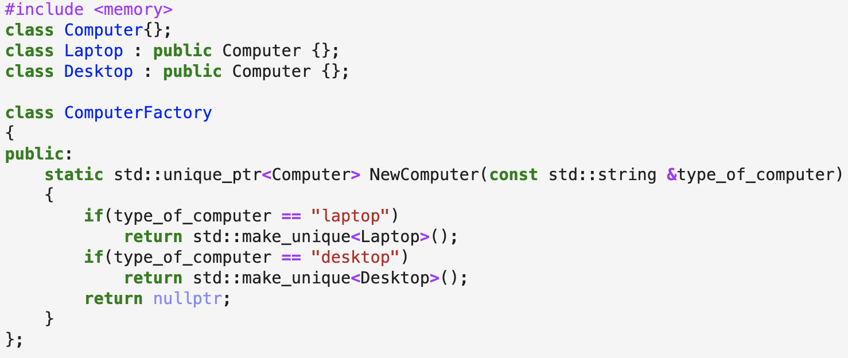
What is an object factory?
We do not want to hard-code programming logic into our applications. We want them to be user-configurable instead, so we use a factory design in C++ to create ObsOperators.

Slide 10
Factories
Factories build objects, they are used when the type of the object to create is known only at run time and return pointers.
// Vector of pointers to hold filters
std::vector< std::shared_ptr< ObsFilterBase<MODEL> > > filters_;
// Get filters from the YAML configuration
std::vector<eckit::LocalConfiguration> confs;
conf.get("ObsFilters", confs);
// Create the filters
for (std::size_t jj = 0; jj < confs.size(); ++jj) {
std::shared_ptr< ObsFilterBase<MODEL> > filtr(
FilterFactory<MODEL>::create(os, confs[jj], qcflags, obserr)
);
filters_.push_back(filtr);
}

Slide 11
ObsOperator factory
ObsOperators are created at runtime using a factory class.
Which ObsOperators are created and used is determined by yaml file:
ObsTypes:
- ObsSpace: ...
ObsOperator:
name: CRTM # name in ObsOperator factory
...
- ObsSpace: ...
ObsOperator:
name: Radiosonde # name in ObsOperator factory

Slide 12
ObsOperator factory
Names in ObsOperator factory are defined at the beginning of Obs<Operator>.cc file, for example in ufo/src/ufo/crtm/ObsRadianceCRTM.cc:
static ObsOperatorMaker<ObsRadianceCRTM> makerCRTM_("CRTM");
ObsTypes:
- ObsSpace: ...
ObsOperator:
name: CRTM # name in ObsOperator factory

Slide 13
ObsOperator interface (from OOPS)
template <typename MODEL>
class ObsOperator : public util::Printable,
private boost::noncopyable,
private util::ObjectCounter<ObsOperator<MODEL> > {
public:
ObsOperator(const ObsSpace_ &, const eckit::Configuration &);
~ObsOperator();
/// Obs Operator
void simulateObs(const GeoVaLs_ &, ObsVector_ &, const ObsAuxControl_ &) const;
/// Interfacing
const ObsOperator_ & obsoperator() const {return *oper_;}
/// Other
const Variables & variables() const; // Required inputs variables from Model
Locations_ locations(const util::DateTime &, const util::DateTime &) const;
private:
void print(std::ostream &) const;
boost::scoped_ptr<ObsOperator_> oper_;
};

Slide 14
ObsOperator interface (from OOPS)
template <typename MODEL>
class ObsOperator : public util::Printable,
private boost::noncopyable,
private util::ObjectCounter<ObsOperator<MODEL> > {
public:
ObsOperator(const ObsSpace_ &, const eckit::Configuration &);
~ObsOperator();
/// Obs Operator
void simulateObs(const GeoVaLs_ &, ObsVector_ &, const ObsAuxControl_ &) const;
/// Interfacing
const ObsOperator_ & obsoperator() const {return *oper_;}
/// Other
const Variables & variables() const; // Required inputs variables from Model
Locations_ locations(const util::DateTime &, const util::DateTime &) const;
private:
void print(std::ostream &) const;
boost::scoped_ptr<ObsOperator_> oper_;
};

Slide 15
LinearObsOperators and Factory
LinearObsOperators are created at runtime using a factory class, like ObsOperators.
LinearObsOperators are created with the same name as ObsOperators and use the same yaml section for initialization:
ObsTypes:
- ObsSpace: ...
ObsOperator:
name: CRTM # name in ObsOperator and LinearObsOperator
# factories
...

Slide 16
LinearObsOperator interface
template <typename MODEL>
class LinearObsOperator : public util::Printable,
private boost::noncopyable,
private util::ObjectCounter<LinearObsOperator<MODEL> > {
public:
LinearObsOperator(const ObsSpace_ &, const eckit::Configuration &);
~LinearObsOperator();
/// Interfacing
const LinearObsOper_ & linearobsoperator() const {return *oper_;}
/// Obs Operators
void setTrajectory(const GeoVaLs_ &, const ObsAuxControl_ &);
void simulateObsTL(const GeoVaLs_ &, ObsVector_ &, const ObsAuxIncrement_ &) const;
void simulateObsAD(GeoVaLs_ &, const ObsVector_ &, ObsAuxIncrement_ &) const;
/// Other
const Variables & variables() const; // Required inputs variables from LinearModel
private:
void print(std::ostream &) const;
boost::scoped_ptr<LinearObsOperBase_> oper_;
};

Slide 17
LinearObsOperator interface
template <typename MODEL>
class LinearObsOperator : public util::Printable,
private boost::noncopyable,
private util::ObjectCounter<LinearObsOperator<MODEL> > {
public:
LinearObsOperator(const ObsSpace_ &, const eckit::Configuration &);
~LinearObsOperator();
/// Interfacing
const LinearObsOper_ & linearobsoperator() const {return *oper_;}
/// Obs Operators
void setTrajectory(const GeoVaLs_ &, const ObsAuxControl_ &);
void simulateObsTL(const GeoVaLs_ &, ObsVector_ &, const ObsAuxIncrement_ &) const;
void simulateObsAD(GeoVaLs_ &, const ObsVector_ &, ObsAuxIncrement_ &) const;
/// Other
const Variables & variables() const; // Required inputs variables from LinearModel
private:
void print(std::ostream &) const;
boost::scoped_ptr<LinearObsOperBase_> oper_;
};

Slide 18
Other LinearObsOperator methods
LinearObsOperator::setTrajectory: calculates the Jacobian $H= {\left.\frac{∂H}{∂x}\right|}_{x=x_{0}}$
Input: GeoVaLs $x_{0}$ (variables specified in nonlinear obs operator)
LinearObsOperator::simulateObsTL
Input: GeoVaLs $dx$ (variables specified in TL/AD)
Output: ObsVector $Hdx$
LinearObsOperator::simulateObsAD
Input: ObsVector $dy$
Output: GeoVals $H^{T}dy$ (variables specified in TL/AD)

Slide 19
LinearObsOperator::variables()
Similar to ObsOperator, LinearObsOperator specifies list of variables that are requested from the model for computing TL and AD.
Note: ObsOperator::variables can be different from LinearObsOperator::variables, for example:
Vertical interpolation ObsOperator:
ObsOperator requests air_temperature and air_pressure,
LinearObsOperator only updates air_temperature.
CRTM:
ObsOperator requests a lot of surface variables,
LinearObsOperator doesn’t update any of those

Slide 20
UFO observation “filters”
Abstract “observation filters” are called before and after the obs. operator
Observation filters are generic and have access to
Observation values and metadata
Model values at observations locations (GeoVaLs)
Simulated observation value and diagnostics (for post-filter)
Their own private data
Filters are written once and used with many observation types
Generic filters already exist for:
Gross error check, background check, blacklisting, thinning…
Entirely controlled from yaml configuration file(s)
More filters will be developed as needed
Generic filters should cover most needs

Slide 21
Observation processing
The observation operator is called from the Observer
Observation filters are called immediately before/after the operator
template <typename MODEL>
void Observer<MODEL>::doFinalize() {
Log::trace() << "Observer::doFinalize start" << std::endl;
filters_->priorFilter(*gvals_);
hop_.simulateObs(*gvals_, yobs_, ybias_);
filters_->postFilter(yobs_);
Log::trace() << "Observer::doFinalize done" << std::endl;
}
filters_ contains the list of filters and calls them

Slide 22
A few UFO generic observation filters
PreQC
Handles flags set by pre-processing in IODA
BackgroundCheck
ObsBoundsCheck
Rejects observations values outside some bounds
ObsDomainCheck
Rejects observations with metadata values outside some bounds (metadata can be location or any other attribute)
BlackList
Unconditionally rejects data for some variables, channels…
Thinning
Reduce the amount of data that we process
Regular, Gaussian, Temporal, Poisson Disk methods are available.
See src/ufo/instantiateObsFilterFactory.h
for the full list.

Slide 23
QC flowchart for IR sounders
ObsFilter example for IR sounders
A
$$ν>2400 {cm}^{−1}$$
$$T_{B}>550 or T_{B}<50$$
$$τ \left( l_{cld}→TOA \right)>0.02$$
Wavenumber
Obs BT Check
Cloud & Surface Check
tzr_qc=0
Surface Jacobian Check
Check
tzr_qc=1
$$ν∈\left( 2000, 2400 \right]$$
CrIS
over Land
NSST Check
GOES
Sounder
Topography
check
$$T_{sfc}$$
Sensitivity
Check
tzr_qc=0
Satellite Zenith Angle Check
$$Obs−h\left(x\right)−bias>Error Bound$$
*Model Top Transmittance Check
*Latitude Check
Gross Check
$$θ_{sat}>60°$$
Minimization

Slide 24
UFO generic observation filters
Filters are controlled by the yaml configuration file
Filters are applied in the order in which they appear in the yaml
Most scientific work happens in the yaml file
All filters except the BlackList take an optional “where” clause to restrict their scope of application
The where clause is very generic and can be expressed in terms of observation metadata, value or GeoVaLs value
Another filter (QCmanager) is used internally for book-keeping
GeoVaLsWriter (in OOPS) saves GeoVaLs to file. This is also a “filter”.

Slide 25
Example: Domain check filter
Observations:
ObsTypes:
- ObsSpace:
name: GnssroBnd
ObsDataIn:
obsfile: Data/ioda/testinput_tier_1/gnssro_obs_2018041500_m.nc4
ObsDataOut:
obsfile: Data/gnssro_bndnbam_2018041500_m_output.nc4
simulate:
variables: [bending_angle]
ObsFilters
- Filter: Domain Check
filter variables:
- name: bending_angle
where:
- variable:
name: earth_radius_of_curvature@MetaData
minvalue: 6250000.
maxvalue: 6450000.
- variable:
name: geoid_height_above_reference_ellipsoid@MetaData
minvalue: -200.
maxvalue: 200.
- variable:
name: latitude@MetaData
minvalue: -90.
maxvalue: 90.
Example: Sanity Check on the geolocation values associated with the GPSRO bending angle
Domain check applies to GPSRO data (bending angle)
Using three variables related to geolocation of the observation as screening criteria
Observations with geolocation variables outside of the specified range are screened out

Slide 26
Example: Domain check filter
The Domain Check filter is not very complicated:
void ObsDomainCheck::priorFilter(const GeoVaLs & gv) const {
const oops::Variables vars(config_.getStringVector("observed"));
std::vector<bool> inside = processWhere(obsdb_, gv, config_);
for (size_t jv = 0; jv < vars.size(); ++jv) {
for (size_t jobs = 0; jobs < obsdb_.nlocs(); ++jobs) {
if (!inside[jobs] && flags_[jv][jobs] == 0) {
flags_[jv][jobs] = QCflags::domain;
}
}
}
}

Slide 27
Observations:
ObsTypes:
- ObsOperator:
name: CRTM
Absorbers: [H2O,O3,CO2]
Clouds: [Water, Ice]
Cloud_Fraction: 1.0
ObsOptions:
Sensor_ID: amsua_n19
EndianType: little_endian
CoefficientPath: Data/
ObsSpace:
name: amsua_n19
ObsDataIn:
obsfile: Data/ioda/testinput_tier_1/amsua_n19_obs_2018041500_m.nc4
simulate:
variables: [brightness_temperature]
channels: 1-15
GeoVaLs:
filename: Data/amsua_n19_geoval_2018041500_m.nc4
ObsFilters:
- Filter: Bounds Check
filter variables:
- name: brightness_temperature
channels: 1-15
minvalue: 50.0
maxvalue: 500.0
- Filter: Bounds Check
filter variables:
- name: brightness_temperature
channels: 1-6,15
test variables:
- name: brightness_temperature_jacobian_surface_temperature@ObsDiag
channels: 1-6,15
minvalue: 0.2
Bounds Check
Bounds check applies to channels 1 through 15
Filter out unphysical observation values
$T_{b, k}$ < 50 or ${ T}_{b, k}$< 500 where k = 1, 2, … 15 are screened out
Bounds check using test variable applies to channel 1-6, and 15 only
Filter out observations based on test variable: surface temperature jacobians
${δT_{ b}}/{δT_{s}>0.2}$

Slide 28
window_begin: 2018-04-14T21:00:00Z
window_end: 2018-04-15T03:00:00Z
Observations:
ObsTypes:
- ObsSpace:
name: Aircraft
ObsDataIn:
obsfile: Data/ioda/testinput_tier_1/aircraft_obs_2018041500_m.nc4
simulate:
variables: [eastward_wind, northward_wind, air_temperature]
ObsOperator:
name: VertInterp
GeoVaLs:
filename: Data/aircraft_geoval_2018041500_m.nc4
ObsFilters:
- Filter: Background Check
filter variables:
- name: air_temperature
threshold: 2.0
- Filter: Background Check
filter variables:
- name: eastward_wind
- name: northward_wind
threshold: 6.0
abs_threshold: 10.0
Background Check
Background check applies to aircraft temperature data
Filter out observations with innovation
$$\left| h\left(x\right)−Obs \right|>threshold ∗obserr$$
Background check applies to aircraft wind data
Filter out observations with innovation
$$\left| h\left(x\right)−Obs \right|>\min{( absolute threhold, threshold ∗obserr )}$$

Slide 29
Example: Thinning filter
window_begin: 2018-04-14T20:30:00Z
window_end: 2018-04-15T03:30:00Z
Observations:
ObsTypes:
- ObsSpace:
name: Radiosonde
ObsDataIn:
obsfile: Data/ioda/testinput_tier_1/sondes_obs_2018041500_m.nc4
simulate:
variables: [air_temperature, eastward_wind, northward_wind]
ObsFilters:
- Filter: Thinning
random_seed: 0
amount: 0.75
Reduce the number density of radiosonde temperature
and wind observations by applying thinning filter
Generate a number between 0 and 1 randomly for each observation
Filter out the observation if the assigned random number is greater than 0.75

Slide 30
Afternoon practical
General breakdown:
Continue practicing building the JEDI code. Yesterday, you built fv3-bundle. Today, you can clone, customize, configure and build the UFO bundle.
Learn more about YAML and how you can write it.
Add in a new filter into the UFO code.
This builds into adding new unit tests (Thursday).

